Slide 1
Algorithm

Slide 2
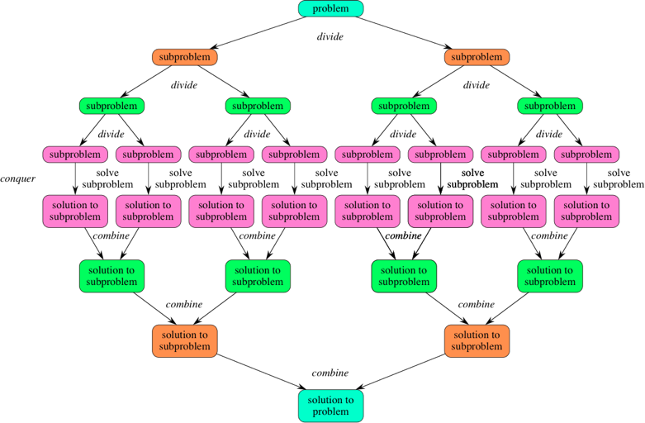
Algorithms
This paradigm, divide-and-conquer, breaks a problem into subproblems that are similar to the original problem, recursively solves the subproblems, and finally combines the solutions to the subproblems to solve the original problem. Because divide-and-conquer solves subproblems recursively, each subproblem must be smaller than the original problem, and there must be a base case for subproblems. You should think of a divide-and-conquer algorithm as having three parts:
Divide the problem into a number of subproblems that are smaller instances of the same problem.
Conquer the subproblems by solving them recursively. If they are small enough, solve the subproblems as base cases.
Combine the solutions to the subproblems into the solution for the original problem.

Slide 3
Examples
The following computer algorithms are based on divide-and-conquer programming approach −
Binary Search
Finding Maximum and Minimum in an array
Merge Sort
Quick Sort
binary search algorithm
For this algorithm to work, the input must be sorted. Let a_{i} 1<i<n be a list of elements that are sorted in nondecreasing order. It works by looking for a particular item by comparing the middle item of the collection. If a match occurs, then the index of the item is returned. If the middle item is greater than the item, then the item is searched in the sub-array to the left of the middle item. Otherwise, the item is searched for in the sub-array to the right of the middle item. This process continues on the sub-array as well until the size of the subarray reduces to zero.

Slide 4
Let us assume we have an array like below and we are searching for the value 31 in this.
First , we have to find the middle of the array. The array consists of 10 elements. To find the middle value the following formula is used:
mid=(low+high)/2
here it is,
mid=(9+0)/2=4. So , 4 is the mid of the array.
Now the value stored in mid i.e 27 is compared with the value being searched i.e 31. we find 27 (mid) is smaller than value to be searched(31). So now we know that the value to be serached is present in the right hand side of middle.

Slide 5
Change the low to be mid+1 as
low=mid+1 i.e low=4+1=5
mid=(low+high)/2 i.e mid=(5+9)/2 =14/2 =7
now the search value 31 is checked whether
mid[7]==31 or not.
Mid[7]=35 in our case which is more than search value. So now, it is found that the search value is in the left hand side of mid (lower side).
So the mid value is to be calculated again. Since the value is found at lower side we have to change the high as below:
high=mid-1 i.e high=7-1 = 6
mid=(high+low)/2 i.e mid=(6+5)/2= 11/2=5
We compare the value stored at location 5 with our target value
. We find that it is a match.

Slide 6
Algorithm for Binary search :
Procedure binary_search
A ← sorted array
n ← size of array
x ← value to be searched
Set low = 0
Set high = n
while (low<=high)
set mid = ( low+high ) / 2
if A[mid] < x
set low = mid + 1
else
if A[mid] > x
set high = mid – 1
else
return mid
end while
return 0
end procedure

Slide 7
Algorithm for Binary search :
let us take another example which consists of 14 entries:
a[1:14] = -15, -6, 0, 7, 9, 23, 54, 82, 101, 112, 125, 131, 142, 151
the below table explains three different searches of an element
X=151 | Low | High | mid
 | 1 | 14 | 7
 | 8 | 14 | 11
 | 12 | 14 | 13
 | 14 | 14 | found
X=-14 | 1 | 14 | 7
 | 1 | 6 | 3
 | 1 | 2 | 1
 | 2 | 2 | 2
 | 2 | 1 | Not found
X=9 | 1 | 14 | 7
 | 1 | 6 | 3
 | 4 | 6 | 5
 |  |  | found
When X=151 , at the 4th iteration the element is found.
Let say the iteration in Binary Search terminates after k iterations. In the above example, it terminates after 4 iterations, so here k = 4

Slide 8
At each iteration, the array is divided by half. So let’s say the length of array at any iteration is n
At Iteration 1,
Length of array = n
At Iteration 2,
Length of array = n⁄2
At Iteration 3,
Length of array = (n⁄2)⁄2 = n⁄2²
Therefore, after Iteration k,
Length of array = n⁄2^{k}
Also, we know that
After k divisions, the length of array becomes 1
Therefore
Length of array = n⁄2^{k} = 1
=> n = 2^{k}
Applying log function on both sides:
=> log₂ (n) = log₂ (2^{k})
=> log₂ (n) = k log₂ (2)
As(log_{a}(a) = 1) Therefore,
=> k = log₂ (n)

Slide 9
Complexity
n | log₂​n
1 | 0
2 | 1
4 | 2
8 | 3
16 | 4
32 | 5
64 | 6
128 | 7
256 | 8
512 | 9
1024 | 10
1,048,576 | 20
2,097,152 | 21
SN | Performance | Complexity
1 | Worst case | O(log n)
2 | Best case | O(1)
3 | Average Case | O(log n)
4 | Worst case space complexity | O(1)
The logarithm function grows very slowly. Logarithms are the inverse of exponentials, which grow very rapidly, so that if log₂​n=x, then n=2^{x}. For example, because log₂​128=7, we know that 2⁷=128.
That makes it easy to calculate the runtime of a binary search algorithm on an n that's exactly a power of 2. If n is 128, binary search will require at most 8 (log₂​128+1) guesses.

Slide 10
Finding the minimum and maximum
The problem is to find the maximum and minimum items in a set of n elements.
Algorithm for straight forward maximum and minimum
StraightMaxMin(a,n,max,min)
// set max to the maximum and min to the minimum of a[1:n].
{
max := min := a[1];
for i := 2 to n do
{
if(a[i] > max) then max := a[i];
if(a[i] < min) then min := a[i];
}
}
max=60
min=-8
22 | 13 | -5 | -8 | 15 | 60 | 17 | 31 | 47
1 | 2 | 3 | 4 | 5 | 6 | 7 | 8 | 9

Slide 11
Analyzing the Straight Forward Method
In analyzing the time complexity of this algorithm, we have to concentrate on the number of element comparisons. This algorithm requires 2(n-1) element comparisons in the best, average, and worst cases. An immediate improvement is possible by realizing that the comparison a[i] < min is necessary only when a[i]>max is false.
We can replace the contents of for loop as:
if(a[i] > max) then max := a[i];
else if(a[i] < min) then min := a[i];
Now the Best case occurs when the elements are in increasing order. The number of element comparisons is n-1. The worst case occurs when the element are in decreasing order. In this case number of comparisons is 2(n-1).

Slide 12
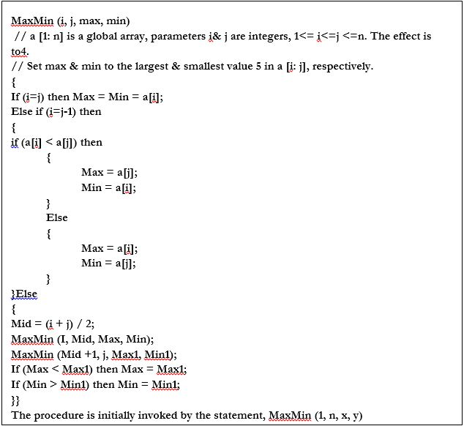
22 | 13 | -5 | -8 | 15 | 60 | 17 | 31 | 47
1 | 2 | 3 | 4 | 5 | 6 | 7 | 8 | 9

Slide 13
1 | 9 | x | y
1 | 9 | x | y
1 | 9 | x | y
1 | 9 | x | y
1 | 9 | x | y
1 | 9 | x | y
1 | 9 | x | y
1 | 9 | x | y
1 | 9 | x | y
22 | 13 | -5 | -8 | 15 | 60 | 17 | 31 | 47
1 | 2 | 3 | 4 | 5 | 6 | 7 | 8 | 9

Slide 14
complexity Analysis
for method1 (straight forward)= 2(n-1)
for method2 (recursive) = 3(n/2)-2
suppose we have the array of size 8 elements.
Method1: requires (2n-2), (2x8)-2=14 comparisons
Method2: requires
It is evident; we can reduce the number of comparisons (complexity) by using a proper technique.
9
m1=2(9-1)=16
m2= (3*9)/2 -2= 24/2 -2 = 12-2=10

Slide 15
Merge sort
Conceptually, it works as follows:
Divide: Divide the unsorted list into two sublists of about half the size.
Conquer: Sort each of the two sublists recursively until we have list sizes of length 1, in which case the list items are returned.
Combine: Join the two sorted Sub lists back into one sorted list.
The Main purpose is to sort the unsorted list in nondecreasing order.
The Mergesort algorithm:
The Mergesort function repeatedly divides the array into two halves until we reach a stage where we try to perform mergesort on a subarray of size 1. After that the merge function is called and combines the sorted array into larger arrays until the whole array is merged.

Slide 16
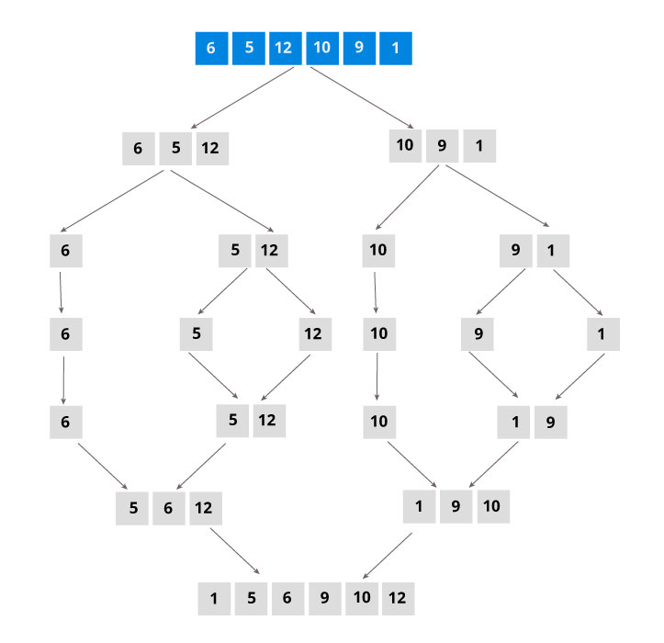
Alogorithm MergeSort(low,high)
//a[low : high] is a global array to be sorted.
{
if (low < high) then //if there are more than one element
{
//divide P into subproblems
// Find where to split the set
mid=[(low+high]/2];
//solve the sub problem
MergeSort(low,mid);
MergeSort(mid+1,high);
//combine the solutions
Merge(low,mid,high);
}
}
mid=(1+6)/2=7/2=3
mergesort(1,3), mergesort(4,6)
mid=(1+3)/2=4/2=2
mergesort(1,2), mergesort(3,3)
mid =(4+6)/2=10/2=5
mergesort(4,5), mergesort(6,6)

Slide 17
Algorithm Merge(low,mid,high)
//a[low:high] is a global array containing two sorted //subsets in a[low:mid] and in a[mid+1,high]
//b[] is an auxiliary global array
{
int b[10];
h=low;
i=low;
j=mid+1;
while((h ≤ mid) and (j≤ high)) do
{
if(a[h] ≤ a[j] ) then
{
b[i]=a[h];
h=h+1;
}
else
{
b[i]=a[j];
j=j+1;
}
i=i+1;
} //end of while
if( h > mid) then
for k=j to high do
{
b[i] = a[k];
i = i+1;
}
else
for k=h to mid do
{
b[i] = a[k];
i = i+1;
}
for k=low to high do
{
a[k] = b[k]
}
}

Slide 18
example 2: consider an array of 10 elements as:
a[1:10]=(310, 285, 179, 652, 351, 423, 861, 254, 450, 520)
algorithm MergeSort begins by splitting a[] into two subarrays each of size 5 as
a[1:5] and a[6:10]. =[310,285,179,652,351] & [ 423, 861, 254, 450, 520]
a[1:5] splits into a[1:3] and a[4:5] = [ 310,285,179] & [ 652,351 ]
a[1:3] is again splitted into a[1:2] and a[3:3] = [310,285] & [179]
a[1:2] is further divided into a[1:1] and a[2:2] = [310] & [285]

Slide 19
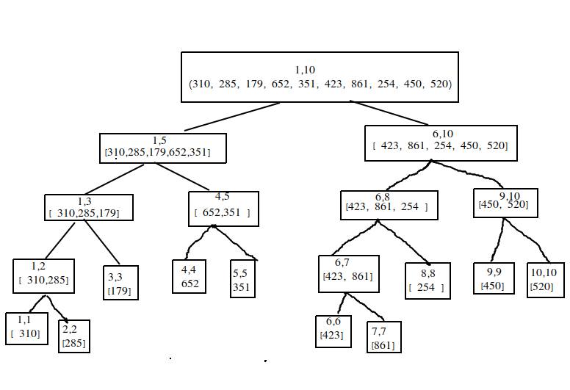
a[1:10]=(310, 285, 179, 652, 351, 423, 861, 254, 450, 520)
Tree of calls by Mergesort algorithm

Slide 20
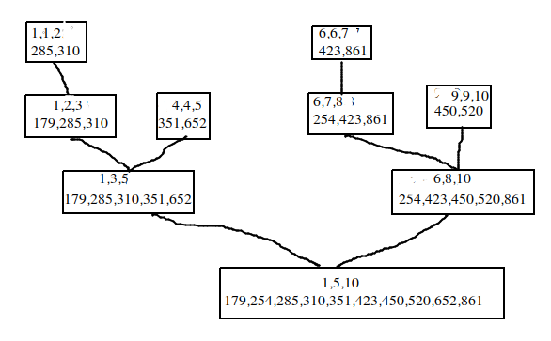
Tree calls of Merge algorithm

Slide 21
Complexity
Complexity | Best case | Average Case | Worst Case
Time Complexity | O(n log n) | O(n log n) | O(n log n)
Space Complexity |  |  | O(n)
Time Complexity:
The list of size N is divided into a max of log N parts, and the merging of all sublists into a single list takes O(N) time, the worst case run time of this algorithm is O(NLogN)

Slide 22
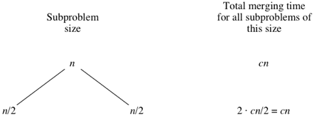
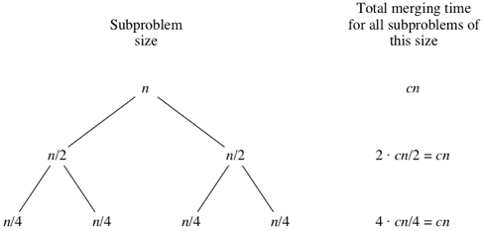
Complexity
The divide step takes constant time, regardless of the subarray size. After all, the divide step just computes the midpoint mid of the indices low and high. Recall that in big-Θ notation, we indicate constant time by Θ(1).
The conquer step, where we recursively sort two subarrays of approximately n/2 elements each, takes some amount of time, but we'll account for that time when we consider the subproblems.
The combine step merges a total of n elements, taking Θ(n) time.
let's consider that the divide and combine steps together take cn time for some constant c.

Slide 23
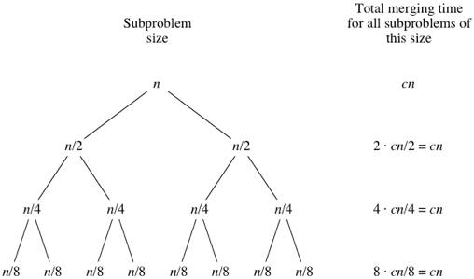
What do you think would happen for the subproblems of size n/8? There will be eight of them, and the merging time for each will be cn/8, for a total merging time of 8⋅cn/8=cn:
As the subproblems get smaller, the number of subproblems doubles at each "level" of the recursion, but the merging time halves. The doubling and halving cancel each other out, and so the total merging time is cn at each level of recursion. Eventually, we get down to subproblems of size 1: the base case.

Slide 24
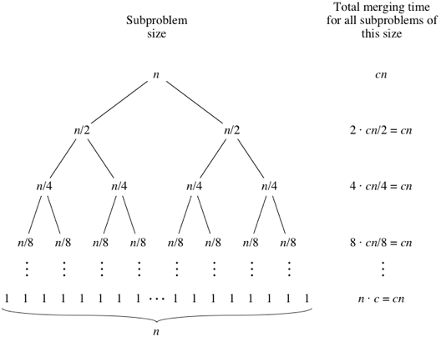
Time complexity = cn(log₂n+1).
When we use big-Θ notation to describe this running time, we can discard the low-order term (+1) and the constant coefficient (c), giving us a running time of Θ(nlog₂n).

Slide 25
Quick sort
A large array is partitioned into two arrays one of which holds values smaller than the specified value, say pivot, based on which the partition is made and another array holds values greater than the pivot value.
It is an in-place sorting algorithm which means it doesn’t take an additional array to sort the data. It uses the same array to sort the elements
Quick sort pivot algorithm
1 − picks an element called ‘pivot” 2. rearrange the array elements in such a way that the all values lesser than the pivot should come before the pivot and all the values greater than the pivot should come after it. This method is called partitioning the array. at the end of the partition function, the pivot element will be placed at its sorted position. 3. do the above process recursively to all the sub- arrays and sort the elements base case if the array has zero or one element, there is no need to call the partition method.

Slide 26
Quick Sort Algorithm
void quickSort(int arr[], int start, int end)
{
if(start < end)
{
int pIndex = partition(arr, start, end);
quickSort(arr, start, pIndex-1);
quickSort(arr, pIndex+1, end);
}
}
int partition(int arr[], int start, int end)
{
int pIndex = start;
int pivot = arr[end];
int i;
for(i = start; i < end; i++)
{
if(arr[i] < pivot)
{
swap(&arr[i], &arr[pIndex]);
pIndex++;
}
}
swap(&arr[end], &arr[pIndex]);
return pIndex;
}
void swap(int *x, int *y)
{
int t = *x;
*x = *y;
*y = t;
}

Slide 27
Analysis of quick sort
The pivot chosen by the partition function is always either the smallest or the largest element in the n-element subarray. Then one of the partitions will contain no elements and the other partition will contain n−1 elements—all but the pivot. So the recursive calls will be on subarrays of sizes 0 and n−1. As in merge sort, the time for a given recursive call on an n-element subarray is Θ(n). In merge sort, that was the time for merging, but in quicksort it's the time for partitioning.

Slide 28
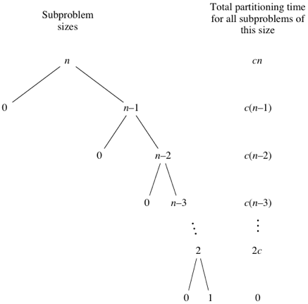
worst case running time of quick sort
n big-Θ notation, quicksort's worst-case running time is Θ(n²)

Slide 29
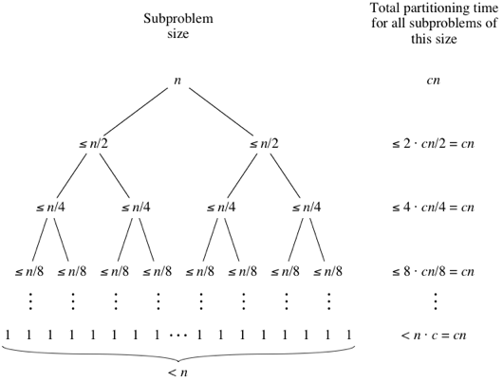
Best case running time of quick sort
Quicksort's best case occurs when the partitions are as evenly balanced as possible:
their sizes either are equal or are within 1 of each other.
The former case occurs if the subarray has an odd number of elements and the pivot is right in the middle after partitioning, and each partition has (n−1)/2 elements. The latter case occurs if the subarray has an even number n of elements and one partition has n/2 elements with the other having n/2−1. In either of these cases, each partition has at most n/2 elements.
n big-Θ notation, quicksort's worst-case running time is Θ(nlog_{2​}n)

Slide 30
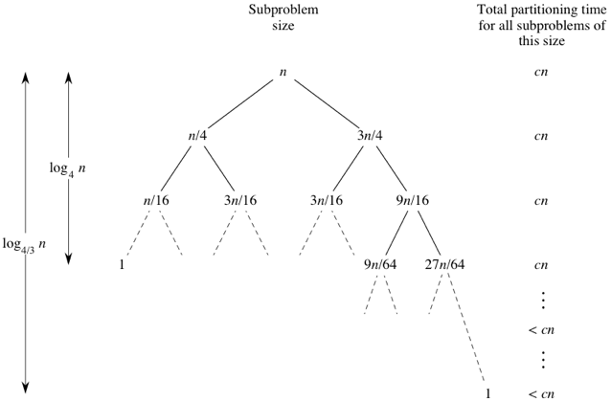
Average case running time of quick sort
First, let's imagine that we don't always get evenly balanced partitions, but that we always get at worst a 3-to-1 split. That is, imagine that each time we partition, one side gets 3n/4 elements and the other side gets n/4.
n big-Θ notation, quicksort's worst-case running time is Θ(nlog_{2​}n)

Slide 31
Selection sort algorithm

Slide 32
Selection sort is an algorithm that selects the smallest element from an unsorted list in each iteration and places that element at the beginning of the unsorted list.
Selection sort working
Algorithm
The array with n elements is sorted by using n-1 pass of selection sort algorithm.
In 1st pass, smallest element of the array is to be found along with its index pos. then, swap A[0] and A[pos]. Thus A[0] is sorted, we now have n -1 elements which are to be sorted.
In 2nd pas, position pos of the smallest element present in the sub-array A[n-1] is found. Then, swap, A[1] and A[pos]. Thus A[0] and A[1] are sorted, we now left with n-2 unsorted elements.
In n-1th pass, position pos of the smaller element between A[n-1] and A[n-2] is to be found. Then, swap, A[pos] and A[n-1].
Therefore, by following the above explained process, the elements A[0], A[1], A[2],...., A[n-1] are sorted.

Slide 33
310 | 285 | 179 | 652 | 351 | 423 | 861 | 254 | 450 | 520
set the first element as minimum
310 | 285 | 179 | 652 | 351 | 423 | 861 | 254 | 450 | 520
2. Compare minimum with the second element. If the second element is smaller than minimum, assign second element as minimum.
Compare minimum with the third element. Again, if the third element is smaller, then assign minimum to the third element otherwise do nothing. The process goes on until the last element.
310 | 285 | 179 | 652 | 351 | 423 | 861 | 254 | 450 | 520
minimum=310 , since second element 285 is lesser it becomes minimum now

Slide 34
310 | 285 | 179 | 652 | 351 | 423 | 861 | 254 | 450 | 520
Now since 179 is smaller than 285 , it becomes minimum now
310 | 285 | 179 | 652 | 351 | 423 | 861 | 254 | 450 | 520
652 is greater, so 179 remains minimum and so on
310 | 285 | 179 | 652 | 351 | 423 | 861 | 254 | 450 | 520
310 | 285 | 179 | 652 | 351 | 423 | 861 | 254 | 450 | 520

Slide 35
310 | 285 | 179 | 652 | 351 | 423 | 861 | 254 | 450 | 520
310 | 285 | 179 | 652 | 351 | 423 | 861 | 254 | 450 | 520
310 | 285 | 179 | 652 | 351 | 423 | 861 | 254 | 450 | 520
310 | 285 | 179 | 652 | 351 | 423 | 861 | 254 | 450 | 520
179 | 285 | 310 | 652 | 351 | 423 | 861 | 254 | 450 | 520
Till the minimum=175 only. Now it is swapped with first element as

Slide 36
179 | 285 | 310 | 652 | 351 | 423 | 861 | 254 | 450 | 520
in this second element 285 is taken as minimum and it is compared with other values in the next positions and if anything lesser than that value is found it is assigned as minimum and that value is swapped with second element.
MINIMUM= 285
minimum=254
179 | 285 | 310 | 652 | 351 | 423 | 861 | 254 | 450 | 520
179 | 285 | 310 | 652 | 351 | 423 | 861 | 254 | 450 | 520
179 | 285 | 310 | 652 | 351 | 423 | 861 | 254 | 450 | 520
179 | 285 | 310 | 652 | 351 | 423 | 861 | 254 | 450 | 520
179 | 285 | 310 | 652 | 351 | 423 | 861 | 254 | 450 | 520
179 | 285 | 310 | 652 | 351 | 423 | 861 | 254 | 450 | 520

Slide 37
179 | 285 | 310 | 652 | 351 | 423 | 861 | 254 | 450 | 520
179 | 254 | 310 | 652 | 351 | 423 | 861 | 285 | 450 | 520
179 | 254 | 310 | 652 | 351 | 423 | 861 | 285 | 450 | 520
179 | 254 | 310 | 652 | 351 | 423 | 861 | 285 | 450 | 520
179 | 254 | 310 | 652 | 351 | 423 | 861 | 285 | 450 | 520
179 | 254 | 285 | 652 | 351 | 423 | 861 | 310 | 450 | 520
179 | 254 | 310 | 652 | 351 | 423 | 861 | 285 | 450 | 520
Now minimum=285
now all the values are exhausted, and it is found that in this iteration minimum is 285. Now it is swapped with third element as:
179 | 254 | 310 | 652 | 351 | 423 | 861 | 285 | 450 | 520
179 | 254 | 310 | 652 | 351 | 423 | 861 | 285 | 450 | 520

Slide 38
179 | 254 | 285 | 652 | 351 | 423 | 861 | 310 | 450 | 520
179 | 254 | 285 | 310 | 351 | 423 | 450 | 520 | 652 | 861
179 | 254 | 285 | 652 | 351 | 423 | 861 | 310 | 450 | 520
179 | 254 | 285 | 652 | 351 | 423 | 861 | 310 | 450 | 520
179 | 254 | 285 | 652 | 351 | 423 | 861 | 310 | 450 | 520
179 | 254 | 285 | 652 | 351 | 423 | 861 | 310 | 450 | 520
Now minimum=310
now all the values are exhausted, and it is found that in this iteration minimum is 310. Now it is swapped with fourth element as:
179 | 254 | 285 | 652 | 351 | 423 | 861 | 310 | 450 | 520
179 | 254 | 285 | 310 | 351 | 423 | 861 | 652 | 450 | 520

Slide 39
void swap(int *a,int *b)
{
int temp;
temp=*a;
*a=*b;
*b=temp;
}
void selectionsort(int a[],int size)
{
for(int step=0;step<size-1;step++)
{
int minindex=step;
for(int i=step+1;i<size;i++)
{
if(a[i]<a[minindex])
minindex=i;
}
swap(&a[minindex],&a[step]);
printarray(a,size);
}
}

Slide 40
Complexity
Cycle | Number of Comparison
1st | (n-1)
2nd | (n-2)
3rd | (n-3)
... | ...
last | 1
Number of comparisons : (n-1) + (n-2) + (n-3) +.....+ 1 = n(n-1)/2 nearly equals to n²
Complexity | Best Case | Average Case | Worst Case
Time | Ω(n) | θ(n²) | o(n²)
Space |  |  | o(1)

