Slide 1
Maps in python

Slide 2
Map implementation
Searching for data items based on unique key values is a very common application. an abstract data type that provides this type of search capability is ofen referred to as a map or dictionary since it maps a key to a corresponding value.

Slide 3
MAP ADT
A map is a container for storing a collection of data records in which each record is associated with a unique key. the key components must be comparable:
Map() :- creates a new empty map
Length ():- returns the number of key / value pairs in the map
contains(key) : determines if the given key is in the map and returns True if the key is found and False otherwise
add(key, value): Adds a new key/value pair to the map if the key is not already in the map or replaces the data associated with the key if the key is in the map. Returns True if this is a new key and False if the data associated with the existing key is replaced.
remove(key) : Removes the key/value pair for the given key if it is in the map and raises an exception otherwise
valueOf(key) : returns the data record associated with the given key. The key must exist in the map or an exception is raised.
iterator() : creates and returns an iterator that can be used to iterator over the keys in the map.

Slide 4
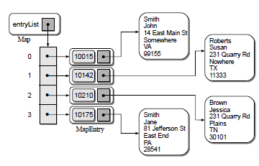
MAP ADT
List- Based implementation.
in order to store key and its value we can use parallel list. but insetad, we can use a single list.

Slide 5
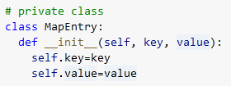
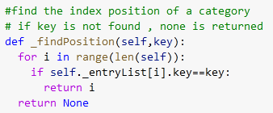
Map- List based implementation
to store individual key, pair value a class called MapEntry is created.
many methods require a search to determine if the map contains a given key or not. To this a method called FindPosition() is used which searches the list for the given key. if the key is found, the index of its location is returned; otherwise, the function returns None to indicate the key is not contained in the map. when used by other methods, the value returned can be evaluated to determine both the existence of the key and the location of the corresponding entry. if the key is in the map.

Slide 6
Map- List based implementation
The function returns the length of hte objectg

Slide 7
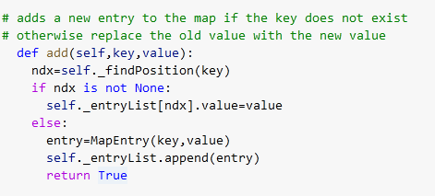
Map- List based implementation
The function to insert new key / value pair into map

Slide 8
Map- List based implementation
The function to see the value associated with a key
The function to remove a key

Slide 9
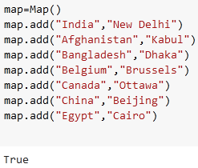
Map- List based implementation
The function to return a iterator for traversing the keys in the map
creating an object of type Map and adding values to a Map

Slide 10
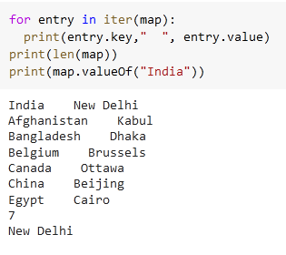
Map- List based implementation
The following code will traverse the map using iter and valueof function defined eralier

Slide 11
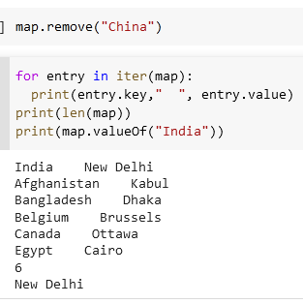
Map- List based implementation
After removal the map looks

