Slide 1
Graphs in python

Slide 2
Graphs
A graph is a way of representing relationships that exist between pairs of objects. that is, a graph is a set of objects, called vertices, together with a collection of pairwise connections between them, called edges.
A graph G is simply a set V of vertices and a collection E of pairs of vertices from V, called edges.
Edges in a graph are either directed or undirected.
An edge(u,v) is said to be directed from u to v if the pair (u,v) is ordered, with u preceding v.
An edge(u,v) is said to be undirected if the pair (u,v) is not ordered.
Graphs - vertices represented with ovals or rectangles, edges as segments or curves connecting pairs of ovals and rectangles.

Slide 3
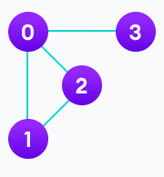
Graph
On facebook, everything is a node. That includes User, Photo, Album, Event, Group, Page, Comment, Story, Video, Link, Note...anything that has data is a node. Every relationship is an edge from one node to another. Whether you post a photo, join a group, like a page, etc., a new edge is created for that relationship.All of facebook is then a collection of these nodes and edges. This is because facebook uses a graph data structure to store its data.
More precisely, a graph is a data structure (V, E) that consists of
A collection of vertices V
A collection of edges E, represented as ordered pairs of vertices (u,v)
V = {0, 1, 2, 3}
E = {(0,1), (0,2), (0,3), (1,2)}
G = {V, E}

Slide 4
Graph Terminology
Adjacency: A vertex is said to be adjacent to another vertex if there is an edge connecting them. Vertices 2 and 3 are not adjacent because there is no edge between them.
Path: A sequence of edges that allows you to go from vertex A to vertex B is called a path. 0-1, 1-2 and 0-2 are paths from vertex 0 to vertex 2.
Directed Graph: A graph in which an edge (u,v) doesn't necessarily mean that there is an edge (v, u) as well. The edges in such a graph are represented by arrows to show the direction of the edge.

Slide 5
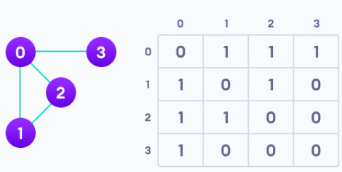
Graph Representation
graphs are commonly represented in two ways:
Adjacency Matrix
Adjacency LIst
Adjacency Matrix
An adjacency matrix is a 2D array of V x V vertices. Each row and column represent a vertex.
If the value of any element a[i][j] is 1, it represents that there is an edge connecting vertex i and vertex j.

Slide 6
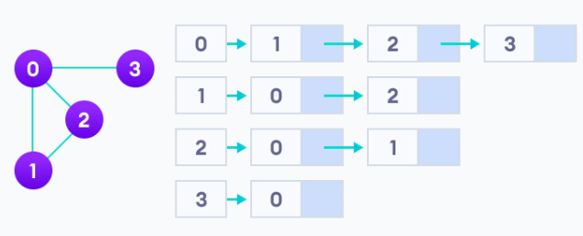
Graph Representation
Adjacency LIst
An adjacency list represents a graph as an array of linked lists
The index of the array represents a vertex and each element in its linked list represents the other vertices that form an edge with the vertex.
the adjacency list for the graph given is:

Slide 7
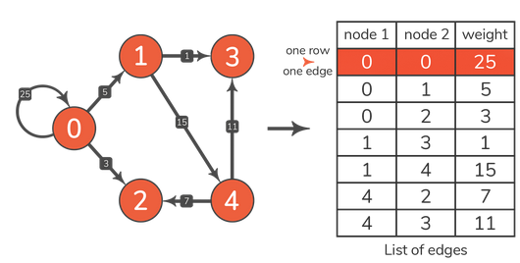
Graph representation
adding edges between vertices (nodes)

Slide 8
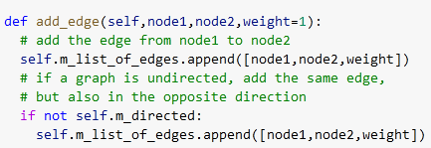
Graph implementation - using adjacency list
a constructor which initializes the number of nodes and a boolean argument for whether it is a directed or undirected graph is done.
a list for holding the edges data is initialized
through add_edge function, we pass tow vertices which are connected and the weight for that edge is also given.
an edge is added between there vertices i.e node1, node2 and the weight data is also updated in the list_of_edges list

Slide 9
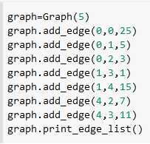
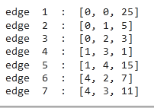
Graph implementation - using adjacency list
Print the edge matrix
create an instance of class Graph and add edges as follows:
output

Slide 10
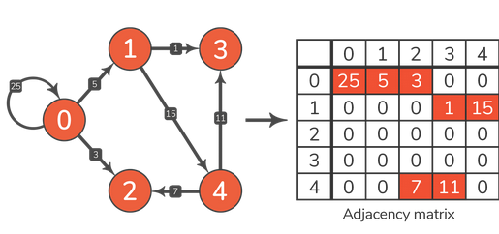
Adjacency Matrix
An adjacency matrix is represented by n x n matrix, where n is the numbe of nodes (vertex) in a graph.
A list comprehension is used to construct the matrix and initialize all to 0
no edge is represented as = 0
if edge = 1
weight is also added
creation of adjacency matrix

Slide 11
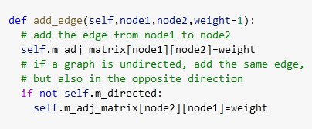
Graph implementation - using adjacency matrix
a constructor which initializes the number of nodes and a boolean argument for whether it is a directed or undirected graph is done.
an adjacency matrixt for holding the edges data is initialized
through add_edge function, we pass two vertices which are connected and the weight for that edge is also given.
an edge is added between there vertices i.e node1, node2 and the weight data is also updated in the adj_matrix

Slide 12
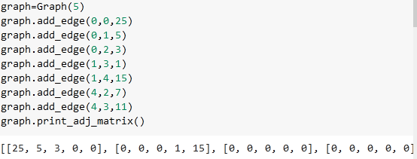
Graph implementation - using adjacency matrix

Slide 13
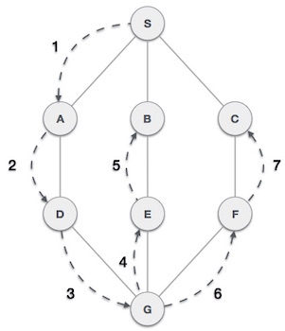
Graph Traversal - Depth first Search
Traversal means that visiting all the nodes of a graph which can be done through Depth-first search or Breadth-first search The Depth-First Search is a recursive algorithm that uses the concept of backtracking.
The DFS algorithm traverses a graph in a depthward motion and uses a stack to remember to get the next vertex to start a search, when a dead end occurs in any iteration
in the example given, DFS algorithm traverses from S to A to D to G to E to B first, then to F and lastly to C.

Slide 14
Graph Traversal - Depth first Search
A standard DFS implementation puts each vertex of the graph into one of two categories:
Visited
Not Visited
The purpose of the algorithm is to mark each vertex as visited while avoiding cycles.
The DFS algorithm works as follows:
Start by putting any one of the graph's vertices on top of a stack.
Take the top item of the stack and add it to the visited list.
Create a list of that vertex's adjacent nodes. Add the ones which aren't in the visited list to the top of the stack.
Keep repeating steps 2 and 3 until the stack is empty.

Slide 15
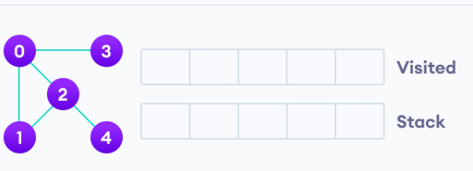
Graph Traversal - Depth first Search
We start from vertex 0, the DFS algorithm starts by putting it in the Visited list and putting all its adjacent vertices in the stack.

Slide 16
Next, we visit the element at the top of stack i.e. 1 and go to its adjacent nodes. Since 0 has already been visited, we visit 2 instead.
Vertex 2 has an unvisited adjacent vertex in 4, so we add that to the top of the stack and visit it.

Slide 17
After we visit the last element 3, it doesn't have any unvisited adjacent nodes, so we have completed the Depth First Traversal of the graph.

Slide 18
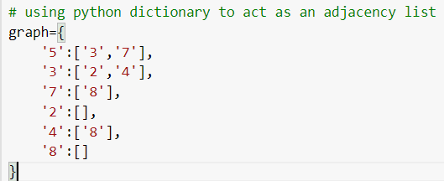
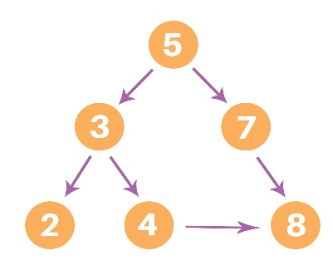
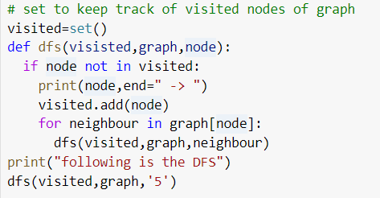
Depth first traversal

Slide 19
Depth first traversal
Time Complexity
The time complexity of the Depth-First Search algorithm is represented within the sort of O(V + E), where V is that the number of nodes and E is that the number of edges.
The space complexity of the algorithm is O(V).

Slide 20
Breadth first traversal
BFS is an algorithm used for tree traversal on graphs or tree data structures. BFS can be easily implemented using recursion and data structures like dictionaries and lists
Algorithm
pick any node, visit the adjacent unvisited verted, mark it as visited, display it, and insert it in a queue.
if there are no remaining adjacent vertices left, remove the first vertex from the queue.
Repeat step1 and step 2 until the queue is empty or the desired node is found.

Slide 21
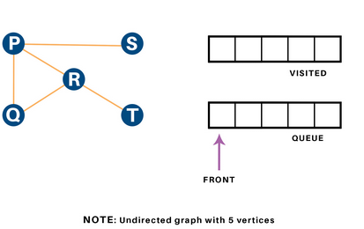
Breadth first traversal
Here, we will use an undirected graph with 5 vertices.

Slide 22
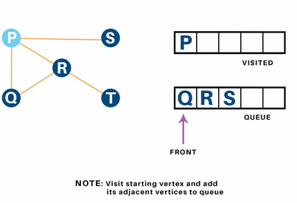
Breadth first traversal
we begin from the vertex P, the BFS algorithmic program starts by putting it within the visited list and puts all its adjacent vertices within the stack

Slide 23
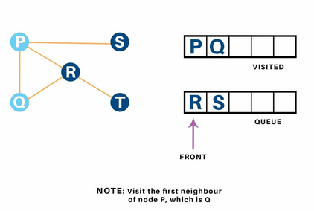
Breadth first traversal
next visit the front part of the queue Q, and visit its adjacent nodes. since P has already been visited, we have tendency to visit R instead

Slide 24
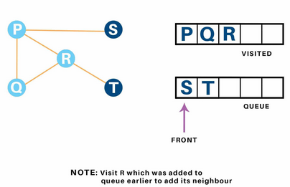
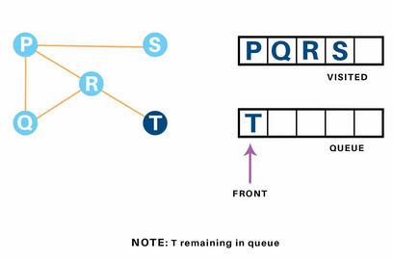
Breadth first traversal
Vertex R has an unvisited adjacent vertex in T, thus we have a tendency to add that to the rear of the queue and visit S, which is at the front of the queue.

Slide 25
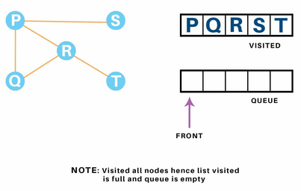
Breadth first traversal
Now, only T remains within the queue since the only adjacent node of S i.e. P is already visited. We have a tendency to visit it.
Since the queue is empty, we've completed the Traversal of the graph.

Slide 26
Breadth first traversal
Time Complexity
The time complexity of the Breadth first Search algorithm is in the form of O(V+E), where V is the representation of the number of nodes and E is the number of edges.
Also, the space complexity of the BFS algorithm is O(V).

Slide 27
Breadth first traversal
Applications
Breadth-first Search Algorithm has a wide range of applications in the real-world. Some of them are as discussed below:
In GPS navigation, it helps in finding the shortest path available from one point to another.
In pathfinding algorithms
Cycle detection in an undirected graph
In minimum spanning tree
To build index by search index
In Ford-Fulkerson algorithm to find maximum flow in a network.

Slide 28
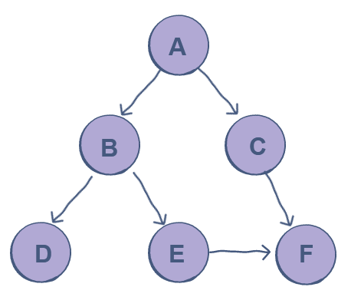
Breadth first traversal

Slide 29
https://favtutor.com/blogs/depth-first-search-python
https://www.geeksforgeeks.org/python-program-for-depth-first-search-or-dfs-for-a-graph/
https://www.geeksforgeeks.org/depth-first-search-or-dfs-for-a-graph/
https://www.educative.io/answers/how-to-implement-depth-first-search-in-python
https://www.educative.io/answers/how-to-implement-a-breadth-first-search-in-python
https://favtutor.com/blogs/breadth-first-search-python#:~:text=BFS%20in%20python%20can%20be,to%20the%20same%20node%20again.

