Slide 1
Trees

Slide 2
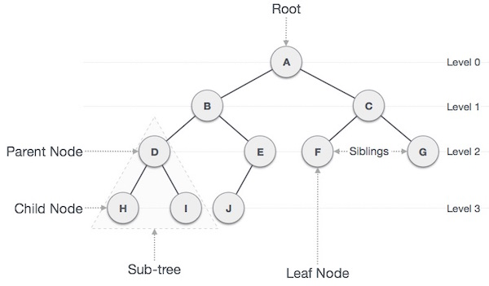
TREES
What are trees?
Tree is a hierarchical data structure which stores the information naturally in the form of hierarchy style.
It is a non-linear data structure compared to arrays, linked lists, stack and queue.
A tree is a non-linear hierarchical data structure that consists of nodes connected by edges.

Slide 3
Basic terminology in Trees
Important terms
Node: each data item in a tree is referred as a node.
Edge: this represents the connection between two nodes.
Root − The node at the top of the tree is called root. There is only one root per tree and one path from the root node to any node.
Path − Path refers to the sequence of nodes along the edges of a tree.
Parent − Any node except the root node has one edge upward to a node called parent.
Child − The node below a given node connected by its edge downward is called its child node.
Leaf − The node which does not have any child node is called the leaf node.
Subtree − Subtree represents the descendants of a node.
Visiting − Visiting refers to checking the value of a node when control is on the node.
Traversing − Traversing means passing through nodes in a specific order.
Levels − Level of a node represents the generation of a node. If the root node is at level 0, then its next child node is at level 1, its grandchild is at level 2, and so on.
Degree : Degree of a node is equal to number of children , a node have.
height : number of levels in a tree

Slide 4
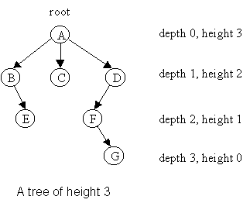
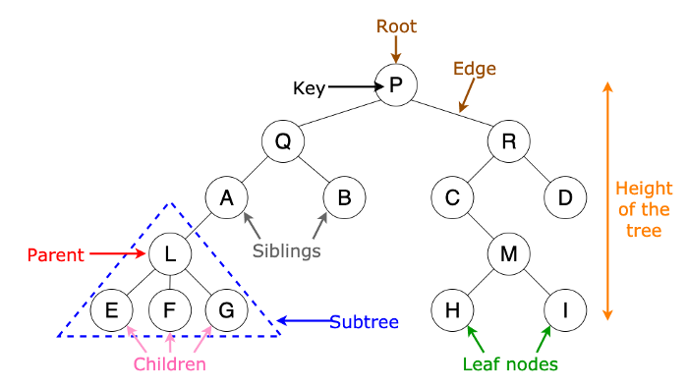

Slide 5
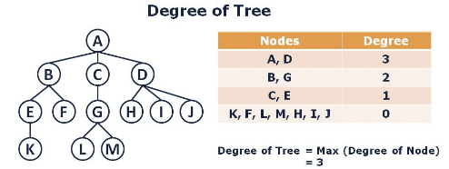

Slide 6
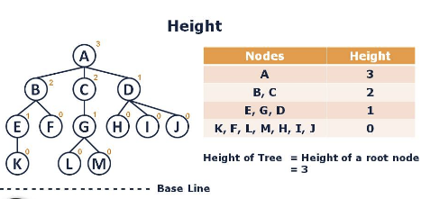
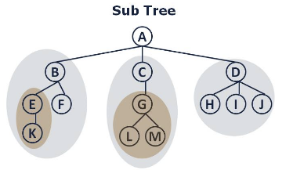

Slide 7
Why tree data structure ?
The data structure such as arrays, linked list, stack and queue are linear data structure that store data sequentially. In order to perform any operation in a linear data structure, the time complexity increases with the increase in the data size.
This is not acceptable in today’s computational world.
Different tree data structure allow quicker and easier access to the data as it is a non-linear data structure.

Slide 8
Applications of a tree - example1
A file system is an application of a tree
example
one can follow a path from the root to any directory which will uniquely identify that subdirectory
another important property of a tree is, one can move a subtree to a different position in the tree without affecting the lower levels of the hierarchy. for example, the entire subtree starting with /etc/ can be moved from root and reattach under /usr.
this would change the unique pathname of /httpd from /etc/httpd to /usr/etc/httpd. it will not affect the contents or any children of the httpd directory.

Slide 9
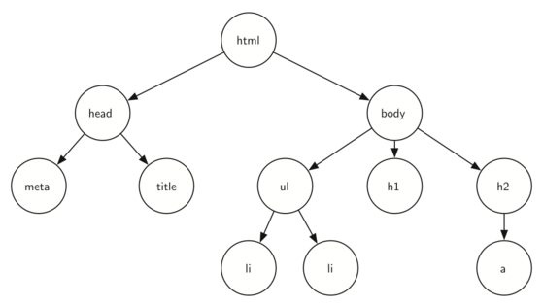
Applications of a tree - example 2
Another example is a web page
consider the following Html code
<html>
<head>
<title>simple</title>
</head>
<body>
<h1>A simple web page</h1>
<ul>
<li>List item one</li>
<li>List item two</li>
</ul>
<h2><a href="https://www.google.com">Google</a><h2>
</body>
</html>

Slide 10
Types of Tree Data Structure
General tree
Binary tree
Binary search tree
AVL tree
Red-black tree
Splay tree
Treap
B-tree

Slide 11
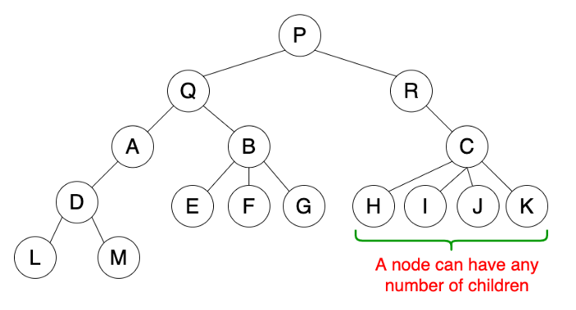
A general tree
A general tree is a tree data structure where there are no constraints on the hierarchical structure.
properties:
follow the properties of a tree
a node can have any number of children.
Usage
used to store hierarchical data structure like folders

Slide 12
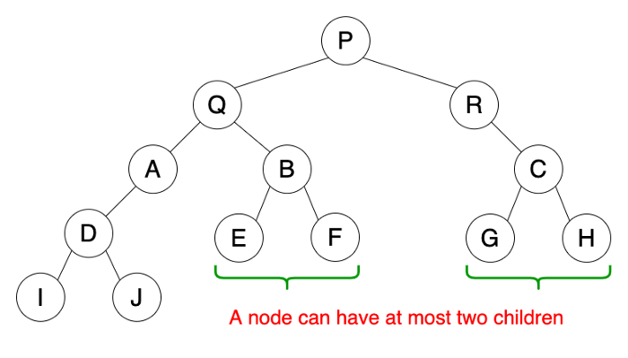
A Binary tree
A binary tree is a tree data structure where there are some constraints on the hierarchical structure.
properties:
follow the properties of a tree
a node can have atmost two number of children.
The node to left of parent is said to be left child and node to right of parent is said to be right child
Usage
used by compilers to build syntax trees
used to implement expression parsers and solvers.
used to store router tables in routers

Slide 13
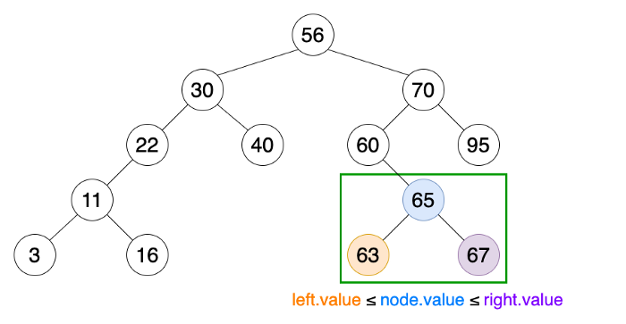
A Binary search tree
A binary search tree is a more constrained binary tree
properties:
follow the properties of a binary tree
the value of left child node should be less than or equal to parent node value and value of right child node should be greater than or equal to parent node value.
Usage
used to implement sorting techniques
can be used to implement priority queue.
used in many search algorithms where data are dynamically entering and leaving

Slide 14
Types of binary trees
Full Binary tree
perfect binary tree
complete binary tree
Skewed binary tree
Degenerate or Pathological tree
Balanced binary tree

Slide 15
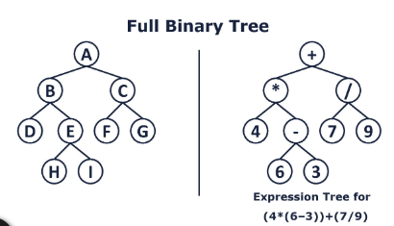
Full or strict binary tree
In this type each node of binary tree has either 2 or 0 child.
This type of tree is used to represent mathematical expressions.

Slide 16
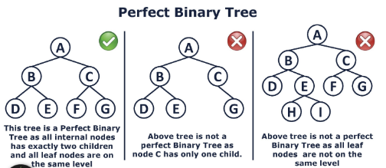
Perfect binary tree
A binary tree is said to be perfect, if all its internal nodes has exactly 2 children.
All leaf nodes are on the same level or depth.

Slide 17
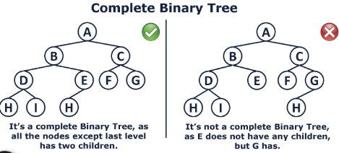
Complete binary tree
In this type all the levels of tree are completely filled except in the last level.
the last level has all keys as left as possible.
Difference between perfect and complete binary tee:
A perfect binary tree whose rightmost leaves on the last level have been removed is called Complete Binary tree.

Slide 18
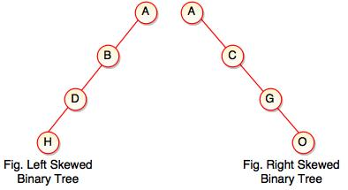
Skewed binary tree
If a tree is dominated by left child node or right child node, is said to be skewed binary tree
All nodes except one have only one child node. the remaining node has no child.

Slide 19
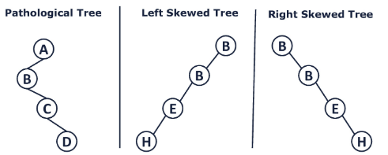
Degenerate or Pathological binary tree
In this tree every parent node has only one child either left or right

Slide 20
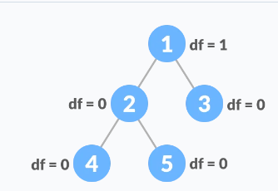
Balanced binary tree
In this type of binary tree, the difference between the height of the left and right subtree for each node is either 0 or 1

Slide 21
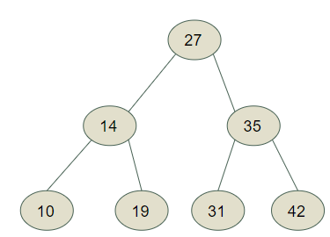
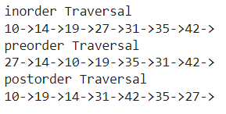
Tree Traversal
inorder - LPR
Pre order - PLR
Post Order - LRP

Slide 22
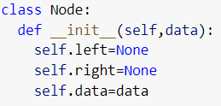
creation of a node in a binary tree

Slide 23
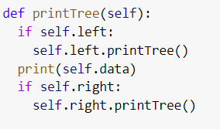
Printing a binary tree

Slide 24
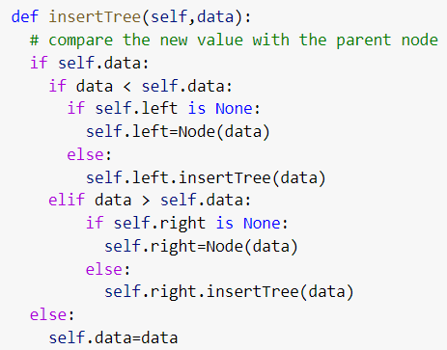
Insert a node in a binary tree

Slide 25
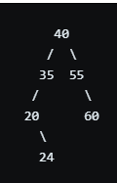
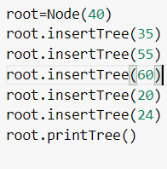
Main program

Slide 26
Tree Traversal
A tree can be traversed in 3 ways
Pre-order Traversal
In-order Traversal
Post-order Traversal

Slide 27
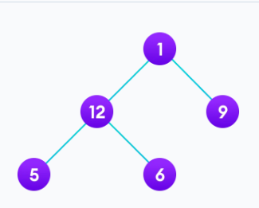
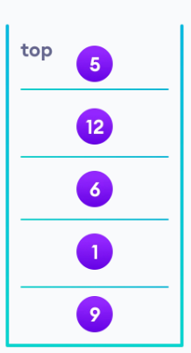
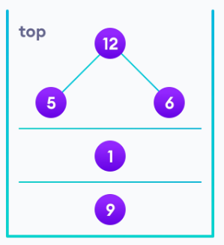
IN-Order Tree Traversal
visit all the nodes in the left subtree
Visit the root node
Visit all the nodes in the right subtree
we use stack data structure to remember the backtracking of path.

Slide 28
Pre-Order Tree Traversal
Visit the root node
visit all the nodes in the left subtree
visit all the nodes in the right subtree
1-> 12 -> 5 -> 6 ->9

Slide 29
Post-Order Tree Traversal
visit all the nodes in the left subtree
visit all the nodes in the right subtree
Visit the root node
5-> 6 -> 12 -> 9 ->1

Slide 30
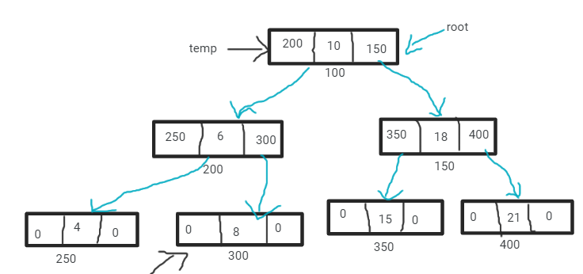
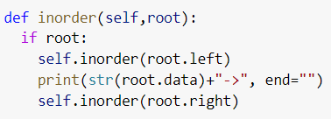
Binary search tree - inorder traversal

Slide 31
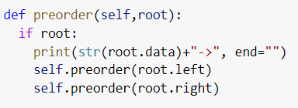
Binary search tree - preorder traversal

Slide 32
Binary search tree - postorder traversal

Slide 33
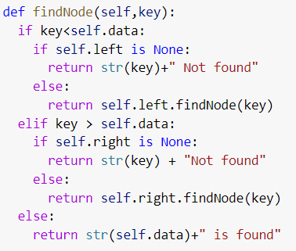
Binary search tree - find node

Slide 34
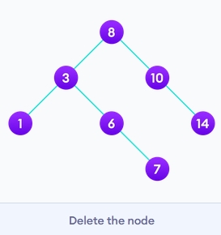
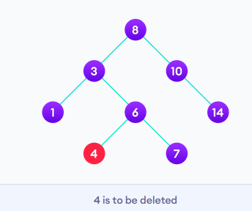
Binary search tree - deletion of a node
three cases
case 1:
the node to be deleted is the leaf node. in this case , it is simple to delete the node from the tree

Slide 35
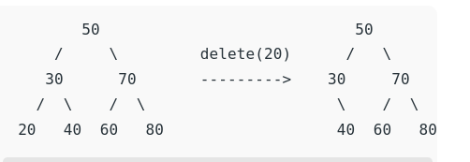
Binary search tree - deletion of a node
three cases
case 1:
the node to be deleted is the leaf node. in this case , it is simple to delete the node from the tree

Slide 36
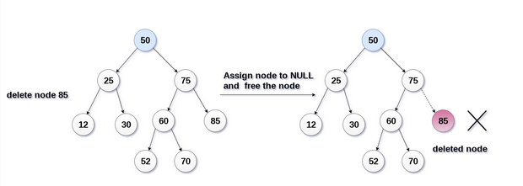
Binary search tree - deletion of a node
three cases
case 1:
the node to be deleted is the leaf node. in this case , it is simple to delete the node from the tree

Slide 37
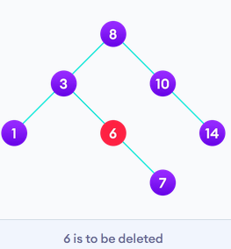
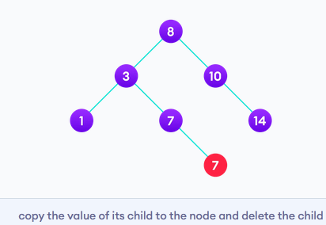
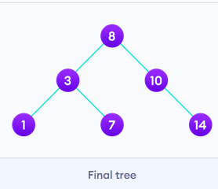
Binary search tree - deletion of a node
three cases
case 2:
the node to be deleted has a single child node. in such case , follow the below steps
1.replace that node with its child node
2. remove the child node from its original position

Slide 38
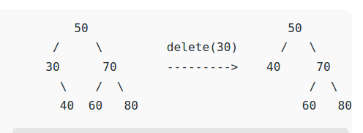
Binary search tree - deletion of a node
three cases
case 2:
the node to be deleted has a single child node. in such case , follow the below steps
1.replace that node with its child node
2. remove the child node from its original position

Slide 39
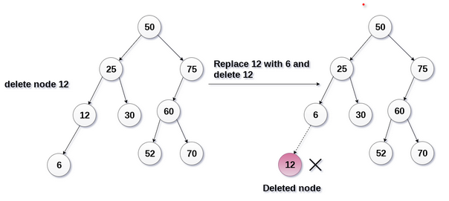
Binary search tree - deletion of a node
three cases
case 2:
the node to be deleted has a single child node. in such case , follow the below steps
1.replace that node with its child node
2. remove the child node from its original position

Slide 40
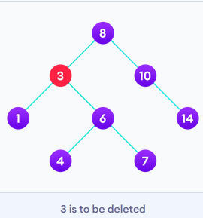
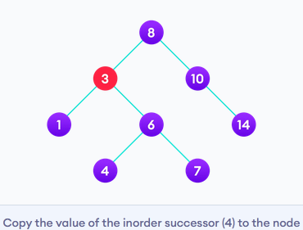
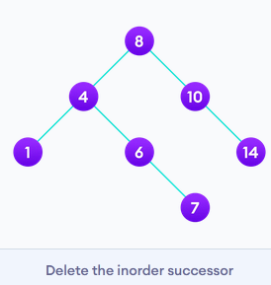
Binary search tree - deletion of a node
three cases
case 3:
the node to be deleted has two children nodes. in such case , follow the below steps
1.Get the inorder successor of that node
2. replace the node with the inorder successor
2. remove the inorder successor from its original position

Slide 41
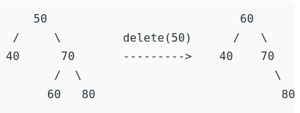
Binary search tree - deletion of a node
three cases
case 3:
the node to be deleted has two children nodes. in such case , follow the below steps
1.Get the inorder successor of that node
2. replace the node with the inorder successor
2. remove the inorder successor from its original position

Slide 42
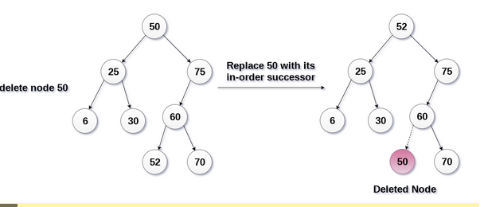
Binary search tree - deletion of a node
three cases
case 3:
the node to be deleted has two children nodes. in such case , follow the below steps
1.Get the inorder successor of that node
2. replace the node with the inorder successor
2. remove the inorder successor from its original position
https://www.codespeedy.com/delete-a-node-from-a-binary-search-tree-in-python/

Slide 43
def deleteNode(self,root,key):
#pointer to store the parent of current node
parent=None
# start with root node
cur=root
#search key in the BST and set its parent pointer
while cur and cur.data!=key:
#update the parent to the current node
parent=cur
#if the given key is less than the current node, go to left subtree
# other wise go to the right subtree
if key < cur.data:
cur=cur.left
else:
cur=cur.right
# return if the key is not found in the tree
if cur is None:
return root

Slide 44
#case 1 : node to be deleted has no children - leaf node
if cur.left is None and cur.right is None:
# if the node to be deleted is not a root node, then set
# its parent left/right child to None
if cur != root:
if parent.left==cur:
parent.left=None
else:
parent.right=None
# if the tree has only a root node, set it to None
else:
root=None

Slide 45
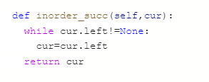
# case 2: node to be deleted has two children
elif cur.left and cur.right:
#find the inorder successor node
successor=self.inorder_succ(cur.right)
val=successor.data
#recursively delete the successor.
# the successor will have at most one child (right child)
self.deleteNode(root,successor.data)
cur.data=val

Slide 46
# case 3: node to be deleted has only one child
else:
# choose a child node
if cur.left:
child=cur.left
else:
child=cur.right
# if the node to be deleted is not a root node, set its parent
# to its child
if cur!=root:
if cur==parent.left:
parent.left=child
else:
parent.right=child
else:
root=child
return root

Slide 47
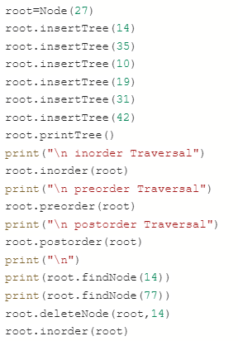
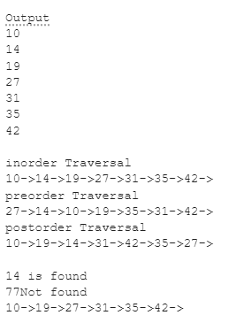
Binary search tree -

Slide 48
