Slide 1
Doubly Linked List - Python

Slide 2
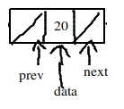
Doubly Linked List
Unlike singly linked list which always points to the next node in the list, the doubly linked list points both to its previous node as well as next node. In singly linked list, the list can be traversed in forward direction only. But in doubly linked list using the previous node pointer , the list can be traversed backwards (reverse) also.
Doubly linked list consists of three fields , ‘prev’,’next’,’data’ respectively as:
previous address field
data field
next address field
The previous address field of a node contains address of its previous node. This field also referred as backward link field. The data field stores the information part of the node. The next address field contains the address of the next node in the list. This field is also referred as forward link filed. The following figure shows the one node of a doubly linked list:

Slide 3
Structure of Doubly Linked List
The first node is designated as the head node and the last node is tail node. Each node has three field prev field, data field and next field. The address of the previous node is stored in the previous field and the address of the next node is stored in the next field of each node.

Slide 4
Doubly Linked List ADT
Function name | What it does
int isFull(); | Check whether dll is full or not.
int isEmpty(); | Check whether dll is empty or not
void insertbegin(qdata); | Insert a node at the begining
void insertend(qdata); | Insert a node at the end
void insertmiddle( qdata); | Insert a node in the middle , wherever needed
void deletionbegin( deldata); | delete the first node
void deletionend( deldata); | delete the last node
void deletionmiddle( deldata); | delete a node in the middle , wherever needed
int search( qdata); | Search for the given node
void reverse_traverse(); | Print reversely the dll
void traverse(); | Print forwardly the dll
int updatalist( olddata, newdata); | Update the particular node with the new data
void destroylist(); | Destroy the whole list

Slide 5
Algorithm to create a Doubly Linked List
create a node class with the three required data variables
create the doubly linked list class and declare the head and tail nodes
create a new node and assign it a value
set the “next” reference of the newly created node to none
set the “prev” reference of the newly created node to none
set both the head and tail reference to the new node
terminate

Slide 6
The creation of a new list involves the following steps:
This involves the following four steps: creating a structure for the node creating a node reading details for a node from the user connect the node with the list

Slide 7
The creation of a new list involves the following steps:

Slide 8
The creation of a new node involves the following steps:
Inserting a new node in doubly linked list can be done as:
inserting as a first node in the list
inserting as a last node in the list
inserting an intermediate node in the list
steps for inserting as a first node in the list
Create a new node. Assign NULL values to both prev and next field. Assign information received from user in the data field.
Check whether the list is empty or not. If empty then this newly created node will be the first node and only one node in the list.
If the list is not empty then follow the steps:
the previous address field of head is made to point to newly created node temp
now the newly created node temp is made as head

Slide 9
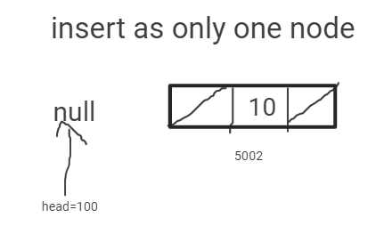
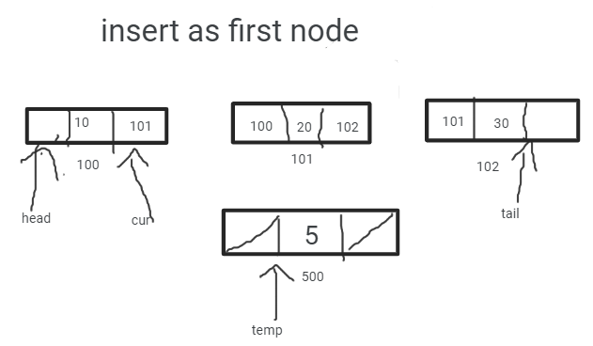

Slide 10
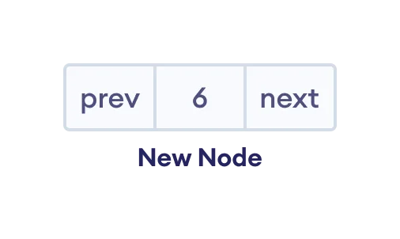
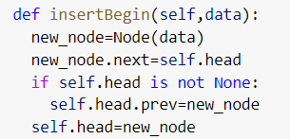
insert as the first node

Slide 11
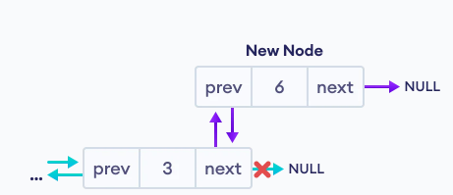
insert as the last node

Slide 12
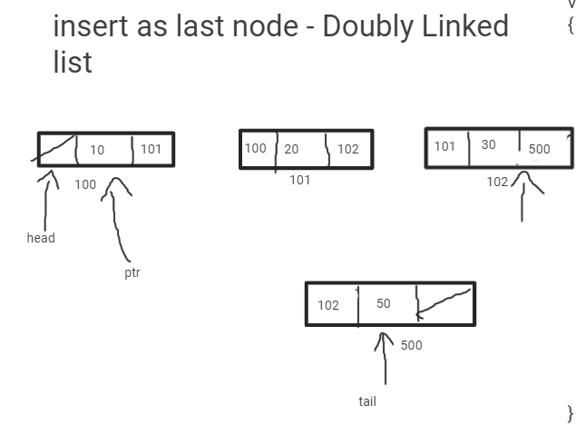
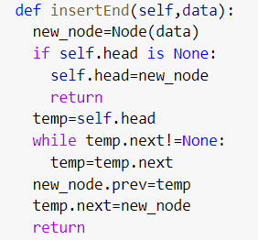

Slide 13
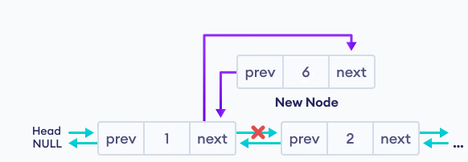
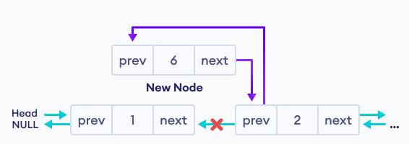
Insert a node in the middle

Slide 14
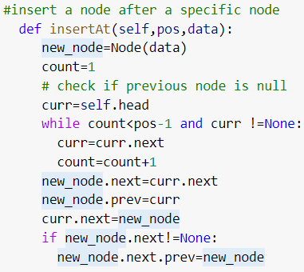

Slide 15
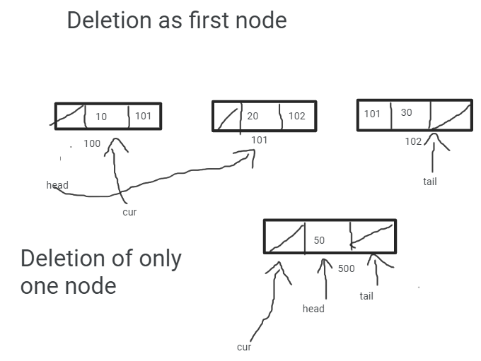
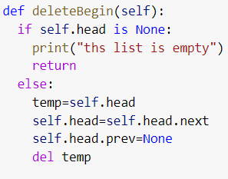

Slide 16
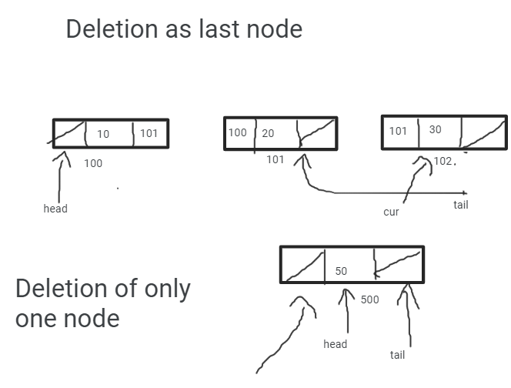
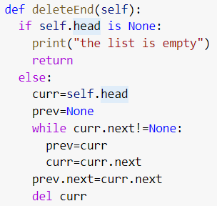

Slide 17
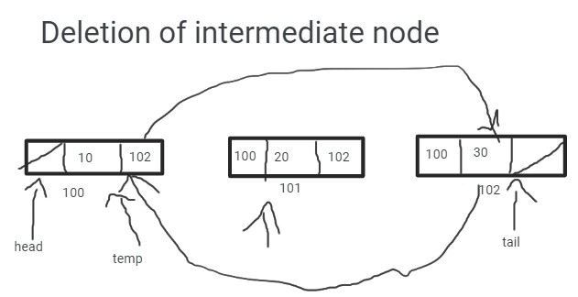
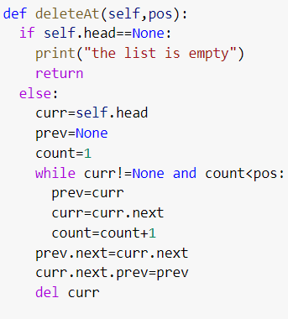

Slide 18
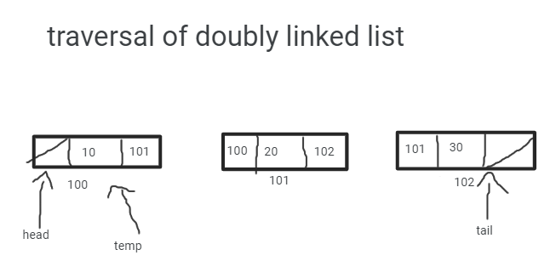
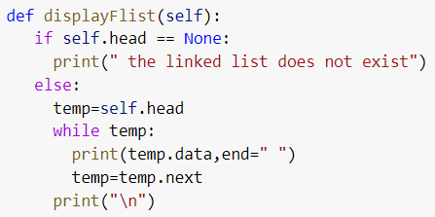

Slide 19
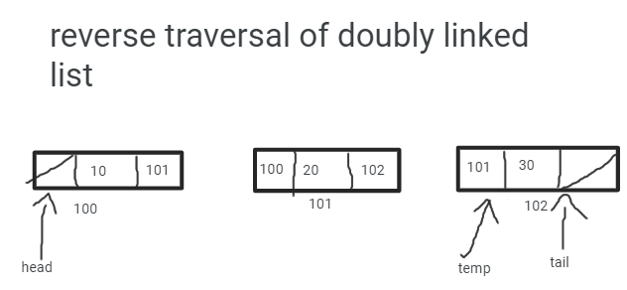
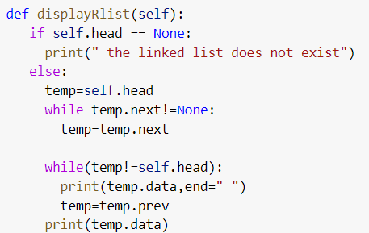

Slide 20
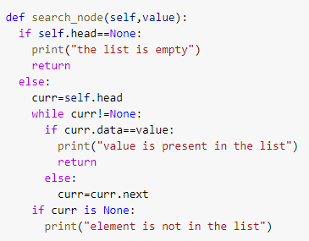
searching a node - doubly linked list

Slide 21
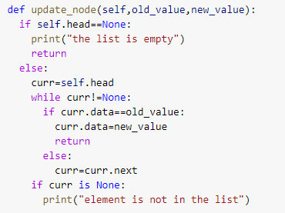
Updating a value in a node - doubly linked list

Slide 22
