Slide 1
Linked List

Slide 2
Linked List
A linked list is a linear data structure where each element is a separate object. The element is said to be Node.
The linked list is a collection of elements called nodes. Each node consists of two fields namely – the data and the next- address of the next node (reference) hence forming a chain like structure.
The last node has address null.
The entry point into a linked list or the first node is called the head of the list.
Each node holds its own data and the address of the next node hence forming a chain like structure, and thus the name came.

Slide 3
Linked List ADT
Function name | What it does
int isFull(); | Check whether dll is full or not.
int isEmpty(); | Check whether dll is empty or not
void insertbegin( qdata); | Insert a node at the begining
void insertend(qdata); | Insert a node at the end
void insertmiddle( qdata); | Insert a node in the middle , wherever needed
void deletionbegin( deldata); | delete the first node
void deletionend( deldata); | delete the last node
void deletionmiddle( deldata); | delete a node in the middle , wherever needed
int search( qdata); | Search for the given node
void traverse(); | Print forwardly the dll
int updatalist(olddata, newdata); | Update the particular node with the new data
void destroylist(); | Destroy the whole list

Slide 4
Advantages of Linked Lists
They are a dynamic in nature which allocates the memory when required.
Insertion and deletion operations can be easily implemented.
Stacks and queues can be easily executed.
Linked List reduces the access time.
Disadvantages of Linked Lists
The memory is wasted as pointers require extra memory for storage.
No element can be accessed randomly; it has to access each node sequentially.
Reverse Traversing is difficult in linked list.
Applications of Linked Lists
Linked lists are used to implement stacks, queues, graphs, etc.
A good example is web-browsers, where it creates a linked list of web-pages visited, so that when you check history (traversal of a list) or press back button, the previous node's data is fetched.

Slide 5
Types of Linked Lists
There are 3 different implementations of Linked List available, they are:
Singly Linked List 2. Doubly Linked List 3. Circular Linked List
Singly Linked list
Doubly Linked List In a doubly linked list, each node contains a data part and two addresses, one for the previous node and one for the next node.
Circular Linked list

Slide 6
Linked list using arrays
Index | Data | next
0 | 10 | 4
1 | 40 | 8
2 | 80 | 9
3 | 100 | 10
4 | 20 | 7
5
6 | 70 | 2
7 | 30 | 1
8 | 50 | 6
9 | 90 | 3
10 | 110 | nil
11
ascending order implementation of linked list using arrays

Slide 7
Linked list using arrays
Index | Data | next
0 | 10 | nil
1 | 40 | 7
2 | 80 | 6
3 | 120 | 10
4 | 20 | 0
5 | 60 | 8
6 | 70 | 5
7 | 30 | 4
8 | 50 | 1
9 | 90 | 2
10 | 110 | 11
11 | 100 | 9
descending order implementation of linked list using arrays

Slide 8
Linked List
create a class to store the information for a linked list is where the list starts (the head of the list). next, create another class to represent each node of the linked list

Slide 9
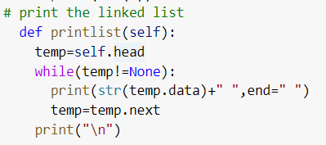
Traversing the list
Start with the head and access each node until you reach null. Do not change the head reference

Slide 10
Insertion in Linked list
Insertion in a linked list can be done in three ways:
1) insertion at the beginning
2) insertion at the middle
3) insertion at the end

Slide 11
Insert at the beginning of Linked List
Before Insertion at the beginning of Linked List
C | 102
E | 103
G | 104
J
101
102
103
104
head
B
new_node=Node(new_data)
200
After Insertion at the beginning of Linked List
C | 102
E | 103
G | 104
J
101
102
103
104
B | 101
200
head

Slide 12
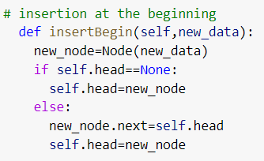
Insert at the beginning of Linked List

Slide 13
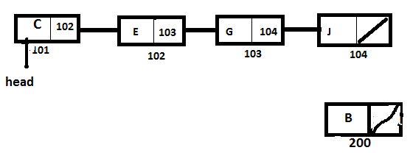
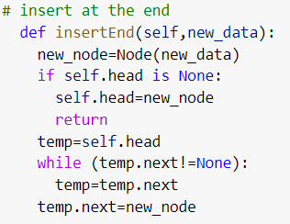
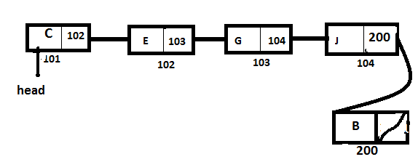
Insertion at the last of Linked List
Before Insertion at the last of Linked List
After Insertion at the last of Linked List

Slide 14
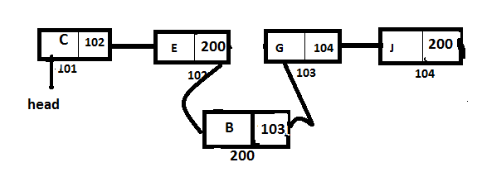
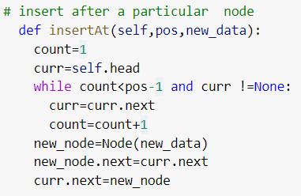
Insertion in the middle of Linkedlist
Before Insertion in the middle of Linkedlist
After Insertion in the middle of Linkedlist

Slide 15
Deletion of a node in Linked list
A node can be deleted from the list from three different places namely:
1) deleting the first node from the list
2) deleting the last node from the list
3) deleting an intermediate node from the list.

Slide 16
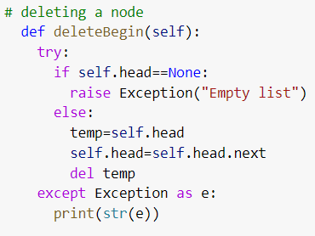
Deletion of a first node in Linked List
Before Deletion of a first node in Linked List
After Deletion of a first node in Linked List

Slide 17
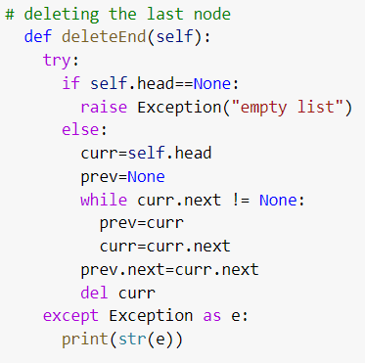
Deletion of a last node in Linked List
Before Deletion of a last node in Linked List
After Deletion of a last node in Linked List
I there is only one node

Slide 18
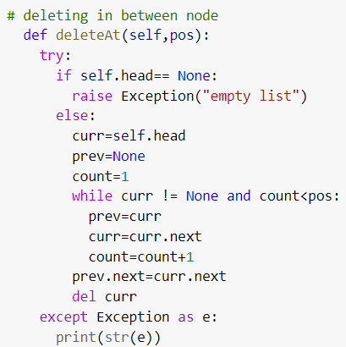
DeletDeletion of an in beween node in Linked List
ion of an intermediate node in Linked List

Slide 19
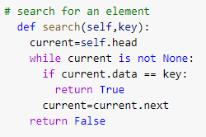
Searching for a value in linked list

Slide 20
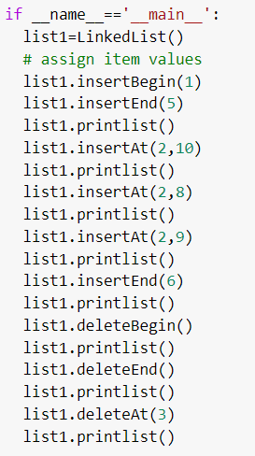
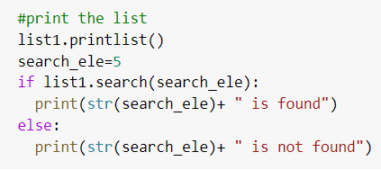
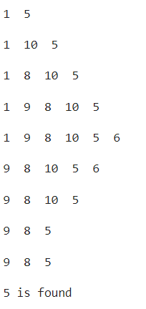

Slide 21
ARRAY | LINKED LIST
Array is a collection of elements of similar data type. | Linked List is an ordered collection of elements of same type, which are connected to each other using pointers.
Array supports Random Access, which means elements can be accessed directly using their index, like arr[0] for 1st element, arr[6] for 7th element etc. Hence, accessing elements in an array is fast with a constant time complexity of O(1). | Linked List supports Sequential Access, which means to access any element/node in a linked list, we have to sequentially traverse the complete linked list, upto that element. To access nth element of a linked list, time complexity is O(n).
In an array, elements are stored in contiguous memory location or consecutive manner in the memory. | In a linked list, new elements can be stored anywhere in the memory. Address of the memory location allocated to the new element is stored in the previous node of linked list, hence forming a link between the two nodes/elements.

Slide 22
In array, Insertion and Deletion operation takes more time, as the memory locations are consecutive and fixed. | In case of linked list, a new element is stored at the first free and available memory location, with only a single overhead step of storing the address of memory location in the previous node of linked list. Insertion and Deletion operations are fast in linked list.
Memory is allocated as soon as the array is declared, at compile time. It's also known as Static Memory Allocation. | Memory is allocated at runtime, as and when a new node is added. It's also known as Dynamic Memory Allocation.
In array, each element is independent and can be accessed using it's index value. | In case of a linked list, each node/element points to the next, previous, or maybe both nodes.
Array can single dimensional, two dimensional or multidimensional | Linked list can be Linear(Singly), Doubly or Circular linked list.
Size of the array must be specified at time of array declaration. | Size of a Linked list is variable. It grows at runtime, as more nodes are added to it.
Array gets memory allocated in the Stack section. | Whereas, linked list gets memory allocated in Heap section.

Slide 23
https://www.pythonforbeginners.com/lists/linked-list-in-python
https://www.pythonforbeginners.com/basics/doubly-linked-list-in-python
https://www.programiz.com/dsa/hash-table

