Slide 1
Binary Search Algorithm

Slide 2
Binary Search Algorithm can be implemented in two ways which are discussed below.
Iterative Method
Recursive Method
The recursive method follows the divide and conquer approach.

Slide 3
Let us assume we have an array like below and we are searching for the value 31 in it
First , we have to find the middle of the array. The array consists of 10 elements. To find the middle value the following formula is used:
mid=(low+high)/2
here it is,
mid=(9+0)/2=4. So , 4 is the mid of the array.
Now the value stored in mid i.e 27 is compared with the value being searched i.e 31. we find 27 (mid) is smaller than value to be searched(31). So now we know that the value to be searched is present in the right hand side of middle.

Slide 4
Change the low to be mid+1 as
low=mid+1 i.e low=4+1=5
mid=(low+high)/2 i.e mid=(5+9)/2 =14/2 =7
now the search value 31 is checked whether
mid[7]==31 or not.
Mid[7]=35 in our case which is more than search value. So now, it is found that the search value is in the left hand side of mid (lower side).
So the mid value is to be calculated again. Since the value is found at lower side we have to change the high as below:
high=mid-1 i.e high=7-1 = 6
mid=(high+low)/2 i.e mid=(6+5)/2= 11/2=5
We compare the value stored at location 5 with our target value
. We find that it is a match.

Slide 5
Algorithm for Binary search :
Procedure binary_search
A ← sorted array
n ← size of array
x ← value to be searched
Set low = 0
Set high = n
while (low<=high)
set mid = ( low+high ) / 2
if A[mid] < x
set low = mid + 1
else
if A[mid] > x
set high = mid – 1
else
return mid
end while
return 0
end procedure

Slide 6
Algorithm for Binary search :
let us take another example which consists of 14 entries:
a[1:14] = -15, -6, 0, 7, 9, 23, 54, 82, 101, 112, 125, 131, 142, 151
the below table explains three different searches of an element
X=151 | Low | High | mid
 | 1 | 14 | 7
 | 8 | 14 | 11
 | 12 | 14 | 13
 | 14 | 14 | found
X=-14 | 1 | 14 | 7
 | 1 | 6 | 3
 | 1 | 2 | 1
 | 2 | 2 | 2
 | 2 | 1 | Not found
X=9 | 1 | 14 | 7
 | 1 | 6 | 3
 | 4 | 6 | 5
 |  |  | found
When X=151 , at the 4th iteration the element is found.
Let say the iteration in Binary Search terminates after k iterations. In the above example, it terminates after 4 iterations, so here k = 4

Slide 7
At each iteration, the array is divided by half. So let’s say the length of array at any iteration is n
At Iteration 1,
Length of array = n
At Iteration 2,
Length of array = n⁄2
At Iteration 3,
Length of array = (n⁄2)⁄2 = n⁄2²
Therefore, after Iteration k,
Length of array = n⁄2^{k}
Also, we know that
After k divisions, the length of array becomes 1
Therefore
Length of array = n⁄2^{k} = 1
=> n = 2^{k}
Applying log function on both sides:
=> log₂ (n) = log₂ (2^{k})
=> log₂ (n) = k log₂ (2)
As(log_{a}(a) = 1) Therefore,
=> k = log₂ (n)

Slide 8
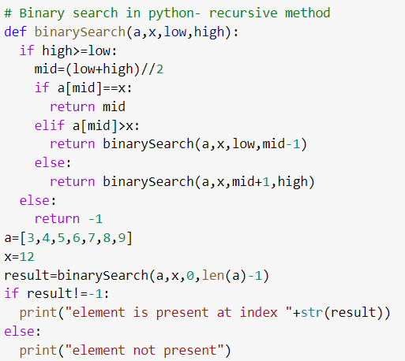

Slide 9
Complexity
n | log₂​n
1 | 0
2 | 1
4 | 2
8 | 3
16 | 4
32 | 5
64 | 6
128 | 7
256 | 8
512 | 9
1024 | 10
1,048,576 | 20
2,097,152 | 21
SN | Performance | Complexity
1 | Worst case | O(log n)
2 | Best case | O(1)
3 | Average Case | O(log n)
4 | Worst case space complexity | O(1)
The logarithm function grows very slowly. Logarithms are the inverse of exponentials, which grow very rapidly, so that if log₂​n=x, then n=2^{x}. For example, because log₂​128=7, we know that 2⁷=128.
That makes it easy to calculate the runtime of a binary search algorithm on an n that's exactly a power of 2. If n is 128, binary search will require at most 8 (log₂​128+1) guesses.

