Slide 1
What is an Algorithm ?
An algorithm is a finite set of instructions or logic, written in order, to accomplish a certain predefined task. Algorithm is not the complete code or program, it is just the core logic(solution) of a problem, which can be expressed either as an informal high level description as pseudocode or using a flowchart.

Slide 2
Every Algorithm must satisfy the following properties:
1. Input- There should be 0 or more inputs supplied externally to the algorithm.
2. Output- There should be atleast 1 output obtained.
3. Definiteness- Every step of the algorithm should be clear and well defined.
4. Finiteness- The algorithm should have finite number of steps.
5. Correctness- Every step of the algorithm must generate a correct output.

Slide 3
Algorithm Analysis
Efficiency of an algorithm can be analyzed at two different stages, before implementation and after implementation.
A priori analysis- this is theoretical analysis. Efficiency of algorithm is measured by assuming that all other factors e.g processor speed, are constant and have no effect on implementation.
An algorithm is said to be efficient and fast, if it takes less time to execute and consumes less memory space. The performance of an algorithm is measured on the basis of following properties :
1. Time Complexity
2. Space Complexity

Slide 4
Space Complexity of Algorithms
Whenever a solution to a problem is written some memory is required to complete. For any algorithm memory may be used for the following:
1. Variables (This include the constant values, temporary values)
2. Program Instruction
3. Execution
Space complexity is the amount of memory used by the algorithm (including the input values to the algorithm) to execute and produce the result.

Slide 5
Space Complexity of Algorithms
When we design an algorithm to solve a problem, it needs some computer memory to complete its execution. For any algorithm, memory is required for the following purposes...
1. Memory required to store program instructions
2. Memory required to store constant values
3. Memory required to store variable values
4. And for few other things
Sometime Auxiliary Space is confused with Space Complexity. But Auxiliary Space is the extra space or the temporary space used by the algorithm during it's execution.
Space Complexity = Auxiliary Space + Input space

Slide 6
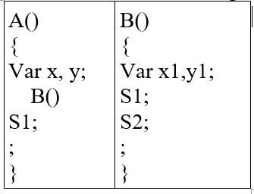
Memory Usage while Execution
While executing, algorithm uses memory space for three reasons:
1. Instruction Space
It's the amount of memory used to save the compiled version of instructions.
2. Environmental Stack
Sometimes an algorithm(function) may be called inside another algorithm(function). In such a situation, the current variables are pushed onto the system stack, where they wait for further execution and then the call to the inside algorithm(function) is made. for the sequential execution , memory stack is used here
3. Data Space
Amount of space used by the variables and constants.
But while calculating the Space Complexity of any algorithm, we usually consider
only Data Space and we neglect the Instruction Space and Environmental Stack.

Slide 7
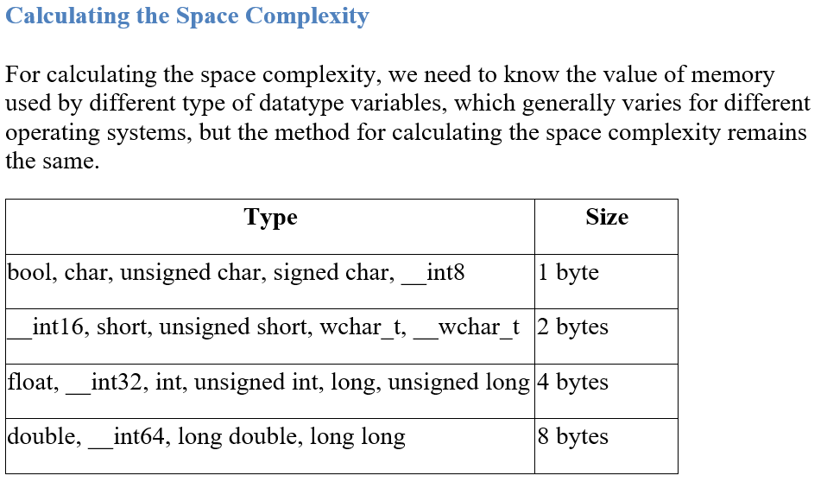

Slide 8
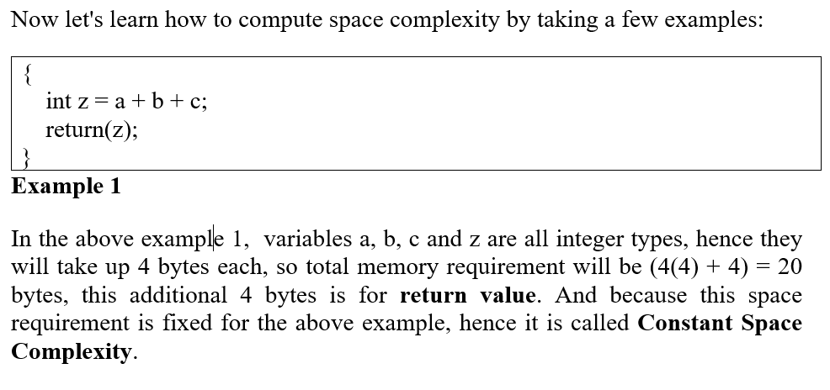

Slide 9
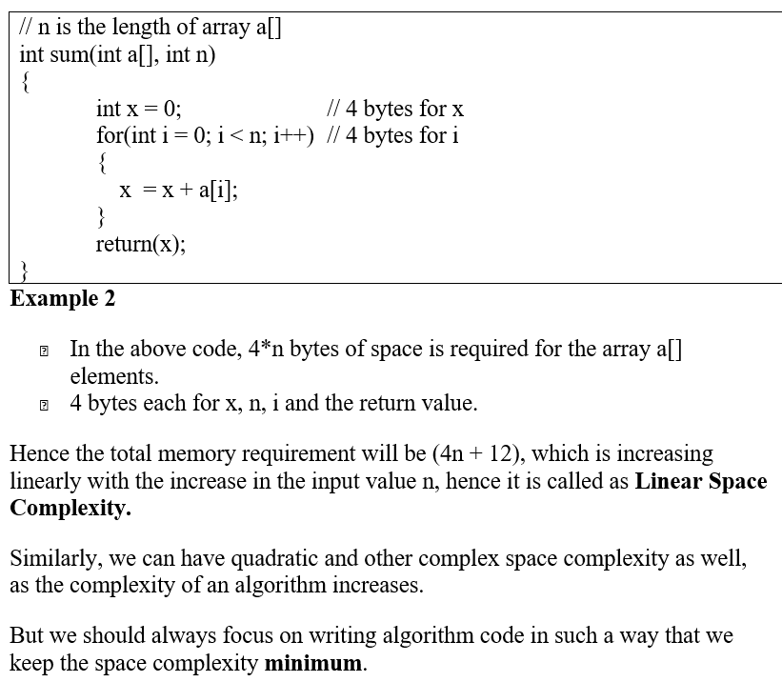

Slide 10
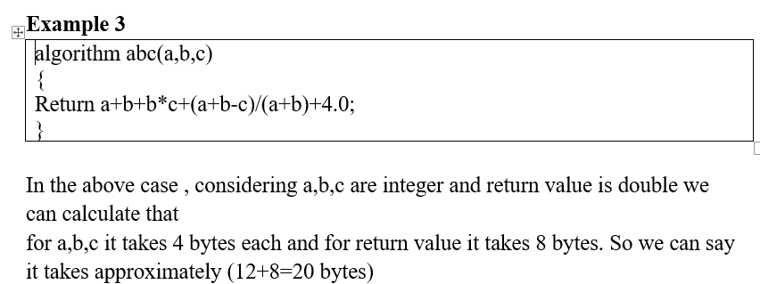

Slide 11
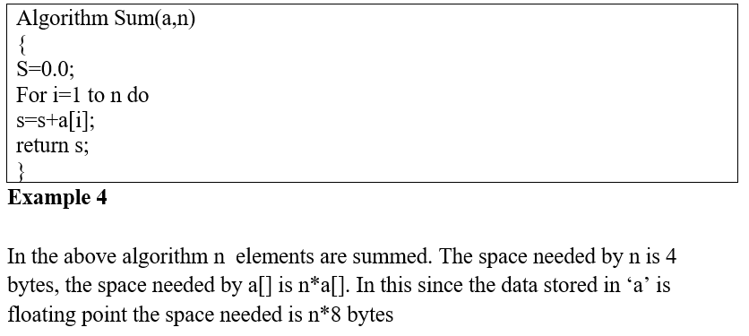

Slide 12
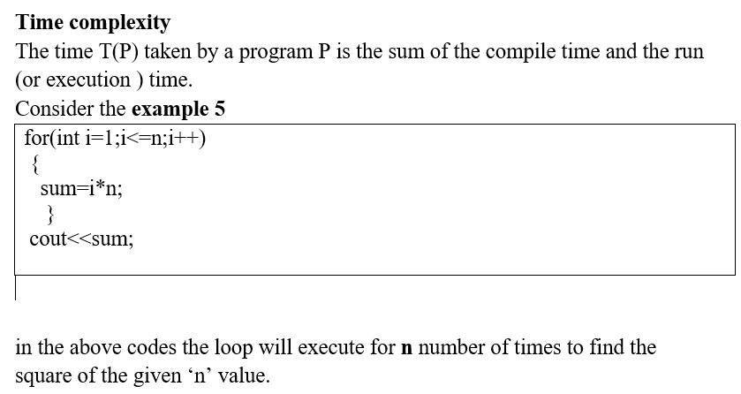

Slide 13
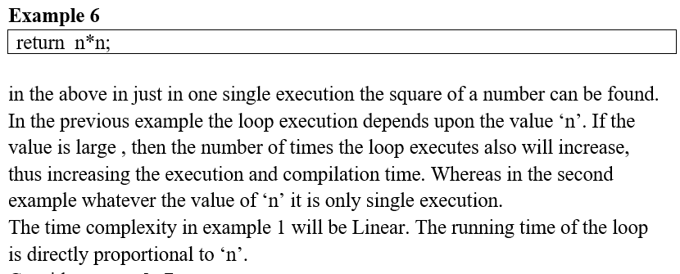

Slide 14
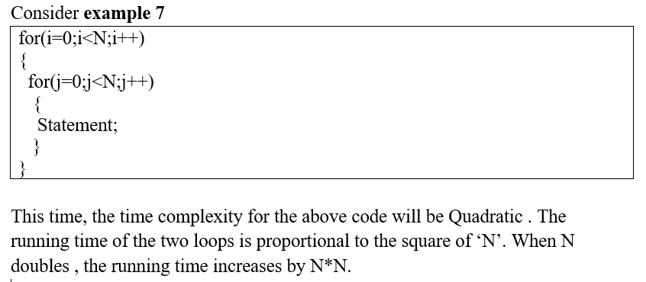

Slide 15
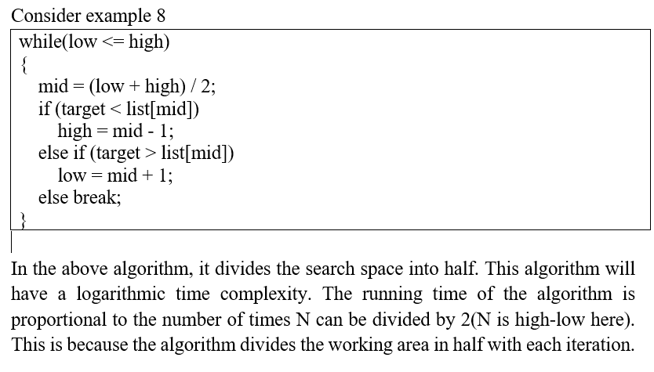

Slide 16
Three types of Analysis
worst case ( Theta notation)
defines the input for which the algorithm takes a long time (slowest time to complete)
input is the one for which the algorithm runs the slowest
Best case ( Big-O notation)
defines the input for which the algorithm takes the least time (fastest time to complete)
input is the one for which the algorithm runs the fastest
Average case ( Omega notation)
provides a prediction about the running time of algorithm
run the algorithm many times, using many different inputs that come from some distribution that generates these inputs, compute the total running time (by adding the individual times), and divide by the number of trials.

Slide 17
For example: In bubble sort, when the input array is already sorted, the time taken by the algorithm is linear i.e. the best case.
But, when the input array is in reverse condition, the algorithm takes the maximum time (quadratic) to sort the elements i.e. the worst case.
When the input array is neither sorted nor in reverse order, then it takes average time.These durations are denoted using asymptotic notations.
There are mainly three asymptotic notations:
1. Theta notation
2.Omega notation
3. Big-O notation

Slide 18
Three types of Analysis
Assumes that the input is random
Lower Bound<= Average Time <= Upper Bound
for a given algorithm, we can represent the best, worst and average cases in the form of expressions. as an example, let f(n) be the function which represents the given algorithm:

Slide 19
Big - O -Asymptotic Notation (worst case)
to represent best, average and worst cases the upperbound and lowerbound must be identified.
to do this we need some kind of syntax.
Big-O Notation [ upper bounding function]
This notation gives the tight upper bound of the given function. It is represented as
that means, at larger values of n, the upper bound of f(n) is g(n).
for example, if
for the given algorithm, then n⁴ is g(n). that means g(n) gives the maximum rate of growth for f(n) at larger values of n

Slide 20
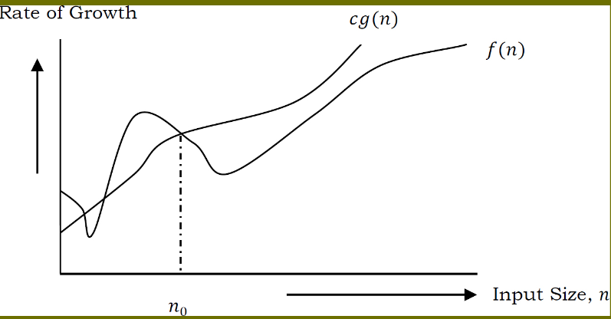
Big O- Asymptotic Notation
let us see the O-notation with a little more detail.
O-notation defined as O(g(n))={f(n) : there exist positive constants c and n₀ such that 0<=f(n) <=cg(n) for all n>n₀
we discard lower values of n.
n₀ is the point from which we need to consider the rate of growth for a given algorithm. Below n₀, the rate of growth could be different. n₀ is called threshold for the given function.

Slide 21
Big - O Visualization
O(g(n)) is the set of functions with smaller or the same order of growth as g(n). For example; O(n²) includes O(1), O(n), O(nlogn) etc

Slide 22
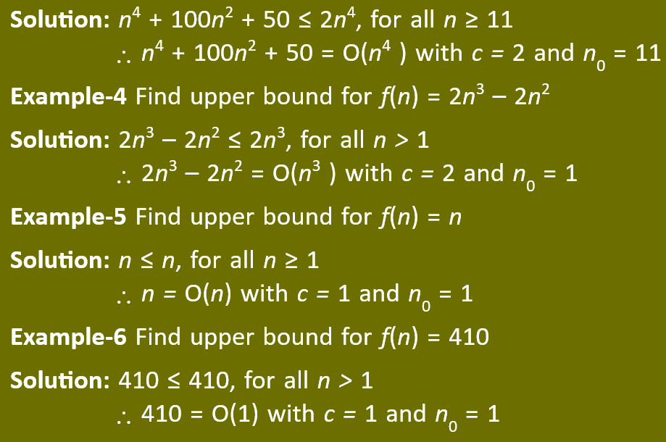
Big - O Visualization

Slide 23
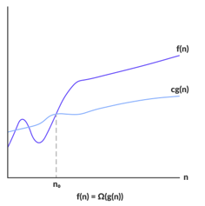
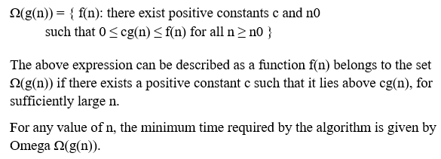
Omega-Q - Asymptotic Notation (best)
Omega gives the tighter lower bound of the given algorithm can be represented as

Slide 24
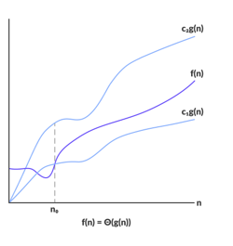
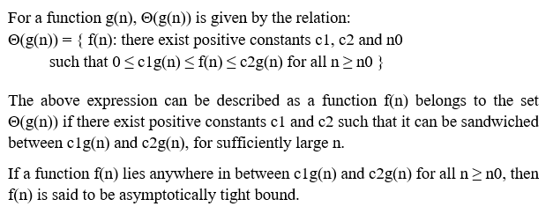
Theta Notation (Θ-notation) (average)
Theta notation encloses the function from above and below. Since, it represents the upper and the lower bound of the running time of an algorithm, it is used for analyzing the average case complexity of an algorithm

Slide 25
Best, worst and Average-case complexity
The worst-case complexity of the algorithm is the function defined by the maximum number of steps taken on any instance of size n. It is the slowest time taken to complete, with given input.
The best-case complexity of the algorithm is the function defined by the minimum number of steps taken on any instance of size n. It can be the fastest time taken to complete, with optimal inputs chosen.
Finally, the average-case complexity of the algorithm is the function defined by the average number of steps taken on any instance of size n. This is nothing but arithmetic mean.

Slide 26
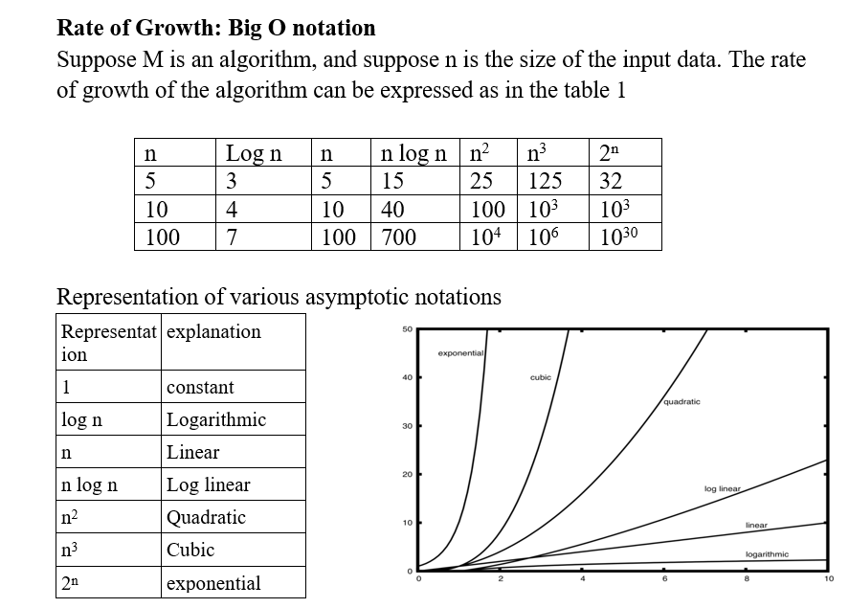

Slide 27
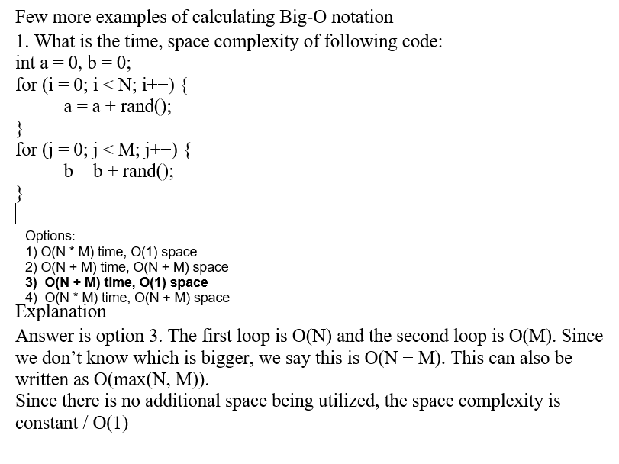

Slide 28
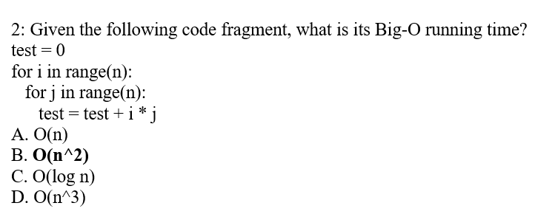
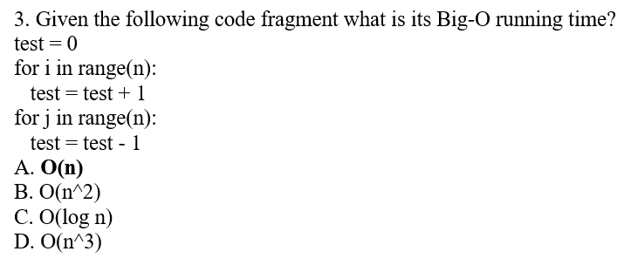

Slide 30
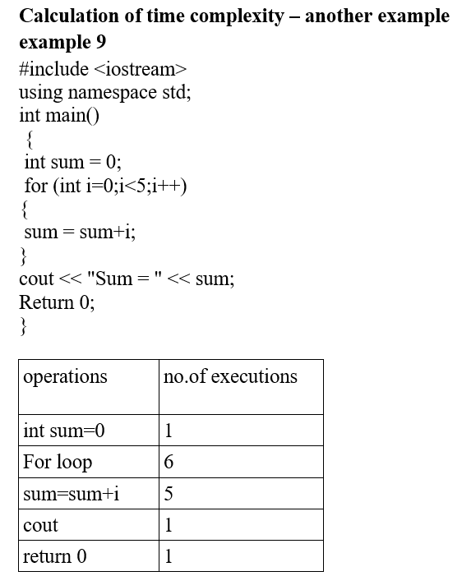
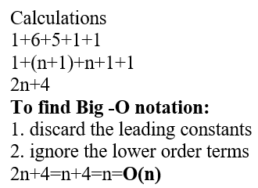

Slide 31
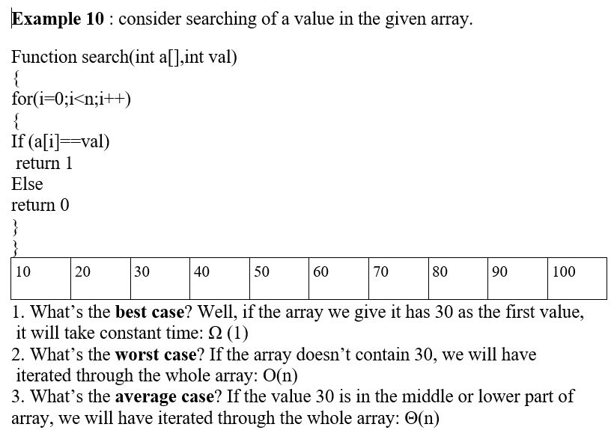

Slide 32
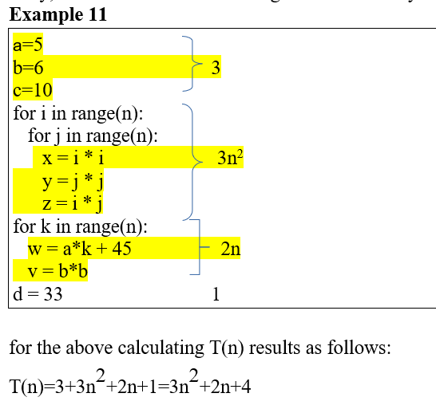

Slide 33
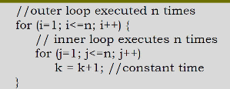
Guidelines for Asymptotic Analysis
Loops: The running time of a loop is, at most, the running time of the statements inside the loop (including tests) multiplied by the number of iterations.
Nested Loops: analyze from the inside out. Total running time is the product of the sizes of all the loops

Slide 34
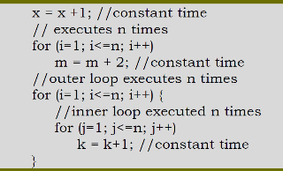
Guidelines for Asymptotic Analysis
Consecutive statements : Add the time complexities of each statement

