Slide 1
Python Tuple

Slide 2
Python tuple
A tuple in Python is similar to a list. In list we can change the list items. But this is not possible in Tuple
A tuple is created by placing all the items (elements) inside parentheses (), separated by commas. The parentheses are optional, however, it is a good practice to use them.
A tuple can store heterogeneous data
Empty tuple can be created as:

Slide 3
Python tuple
Can store multiple data type as follows nested tuples
Tuple packing : when tuples are created without parentheses

Slide 4
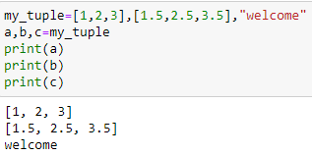
Python tuple
Tuple unpacking :- the items can be placed in individual Tuple length
variables as
To create a tuple with single item, the item should be followed by comma or else it will be treated as string data type.

Slide 5
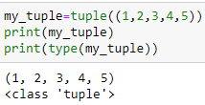
Python tuple
Can be created using tuple() constructor
Access tuple items : using index, and negative indexing

Slide 6
Python tuple
Range of Indexes

Slide 7
Check if an item exists in tuple

Slide 8
Changing a tuple value
Items in tuple can not be changed.
But it can be done by changing tuple to list as follows:

Slide 9
Add items to tuple, concatenation of two tuples
Convert tuple into an list

Slide 10
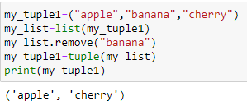
remove items from tuple
Remove item from tuple : as tuples are immutable - cannot change, removal is not possible. But can be done by converting to list, remove items and again convert to tuple.

Slide 11
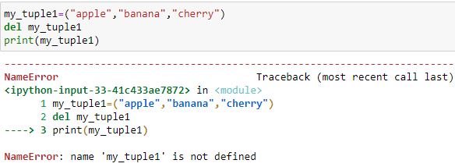
Delete tuple
Use of del keyword- remove the whole tuple

Slide 12
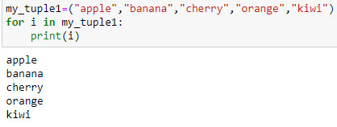
Loop through a tuple - For loop
Loop through index numbers:

Slide 13
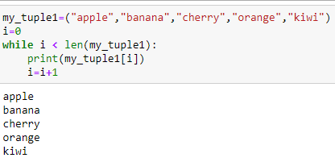
Loop through a tuple - while loop

Slide 14
Tuple methods - count(), index()
count() - returns the number of times a specified value occurs in a tuple
index() - searches the tuple for a specified value first occurrence and returns the position of it

Slide 15
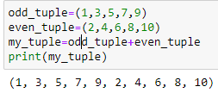
Concatenating two tuples, multiple tuples

Slide 16
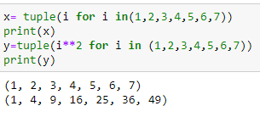
Tuple comprehension

