Slide 1
Python Sets

Slide 2
Python sets
A set is an unordered collection of items. Every set element is unique (no duplicates) and must be immutable ( cannot be changed)
But the set itself is mutable. We can add or remove items from it.
We can perform operations like union, intersection, symmetric differences etc
Creating sets: can be created by placing items inside {} braces separated by comma.

Slide 3
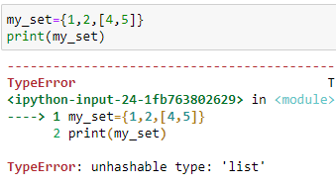
Python sets
Cannot have duplicates But cannot have list (mutable) as one of the element
Cannot have mutable elements like lists, sets or dictionaries
Can be made from a list

Slide 4
Python sets
Creating an empty set as:
my_set=set()
Sets are mutable. Since they are unordered, indexing has no meaning.
Cannot access elements using indexing
Modifying an element in python can be done by the following methods:
add() - adding a single element
update() - adding multiple elements

Slide 5
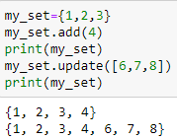
Python sets

Slide 6
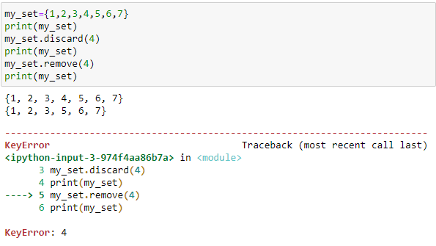
Python sets
Removing elements from a set
discard() - leaves a set unchanged if the element is not present in the set
remove()- will raise an error if the element is not present in the set

Slide 7
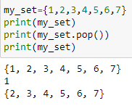
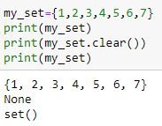
Python sets
Removing all elements from a set
clear() - used to remove all items in a set

Slide 8
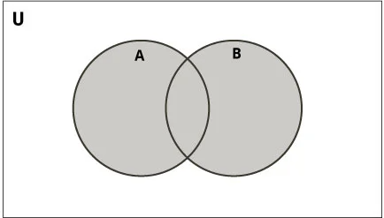
Python sets
Set operations - union ( use | operator or using union() method

Slide 9
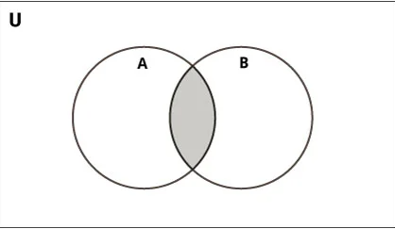
Python sets
Set operations - intersection ( use & operator or using intersection() method

Slide 10
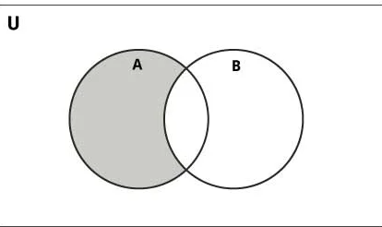
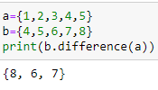
Python sets
Set operations - difference ( use - operator or using difference() method
A-B = means a set of elements that are only in A but not in B.
B-A = means a set of elements that are only in B but not in A.

Slide 11
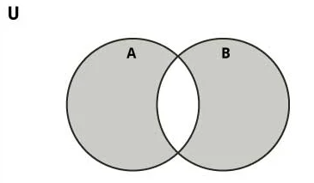
Python sets
Set operations - symmetric difference - A and B are sets and symmetric difference is a set of elements in A and B but not in both (excluding the intersection)

Slide 12
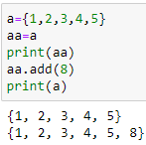
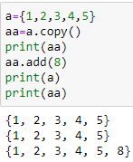
Python sets
Set operations -copy() - returns a shallow copy of the set.
We can use = symbol to do this. When this is done if we do any modification to original it will be carried in the new also.
With copy() method this is not so.

Slide 13
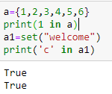
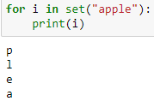
Python sets
Set membership test : using “in” operator we can check whether an item is present in a set or not

Slide 14
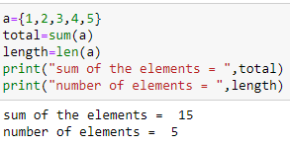
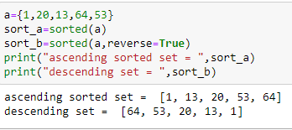
Python sets
Sum() - returns sum of the given set
len() - returns the number of elements in a set
sorted() - sort the given set

Slide 15
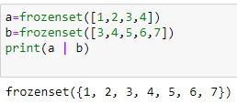
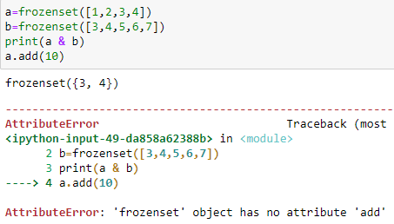
Python sets
Frozen set :- immutable sets

Slide 16
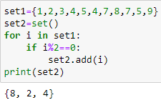
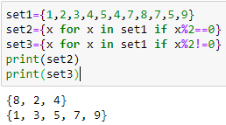
Set comprehension

