Slide 1
Python List

Slide 2
Python collections of data - built-in data types
List
Tuple
Set
dictionary

Slide 3
Python lists
List : Lists are used to store multiple items in a single variable.
List items are ordered, changeable and allow duplicate values
List items are indexed, the first item has index[0], the second item has index[1] etc.
It can be created as by placing elements inside square brackets [ ] separated by commas.
Creating list creating empty list

Slide 4
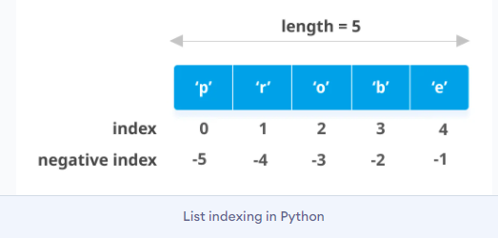
List indexing in python

Slide 5
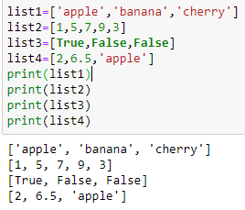
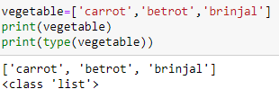
Python lists
Lists are ordered. But when a new item is added to a list, it will be placed at the end of the list.
The list is changeable, meaning that we can change, add, and remove items in a list after it has been created.
It allows duplicates.
A list can contain different data types
type() used to print the type of object

Slide 6
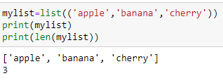
Python lists
List can be constructed using list() - constructor as:
Find the length of list using len() function

Slide 7
Python lists
Access items in a list- can be done by referring the index number. The index starts from 0 in python
Negative indexing - start from the end. -1 refers to the last item, -2 refers to second last item and so on

Slide 8
Python lists
Range of indexes: specify from where to start and end by giving range as:
Listname[start index : end index]
The search will start at index 3 (included) and end at index 5 (not included)
Referring the different ways of indexing

Slide 9
Python lists
Range of Negative indexes: specify negative indexes if search is from end of list:
Listname[start index : end index]
The above returns items from (-4) end of list ‘cherry’ till -1 but not included
Change list item value - a specific value in a list can be changed by referring its index and assigning a new value to it as:

Slide 10
Python lists
Change a range of items in a list- can be done with specifying range and its respective value to be changed as follows:
If more items than in the range is specified, they will be inserted and the remaining items will be moved accordingly as follows:

Slide 11
Python lists
Insert items without replacement use function - insert()
Extend list - to append elements from another list to the current list use- extend()- the elements will be added at the end of list

Slide 12
Python lists
Remove specific item - remove()
Remove specified index - pop()
If index is not specified pop() method removes last item

Slide 13
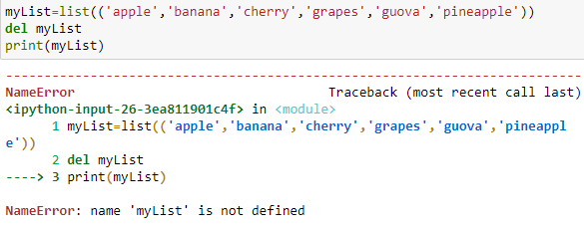
Python lists
Remove specific item using del by specifying index as :
Delete whole list using del

Slide 14
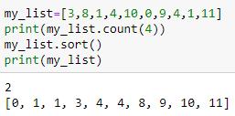
Count, sort, reverse - list
count(element) - returns how many time a particular item is present in the list
sort() - used to sort the list
reverse list

Slide 15
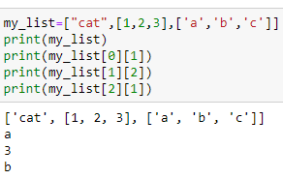
Python lists
Clear list- list remains without items
Creating nested list Accesing nested list

Slide 16
Copy list
copy() - used to make a copy of the list

Slide 17
Read the list value dynamically

Slide 18
List functions - min(), max()

Slide 19
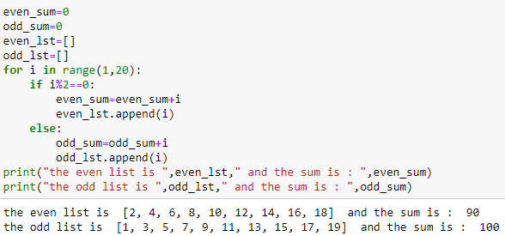
Program to print odd and even list and their sums

Slide 20
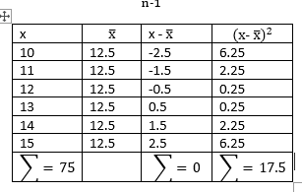
Program to compute mean, variance, standard deviation
Mean =

Slide 21
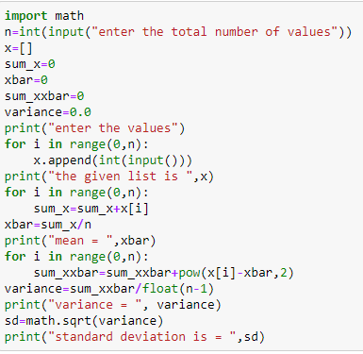

Slide 22
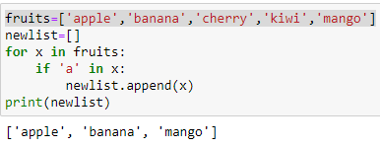
List comprehension
To create a newlist from an existinglist on some criteria like the items having ‘a’ in it .
Using for loop

Slide 23
List comprehension
To create a new list from an existing list on some criteria like the items having ‘a’ in it .Using list comprehension
Syntax :
newlist=[expression for item in iterable if condition == True]
This returns a new list leaving old list unchanged.
The condition is like a filter that only accepts the items that valuate to TRUE
Example
newlist=[x for x in fruits if x != ‘apple’]

Slide 24
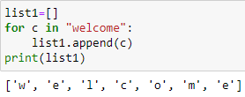
List comprehension
Advantages of list comprehension:
More time-efficient and space-efficient than loops.
Require fewer lines of code
Transforms iterative statement into a formula.

Slide 25
List comprehension

Slide 26
List comprehension
Iterable:
The iterable can be any iterable object, like a list, tuple , set etc
Example: range() function can used to create an iterable
Can give condition as:

Slide 27
List comprehension
Expression
The expression is the current item in the iteration, but it is also the outcome, which can be manipulated before it ends up like a list in the new list:
Set the values in the new list to upper case:
Set all values in the newlist to ‘hello’

Slide 28
List comprehension
Expression
The expression can also contain conditions, not like a filter, but as a way to manipulate the outcome:
Return “orange” instead of “banana”

Slide 29
List comprehension
Example :- generate even numbers using list comprehension
Example :- generate square in range

Slide 30
List comprehension
Example :- generate even numbers and must be divisible by 5 using list comprehension

