Slide 1
Python introduction

Slide 2
Features of Python
UNIT 1 | Lesson 1
UNIT 1 | Lesson 1
Easy to use
Is powerful
Object oriented
No primitive data types
Extensive support libraries
Glue language
Runs everywhere -platform independent
Has strong community
Free and open source
Web development - server side

Slide 3
Features of Python
UNIT 1 | Lesson 1
Can be integrated with C , C++, java
Can be integrated with COM and CORBA components
Quick development of Application

Slide 4
Applications of Python
UNIT 1 | Lesson 1
Machine Learning
Artificial Intelligence
Deep Learning
IOT
Data Science
Web Development
Automation
Gaming
Mobile Apps

Slide 5
Limitations of Python
UNIT 1 | Lesson 1
Speed
Least popular in Mobile computing and Gaming applications
Run-time errors
Database access
Memory consumption is high

Slide 6
Comment statement
UNIT 1 | Lesson 1
# this is a single line comment statement
Triple quotes
“”” anything
*************
Between the triple quotes
Will be printed “””
Example

Slide 7
Start with Print statement
Syntax:
print(object(s), sep=separator, end=end, file=file, flush=flush)

Slide 8
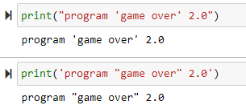
Print statement
When the single quotes is given within double quotes they also will be considered as string only

Slide 9
Print statement
When the single quotes is given within double quotes they also will be considered as string only
End parameter
With sep parameter

Slide 10
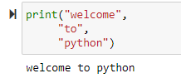
Print statement
When using comma in a print statement to separate arguments
When the arguments are written with blank lines or space, it has no effect. The compiler ignore blank lines and empty spaces.

Slide 11
Using escape sequences
\t = one tab position from left margin
\\ = prints backslash
\n = new line inserted
\’ = a single quote is inserted
\” = a double quote is inserted
\a = bell sound

Slide 12
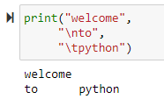
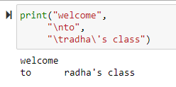
Using escape sequences
\t = one tab position from left margin
\\ = prints backslash
\n = new line inserted
\’ = a single quote is inserted
\” = a double quote is inserted
\a = bell sound

Slide 13
String concatenation
Two or more string can be concatenated using + operator
Printing repeating string

Slide 14
Mathematical operators

Slide 15
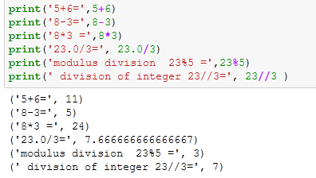
Mathematical operators

Slide 16
Python Variables
Variables can store values, they are the containers for data
Creating variables:
Variable names must be unique and are case-sensitive. Weight, WEIGHT, weight are different variables.
A variable or identifier must start with a letter or underscore. It cannot start with a digit.
It can consists of letters, digits,and underscore(_)
It cannot be a keyword
the python variables are created the moment a value is assigned to it.
No need for declaration as what type
They can change dynamically according to the right hand side data allocation
Specification of a data type to a variable can be done with casting
type() function is used to know what data type a particular variable is

Slide 17
identifiers
Valid identifiers
Miles, test, x, y, radius , area_square
_x_var , _XVAR, xvar1
Invalid identifiers
a+b ; + is not allowed
b-a ; - is not allowed
My var ; space not allowed
4#R ; should not start with number, # is not allowed
$ 4 ; $ not allowed
If ; keyword
Elif ; keyword

Slide 18
Styles of variable declaration
Camel case
Each word , except the first, start with a captial letter:
myVariableName= “welcome”
Pascal case
Each word starts with a captial letter:
MyVariableName= “welcome”
Snake case
Each word is separated by an underscore character:
my_variable_name= “welcome”

Slide 19
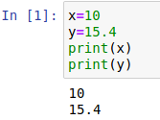
Python variables
In python, variables are created when you assign a value to it:
Example
No need to declared of any particular type.
Can change after they are set

Slide 20
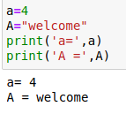
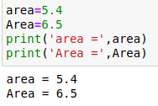
Case - sensitive
Variable names are case-sensitive

Slide 21
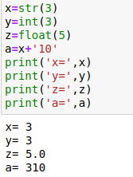
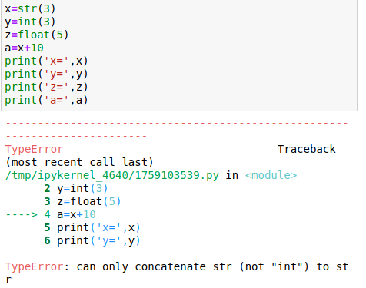
casting
Specification of data type can be done using casting

Slide 22
Assignment statements
When a value or expression is assigned to a variable it is called assignment statement.
= sign is used for assignment.
syntax:
variable=expression
Example
x= 5.0
x= x+5
A value can be assigned to multiple
variables like this:

Slide 23
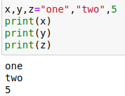
Assignment statements
Assigning many values to multiple variables

Slide 24
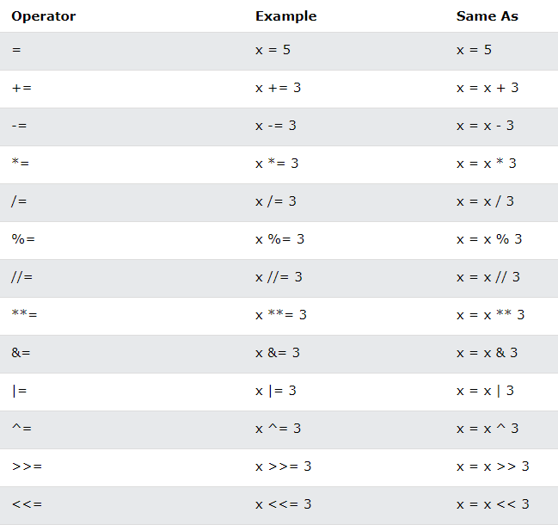
Assignment operators

Slide 25
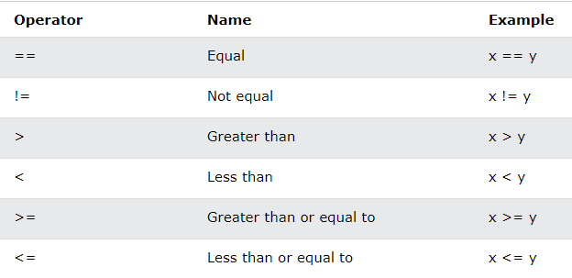
Python comparison operators

Slide 26
Logical operators

Slide 27
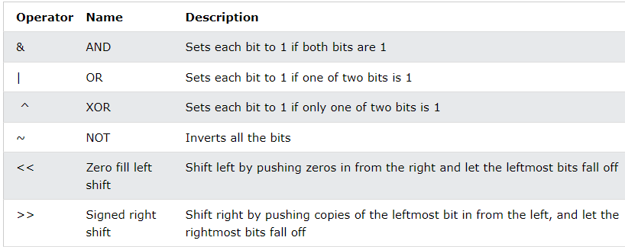
Python Bitwise operators

Slide 28
Print with variable concatenation

Slide 29
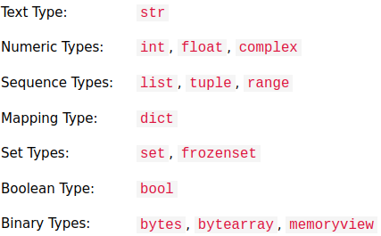
Python data types
Built in data types

Slide 30
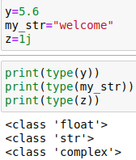
Python Numbers
There are three numeric types
Int
Float
complex
The type of objects can be found using type() command

Slide 31
Printing complex numbers

Slide 32
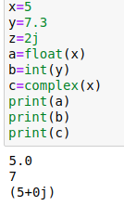
Convert from one type to another data type
Use of int(), float(), complex() functions

Slide 33
Random number
Python does not have random() function to generate random number. But has a built-in module called random which can be used to generate random numbers:
To do that random module must be imported.

Slide 34
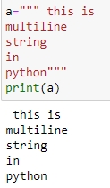
Strings in python
Strings in python are surrounded by either single quotation or double quotation.
Eg ‘hello’ is similar to “hello”
a=”hello”
Multiline assignment

Slide 35
Strings in python
Strings in python are arrays of bytes. It can be accessed with square brackets as follows:
Get the character at position 5 ( first character starts at 0)
String length : len()

Slide 36
Strings in python
Check string :- check if a certain character or phrase is present in a string we can use keyword in
NOT - check if a phrase or character is not present: use not in

Slide 37
Strings in python
Slicing :- return a range of characters within a string. Must specify start and end index.
Slice from the start : by leaving start index, the range will start at first character

Slide 38
Strings in python
Slicing from end :- leaving out the end index , the range will go to the end:
Negative indexing : use negative indexing to start the slice from the end of string

Slide 39
Strings in python
Modify strings
upper() - convert to uppercase
lower() - convert to lowercase
strip() - removes any whitespace from the beginning or end
replace() - replace a string with another string
split() - splits the string into substrings
if it finds instances of the separator

Slide 40
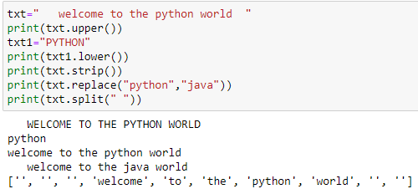
Strings in python
Modify strings

Slide 41
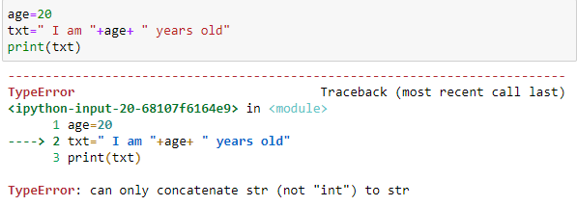
Strings in python
String format
The string and numerical value concatenation generates error as such

Slide 42
Strings in python
String format
format() method combine strings and numbers. It is also used to format the strings and places the arguments in the string where the placeholders {} are present.

