Slide 1
Python input and format statements

Slide 2
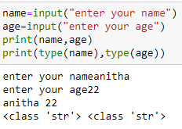
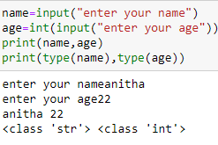
Python Input statement
input() statement allows the user to give input to the program dynamically.
Syntax: input() - this prompts the user to enter data and returns the output as a sting.
variablename=input()

Slide 3
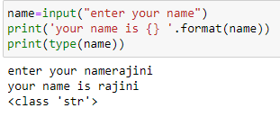
Python string formatting options
format() - this method allows to format parts of a string.
This can be done by adding placeholders {} in the text, and give the values as arguments in format() method
example:

Slide 4
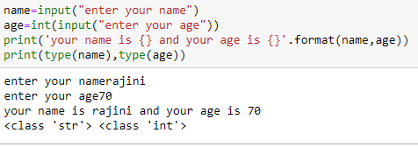
Python string formatting options
Can give more placeholders , and in format the arguments can be passed as:

Slide 5
Python string formatting options
Can give more placeholders , and in format the arguments can be passed as:
If a particular value is to be printed more than once it can be done by referring its index as:

Slide 6
Python string formatting options
Using Named indexes

Slide 7
Python string formatting options
type | meaning
‘b’ | Represents binary format
‘c’ | Represents character and converts integer to the corresponding Unicode
‘d’ | Represents decimal number
‘o’ | Represents octal number
‘x’ | Represents in hex format in lower case
‘X’ | Represents in hex format in upper case
‘e’ | Represents in scientific notation with ‘e’ indicator
‘E’ | Represents in scientific notation with ‘E’ indicator
‘f’ | Represents fixed point number
‘F’ | Represents fixed point number and converts nan to NAN

Slide 8
Python string formatting options
type | meaning
‘s’ | Represents in string format
‘%’ | Represents in percentage format

Slide 9
Formatting statement
Convert a given temperature in celsius to fahrenheit and vice versa
Celsius = (F-32)*(5/9) F=(C*(9/5))+32

Slide 10
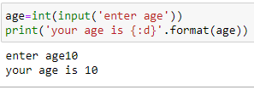
Formatting statement

Slide 11
Python math library
Name | Description
sqrt(x) | Returns square root of x
pow(x,y) | Returns x raised to y
log10(x) | Returns log
pi | 3.141592
e | 2.718281
fabs(x) | Returns absolute value of x
factorial(x) | Returns x factorial
sin(x), cos(x), tan(x) | Returns in radians
radians(x) | Converts angle x from degrees to radians
degrees(x) | Converts angle x from radians to degrees

Slide 12
Python math library
To use the math library use import math statement

Slide 13
Simple Interest and Compound Interest
P- principal amount
t- duration in years
r - rate of interest per annum

Slide 14
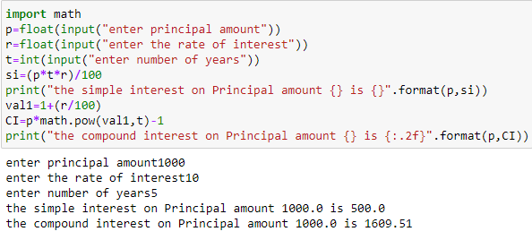
Imagine Mr.X has borrowed 1000 rs at the rate of 10% simple interest per annum from his friend Mr.Y. He proposes to pay the amount borrowed with interest after 5 years. Calculate the amount Mr.X needs.

Slide 15
Python program to print ones place of any given integer
To do this : x%10 is the logic 1452%10= 2

Slide 16
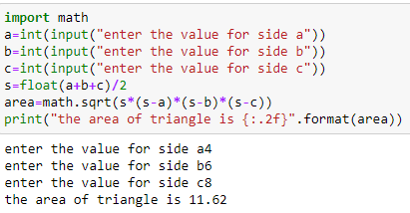
Program to find area of a triangle

Slide 17
Program 1
Write a python program that takes the radius of a sphere (a floating point number) as input and outputs the sphere’s diameter, circumference, surface area and volume.

Slide 18
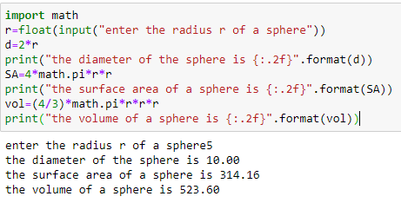

Slide 19
Python string formatting options

