Slide 1
Python Functions

Slide 2
Python Functions
A function is a group of related statements that performs a specific task
Functions help to break our program into smaller and modular chunks.
It avoids repetition and makes the code reusable. Commonly repeated task can be put in a function and are able to run the same code again and again with different parameters instead of writing them again and again.
We can pass data , known as parameters, into a function and can return data to the main function.
Syntax
def function_name(parameters):
“ “ “ docstring “ “ “
statement(s)
Return expression
def - keyword that indicates the start of function
function_name - uniquely identifies the function and must follow the rules of writing identifiers in Python
Parameters - arguments through which we pass values to a function
: - indicates end of function header
return - optional statement to return a value from the function

Slide 3
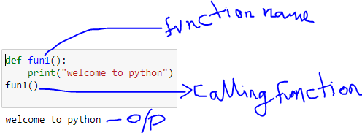
Python Functions
Calling function : after creating a function we can call it by using the name of the function followed by parenthesis containing parameters of that particular function

Slide 4
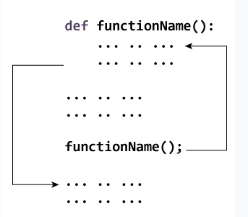
Python Functions
How a function gets executed?

Slide 5
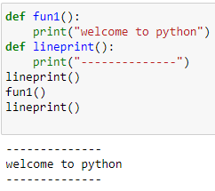
Python Functions

Slide 6
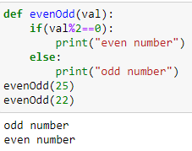
Python Functions
Arguments of a function
Arguments are the values passed inside the parentheses of the function. A function can have any number of arguments separated by commas.
Example : the following function checks whether the passed value is even or odd

Slide 7
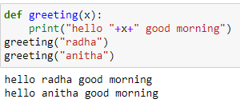
Python Functions
Arguments of a function

Slide 8
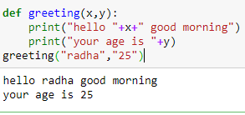
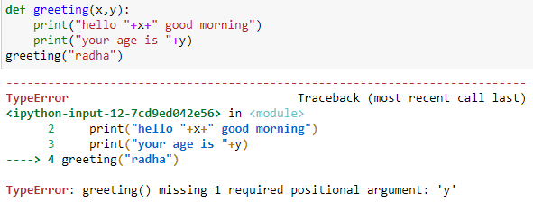
Python Functions
Calling with multiple arguments.
Must call with the correct number of arguments.

Slide 9
Python Functions-arguments type
Information can be passed to functions through arguments or parameters. When we call a function with some values, these values get assigned to the arguments according to their position
Types of Arguments - python supports various types of arguments that can be passed at the time of the function call
Default arguments
Keyword arguments
Variable-length arguments

Slide 10
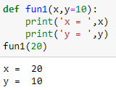
Python Functions
Default arguments
A default argument is a parameter that assumes a default value if a value is not provided in the function call for that argument.
All the arguments to the right of default argument must also be default argument.
Default argument can not be placed in the middle.

Slide 11
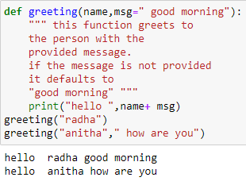
Python Functions
Default arguments
Non-default arguments cannot follow default arguments.
Ex def greeting(msg=" good morning",name):
It displays error as

Slide 12
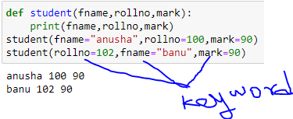
Python Functions
Keyword arguments
The idea is to allow the caller to specify the argument name with values so that caller does not need to remember the order of parameters.

Slide 13
Python Functions
Arbitrary number of arguments : if we don’t know how many arguments we will pass to functions then we can select the following:
Variable-length arguments
In python, we can pass a variable number of arguments to a function using special symbols.
*args (Non-keyword arguments)
**kwargs (keyword arguments)

Slide 14
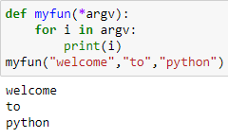
Python Functions
Variable-length non-keywords arguments

Slide 15
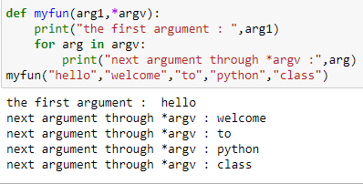
Python Functions
Variable-length non-keywords arguments

Slide 16
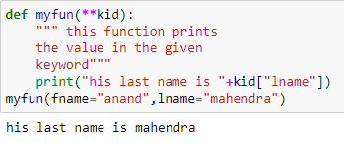
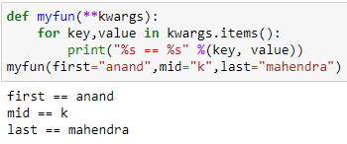
Python Functions
If you do not know how many keyword arguments that will be passed into your function, add two asterisk: ** before the parameter name in the function definition.
This way the function will receive a dictionary of arguments, and can access the items accordingly:

Slide 17
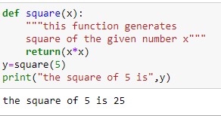
Python Functions- doc string
Doc string
The first string after the function is called the Document string or Docstring in short. This is used to describe the functionality of the function. The use of docstring in functions is optional but it is considered a good practice.We generally use triple quotes so that docstring can extend up to multiple lines.
The below syntax can be used to print out the docstring of a function:
Syntax: print(function_name.__doc__)

Slide 18
Python Functions- doc string
Doc string

Slide 19
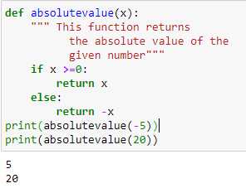
Python Functions-return statement
return statement
It is used to exit a function and go back to the place from where it was called with a value. When the return statement is not present, then it returns nothing to the calling program.

Slide 20
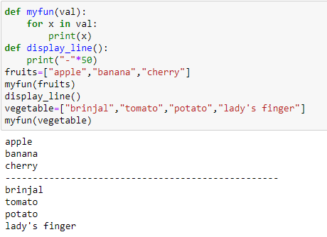
Python Functions
List as argument to function
Any data type can be passed as argument to a function (string, number,list,dictionary etc)

Slide 21
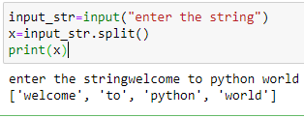
split () function
Split a string into a list where each word is a list item:
Default separator is any whitespace.
Syntax :
string.split(separator, maxsplit )

Slide 22
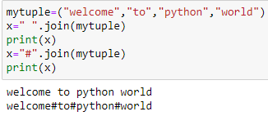
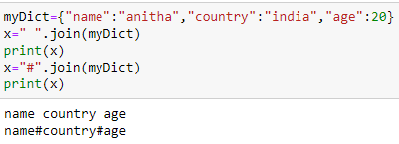
join () function
join() - join all items in a tuple,set, dictionary (iterable element) into a string
string.join(iterable)
join all items in a tuple into a string, using a hash character as separator

Slide 23
filter() function
filter() - filters the given sequence with the help of a function that tests each element in the sequence to be true or not
Syntax:
filter(function, sequence)
Return - an iterator

Slide 24
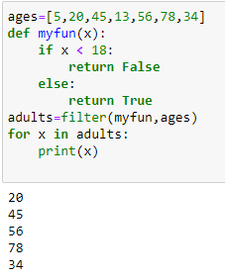
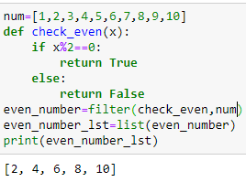
filter() function -example

Slide 25
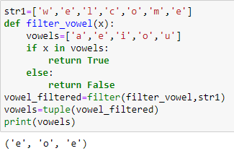
Filter () function

Slide 26
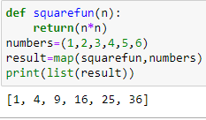
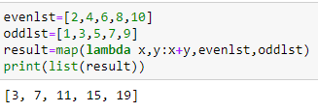
map() function
map() function returns a map object(which is an iterator) of the results after applying the given function to each item of a given iterable (list, tuple etc.)
Syntax: map(fun, iter)
Parameters:
Fun : it is a function to which map passess each element from given iterable
Iter : it is a iterable which is to be mapped.

Slide 27
map() function
map() function returns a map object(which is an iterator) of the results after applying the given function to each item of a given iterable (list, tuple etc.)
Syntax: map(fun, iter)
Parameters:
Fun : it is a function to which map passess each element from given iterable
Iter : it is a iterable which is to be mapped.

Slide 28
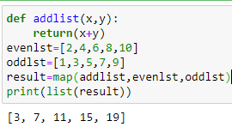
map() function
map() function returns a map object(which is an iterator) of the results after applying the given function to each item of a given iterable (list, tuple etc.)
Syntax: map(fun, iter)
Parameters:
Fun : it is a function to which map passess each element from given iterable
Iter : it is a iterable which is to be mapped.

Slide 29
https://realpython.com/python-map-function/
https://www.freecodecamp.org/news/python-map-explained-with-examples/

