Slide 1
Python - namespaces

Slide 2
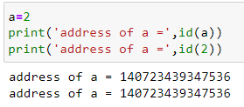
Python namespace
Name (also called identifier) is simply a name given to objects. Everything in Python is an object. Name is a way to access the underlying object.
For example when we write assignment
a=2
2 is an object stored in memory and a is the name we associated with it. We can get the address of it through the built-in function id(). In the below example we can see that object 2 and a refer to the same memory.

Slide 3
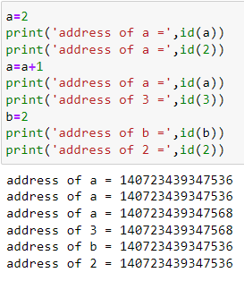
namespace

Slide 4
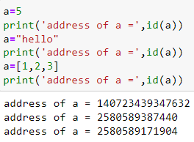
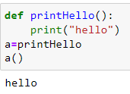
All these are valid and a will refer to three different types of objects in different instances. Functions are objects too, so a name can refer to them as well.
In the above program name ‘a’ refer to a function and we call call the function using this name

Slide 5
Namespace
A namespace is a collection of names of objects.
It is a mapping of every name defined in the program to corresponding objects
Different namespaces can co-exist at a given time but are completely isolated
A namespace containing all the built-in names is created when we start the Python interpreter and exists as long as the interpreter runs.
Each module creates its own global namespace.

Slide 6
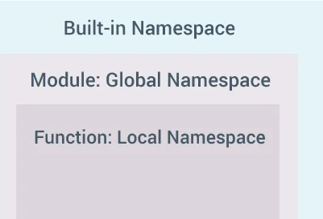
A diagram of different namespace in python

Slide 7
Python variable scope
A scope is the portion of a program from where a namespace can be accessed directly without any prefix.
At any given moment, there are at least three nested scopes.
Scope of the current function which has local names
Scope of the module which has global names
Outermost scope which has built-in names
When a reference is made inside a function, the name is searched in the local namespace, then in the global namespace and finally in the built-in namespace.
If there is a function inside another function, a new scope is nested inside the local scope.

Slide 8
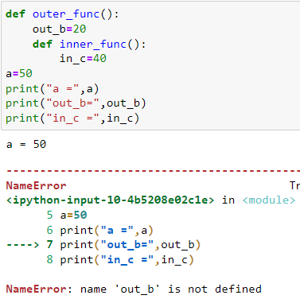

Slide 9
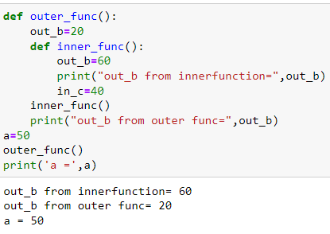

Slide 10
