Slide 1
Python - Modules

Slide 2
Modules - python
Modules refer to a file containing Python statements and definition
For example a file containing python code “test.py, “ is called a module, and its module name would be “test”
Modules are used to break down large programs into small manageable and organized files. They are reusable.

Slide 3
Modules - python
To create a module just save the code in a file with extension .py
Consider the following command in a file called “module1.py”
def welcome(name):
print("hello " +name)
Syntax to use the module is
module_name.function_name.
To use the above module use import statement as

Slide 4
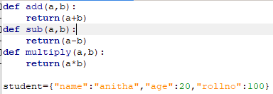
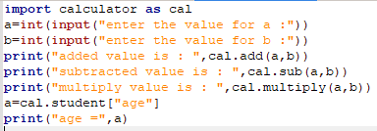
Renaming Modules
The module can be renamed using “as” keyword during import as:
calculator.py contains =
Moduleeg1.py =

Slide 5
output
enter the value for a :20
enter the value for b :15
added value is : 35
subtracted value is : 5
multiply value is : 300
age = 20
------------------
(program exited with code: 0)
Press any key to continue . . .

Slide 6
Built-in modules
There are several built-in modules in Python, which can be imported using “import” statement
Import math
Using alias or renaming a module
Import math as ma

Slide 7
Built-in modules
Python from … import statement
We can import specific names from a module without importing the module as a whole as follows:
from math import pi
print(“the value of pi is “,pi)
Import all names (definitions) from a module using the following construct
from math import *
print(“the value of pi is “,pi)

Slide 8
Python module search path
While importing a module, python first looks for build-in module, then looks into a list of directories defined by sys.path.the
Search order is:
The current directory
PYTHONPATH ( an environment variable with a list of directories)
The installation-dependent default directory.

Slide 9
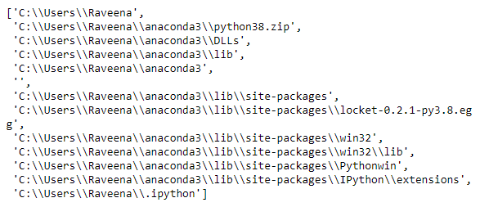
Python module search path
Output : we can add and modify this list to add our own path

Slide 10
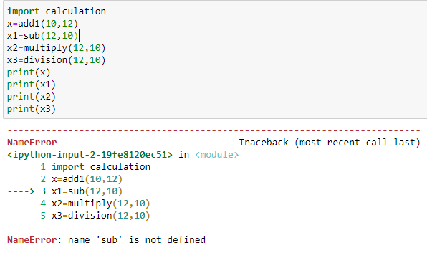
Reloading a module
Suppose if the module is changed during the course of development, we would have to reload it. Through two way you can achieve this
Restart the interpreter - which is not good
We can use reload() function inside the imp module to reload a module like this
If we don’t reload we get the error as

Slide 11
dir() function
dir() - is a built-in function
It returns a sorted list of strings containing the names defined by a module. The list contains the names of all the modules, variables and functions that are defined in a module.
The __name__ attribute contains the name of the module. You can see it as

