Slide 1
Python - Lambda

Slide 2
In Python, an anonymous function is a function that is defined without a name.
While normal functions are defined using the def keyword in Python, anonymous functions are defined using the lambda keyword.
Hence, anonymous functions are also called lambda functions.
Syntax
lambda arguments: expression
Lambda functions can have any number of arguments but only one expression. The expression is evaluated and returned. Lambda functions can be used wherever function objects are required.

Slide 3
In the above program, lambda x: x * 2 is the lambda function. Here x is the argument and x * 2 is the expression that gets evaluated and returned.
This function has no name. It returns a function object which is assigned to the identifier var1. We can now call it as a normal function. The statement in def function syntax is as follows:

Slide 4
Lambda function can take any number of arguments

Slide 5
Lambda function - with filter(), map()

Slide 6
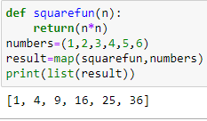
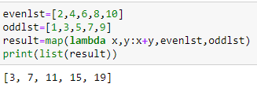
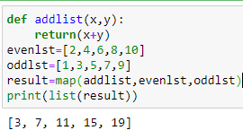
Lambda with map()
Without lamba with lambda

Slide 7
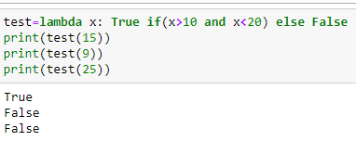
Using if else with lambda functions
Syntax
lambda <arguments> : <Return Value if condition is True> if <condition> else <Return Value if condition is False>

Slide 8
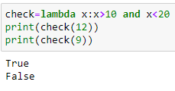
Creating conditional lambda function without if else
Well using ‘if’ ‘else’ keywords makes things easy to understand, but in lambda we can avoid using if & else keywords and still achieve same results.

Slide 9
https://www.freecodecamp.org/news/lambda-function-in-python-example-syntax/
https://www.geeksforgeeks.org/python-lambda-anonymous-functions-filter-map-reduce/
https://thispointer.com/python-how-to-use-if-else-elif-in-lambda-functions/

