Slide 1
Python - iterable and iterators

Slide 2
Python - iterable
Iterable is an object which can be looped over or iterated over with the help of a for loop.
Objects like lists, tuples, sets, dictionaries, strings, etc. are called iterables. In short and simpler terms, iterable is anything that you can loop over.
In simpler words, iterable is a container that has data or values and we perform an iteration over it to get elements one by one. (Can traverse through all the given values one by one)
Iterable has an in-built dunder method __iter__.

Slide 3
In Python, an iterator is an object which implements the iterator protocol, which means it consists of the methods such as __iter__() and __next__().
An iterator is an iterable object with a state so it remembers where it is during iteration
These iterators give or return the data one element at a time.
It performs the iteration to access the elements of the iterable one by one. As it maintains the internal state of elements, the iterator knows how to get the next value.

Slide 4
in-built methods of iterators
Iterator supports in-built dunder methods such as __iter__ and __next__
Iterators can only move forward using __next__. But remember that, iterators cannot go back or cannot be reset.
The __next__() method takes no arguments and always returns the next element of the stream.
If there are no more elements in the stream, __next__() must raise the StopIteration exception.
Iterators don’t have to be finite. It’s perfectly reasonable to write an iterator that produces an infinite stream of data.

Slide 5
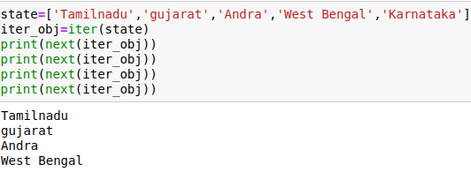
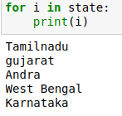

Slide 6
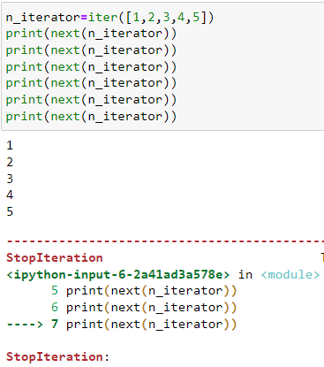

Slide 7
Data types that support iterators
Text sequence type - str
Sequences - list, tuple, range()
Mapping - dict
Set

Slide 8
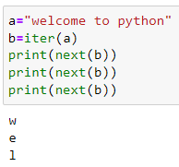
Text sequence type - str

Slide 9
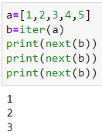
Converting list(iterable) into iterator object

Slide 10
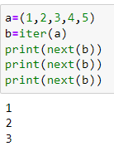
Converting tuple(iterable) into iterator object

Slide 11
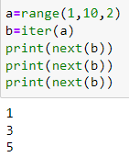
Converting range() into iterator object

Slide 12
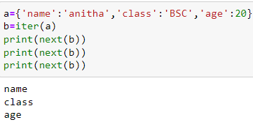
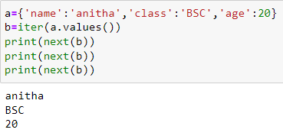
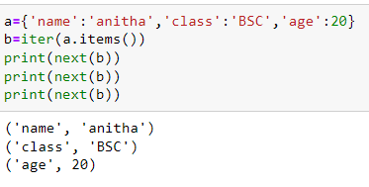
Mapping : Dictionary supports iterator
With keys with values - keyword - values()
With keyword items()

Slide 13
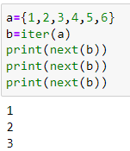
Sets - iterator
With sets

Slide 14
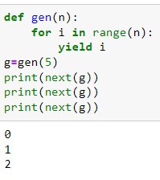
Generator
Generators are a special class of functions that return an iterator that returns a stream of values.
Any function containing a yield keyword is a generator function.

Slide 15
Build in functions that return an iterator
Map, zip, filter, enumerate
map() - returns an iterator that applies a function to every time of iterable, yielding the results
filter() - Returns an iterator from those elements of iterable for which function returns true. iterable may be either a sequence, a container that supports iteration, or an iterator.
zip() -Returns a zip object which is an iterator. It takes one element from each iterable and returns them in a tuple.
enumerate(iterable,start=0) - Return an enumerate object which is an iterator. Iterable must be a sequence, an iterator, or some other object that supports iteration.
Itertools module - this contains a number of commonly used iterators as well as functions for combining several iterators.
reversed()- this function is used to reverse the elements in the sequence (list, tuple,range()). It is also used to reverse the key elements in a dictionary. This returns an iterator object.

Slide 16
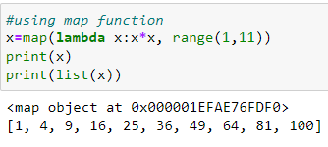
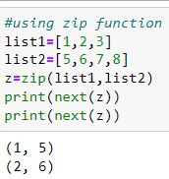
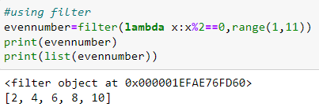
Using map function using zip function
Using Filter function

Slide 17
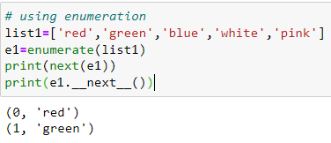
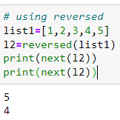
Enumerate
Reversed

Slide 18
Limits of iterator
We can only go forward in an iterator
We can’t make a copy of it
No way to get the previous element
We can’t reset the iterator

