Slide 1
Python -Array

Slide 2
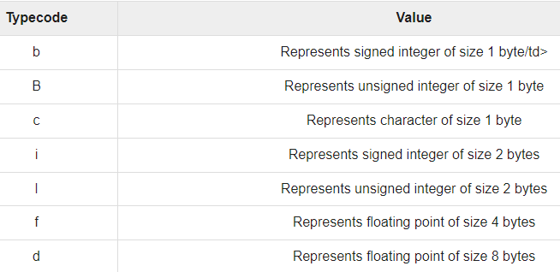
Arrays in python
https://www.programiz.com/python-programming/array

Slide 3
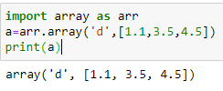
Arrays in python
Access array elements- using indexes

Slide 4
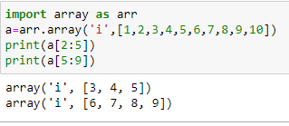
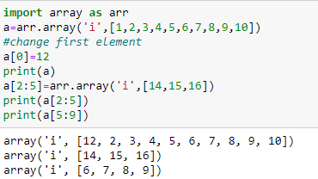
Arrays in Python
Slicing array elements Changing and adding elements to array

Slide 5
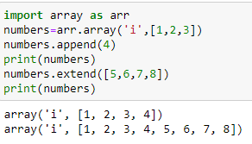
Adding elements to arrays..
append() - Adding of one item
extend()- adding several items

Slide 6
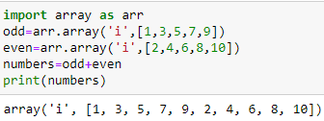
Concatenate two arrays
Two array elements can be concatenate into one using ‘+’

Slide 7
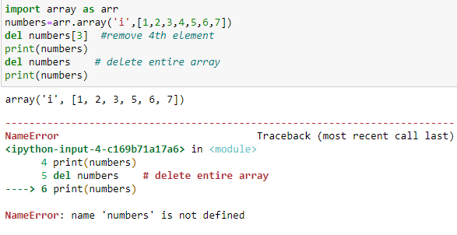
Removing elements from array
Elements can be removed from array using del statement

Slide 8
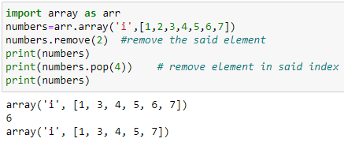
Remove element in array…
remove()- the said element is removed from array
pop(index) - the element in the given index will be removed

Slide 9
Features of Python
UNIT 1 | Lesson 1
Can be integrated with C , C++, java
Can be integrated with COM and CORBA components
Quick development of Application

