Slide 1
Python - access specifiers

Slide 2
Access specifiers
These are used to limit the access of variables and functions of a class. Access modifiers play an important role to protect the data from unauthorized access as well as protecting it from getting manipulated.When inheritance is implemented there is a huge risk for the data to get destroyed(manipulated) due to transfer of unwanted data from the parent class to the child class. Therefore, it is very important to provide the right access modifiers for different data members and member functions depending upon the requirements.
There are 3 types of access specifiers
Public :- by default variables declared inside class are public. They can be accessed outside through an object of the class
Private : these members are only accessible within the class. No outside access is permitted
Protected: these members are accessible from outside the class but only in a class derived from it that is in the child or subclass.

Slide 3
Public access
All the member variables of the class in the below code will be by default public, hence we can access them from anywhere

Slide 4
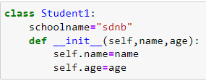
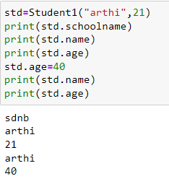
Public access
All the member variables of the class in the below code will be by default public, hence we can access them from anywhere. It can be modified.

Slide 5
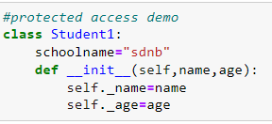
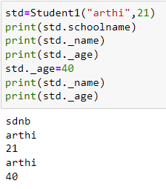
Protected access
A variable can be made protected by adding _(single underscore) as prefix to a variable. The protected variables can be accessed by its member functions of the same class. It can be accessed by its derived class.
In the code above we have made the class variables name and sal protected by adding an _(underscore) as a prefix, so now we can access them as follows:

Slide 6
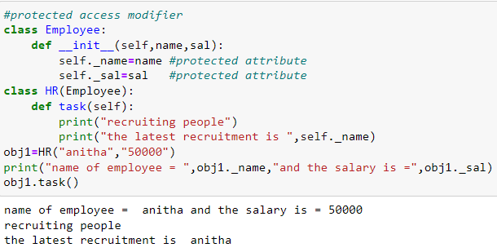
Protected access
A variable can be made protected by adding _(single underscore) as prefix to a variable. The protected variables can be accessed by its member functions of the same class. It can be accessed by its derived class.
In the code above we have made the class variables name and sal protected by adding an _(underscore) as a prefix, so now we can access them as follows:

Slide 7
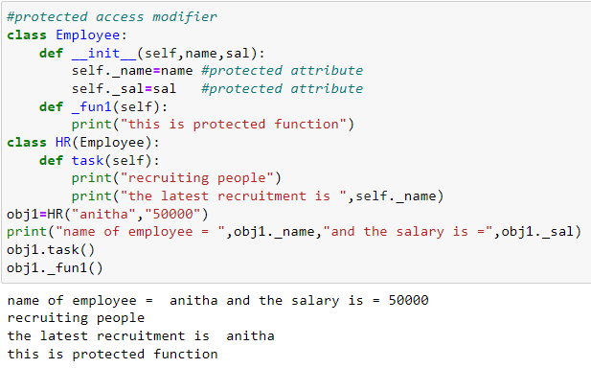
Protected member functions

Slide 8
Private access modifier
To make a variable private add __(double underscore) to a member variable.
They are accessible only inside class. We cannot use private members outside of class.
Private members cannot be inherited to other classes.

Slide 9
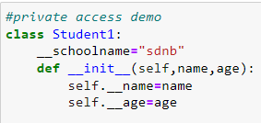
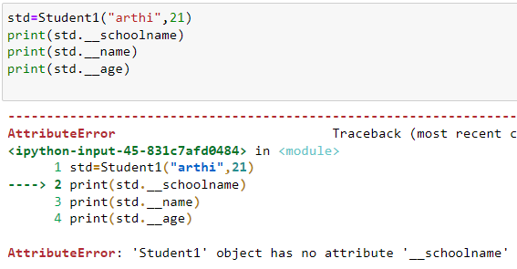
Private member access

Slide 10
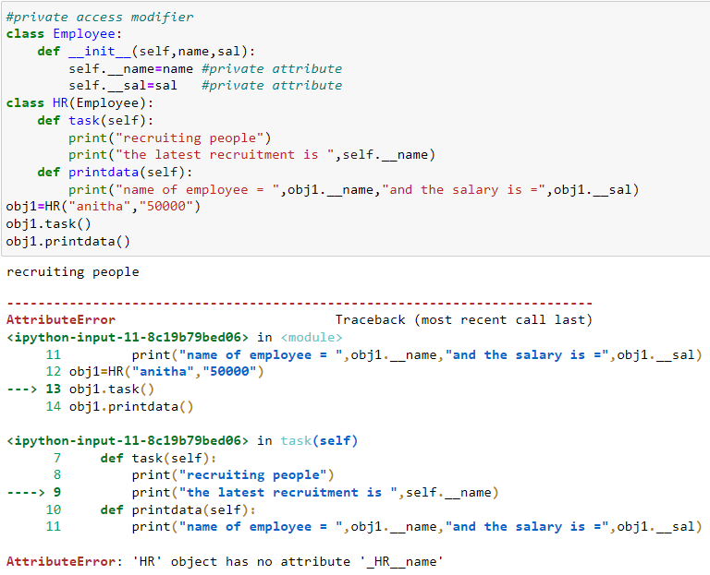
Private access modifier
To make a variable private add __(double underscore) to a member variable.

Slide 11
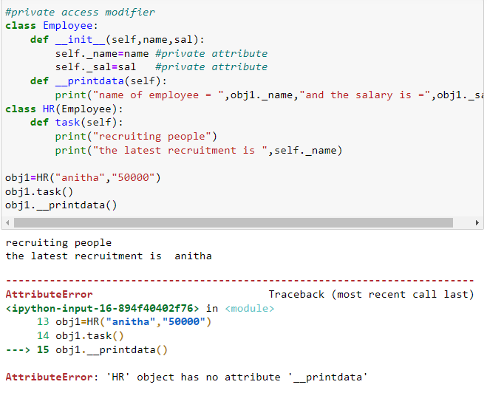
Private access member functions

Slide 12
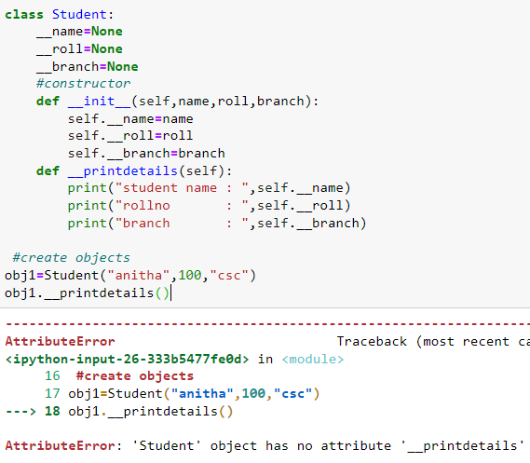
Private member functions

Slide 13
Accessing private member functions
The members of a class that are declared private are accessible only within class. In order to access them from main program, we can declare a public member function within class, and inside that we can access private member function. Then from the main program after creating an instance of the class, we can call public function which inturn call private function.

Slide 14
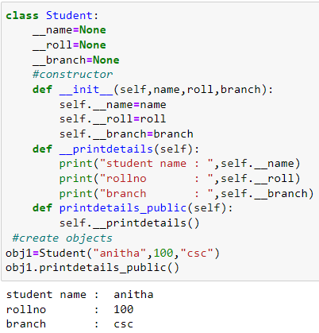
Accessing private member function

Slide 15
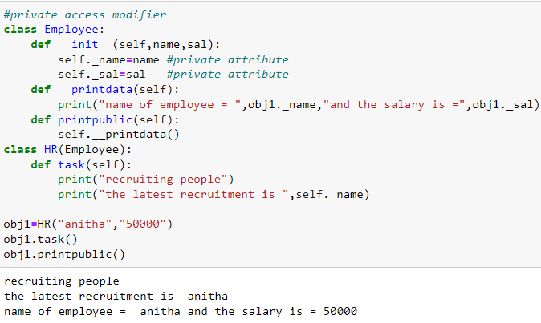

Slide 17
https://www.studytonight.com/python/access-modifier-python
https://www.geeksforgeeks.org/method-overriding-in-python/
https://www.geeksforgeeks.org/encapsulation-in-python/

