Slide 1
Python - Abstract classes

Slide 2
Abstract class
An abstract class is a class which contains one or more abstract methods. An abstract method is the one which is just defined but not implemented.
Types of methods in python
Implemented methods
Un-implemented methods
Implemented methods:
A method which has both method name and method body is called implemented method.
Un-implemented methods :
A method which has only method name, but no implementation (no method body) is said to be un-implemented or abstract method.

Slide 3
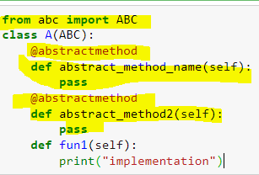
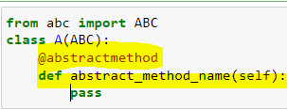
Python comes with a module that provides the base for defining Abstract Base classes(ABC) and that module name is ABC
To define an abstract class, you use the abc (abstract base class) module.
The abc module provides you with the infrastructure for defining abstract base classes.
To define an abstract method, you use the @abstractmethod decorator

Slide 4
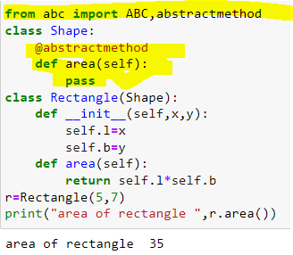
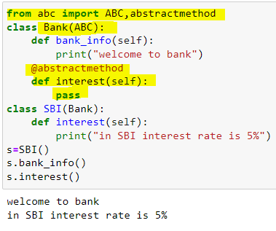
Note the abstract base class may have more than one abstract methods. The child class must implement all of them failing which TypeError will be raised.

Slide 5
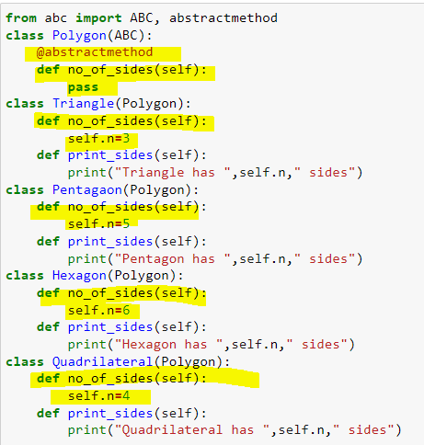
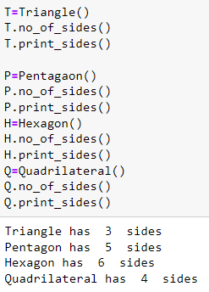

Slide 6
An Abstract class can contain the both method normal and abstract method.
An Abstract cannot be instantiated; we cannot create objects for the abstract class.

Slide 7
https://dotnettutorials.net/lesson/abstract-classes-in-python/

