Slide 1
Python Functions
Recursion

Slide 2
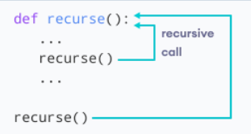
Python Recursion Functions
When a function calls itself, we call it as recursive function.
There are two properties that a recursive function must have:
Base criteria :- there must be at least one base criteria or condition, such that, when this condition is met the function stops calling itself recursively.
Progressive approach :- the recursive calls should progress in such a way that each time a recursive call is made it comes closer to the base criteria.

Slide 3
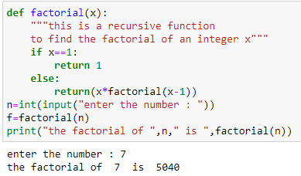
Python Recursion Functions
Base case
Progressive
case

Slide 4
Python Recursion Functions
factorial(7)
7 * factorial(6)
7 * 6 * factorial(5)
7 * 6 * 5 * factorial(4)
7 * 6 * 5 * 4 * factorial(3)
7 * 6 * 5 * 4 * 3 *factorial(2)
7 * 6 * 5 * 4 * 3 * 2 * factorial(1)
7 * 6 * 5 * 4 * 3 * 2 * 1
7 * 6 * 5 * 4 * 3 * 2
7 * 6 * 5 * 4 * 6
7 * 6 * 5 * 24
7 * 6 * 120
7 * 720
5040

Slide 5
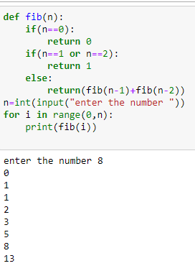
Fibonaci series

Slide 6
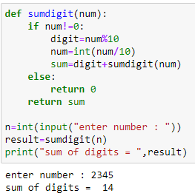
Sum of digits

