Slide 1
Max min Algorithm

Slide 2
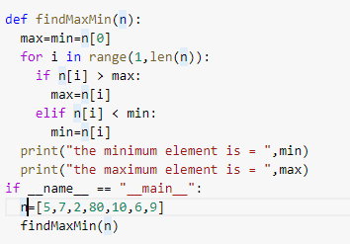
Max min Algorithm
finding the maximum and minimum value in a given array.

Slide 3
Complexity
At every step of the loop, we are doing 2 comparisons in the worst case. Total no. of comparisons (in worst case) = 2*(n-1) = 2n - 2
Time complexity = O(n), Space complexity = O(1)
https://afteracademy.com/blog/find-the-minimum-and-maximum-value
https://prepinsta.com/python-program/largest-element-in-an-array-using-recursion/

