Slide 1
Sorting

Slide 2
Divide and Conquer
divide-and-conquer, breaks a problem into subproblems that are similar to the original problem, recursively solves the subproblems, and finally combines the solutions to the subproblems to solve the original problem. Because divide-and-conquer solves subproblems recursively, each subproblem must be smaller than the original problem, and there must be a base case for subproblems. You should think of a divide-and-conquer algorithm as having three parts:
Divide the problem into a number of subproblems that are smaller instances of the same problem.
Conquer the subproblems by solving them recursively. If they are small enough, solve the subproblems as base cases.
Combine the solutions to the subproblems into the solution for the original problem.

Slide 3
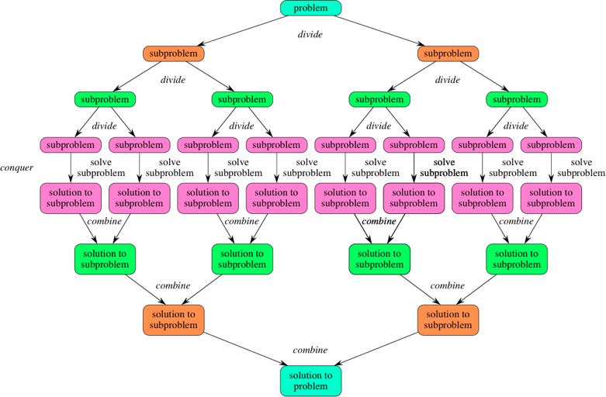

Slide 4
Divide and Conquer
Examples
Merge sort
quick sort
Binary search
selection sort

Slide 5
Merge sort
Conceptually, it works as follows:
Divide: Divide the unsorted list into two sublists of about half the size.
Conquer: Sort each of the two sublists recursively until we have list sizes of length 1, in which case the list items are returned.
Combine: Join the two sorted Sub lists back into one sorted list.
The Main purpose is to sort the unsorted list in nondecreasing order.
The Mergesort algorithm:
The Mergesort function repeatedly divides the array into two halves until we reach a stage where we try to perform mergesort on a subarray of size 1. After that the merge function is called and combines the sorted array into larger arrays until the whole array is merged.

Slide 6
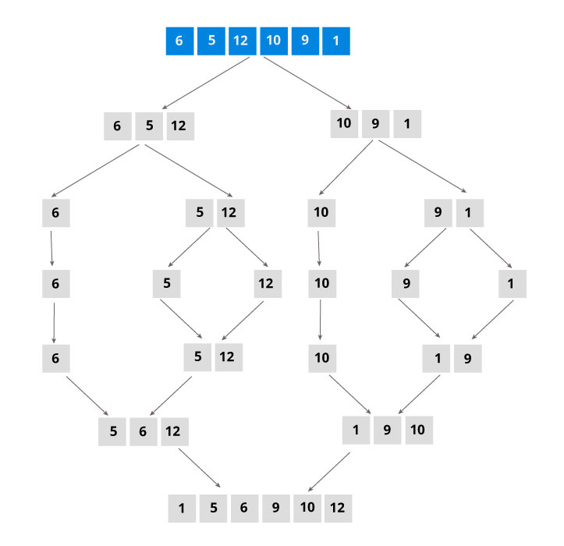
Alogorithm MergeSort(low,high)
//a[low : high] is a global array to be sorted.
{
if (low < high) then //if there are more than one element
{
//divide P into subproblems
// Find where to split the set
mid=[(low+high]/2];
//solve the sub problem
MergeSort(low,mid);
MergeSort(mid+1,high);
//combine the solutions
Merge(low,mid,high);
}
}
mid=(1+6)/2=7/2=3
mergesort(1,3), mergesort(4,6)
mid=(1+3)/2=4/2=2
mergesort(1,2), mergesort(3,3)
mid =(4+6)/2=10/2=5
mergesort(4,5), mergesort(6,6)

Slide 7
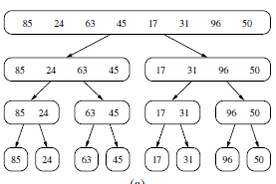
Sorting
sorting is an algorithm that arranges the elements of a list in a certain order either ascending of descending
Merge sort
we can visualize the execution of merge-sort algorithm by means of a binary tree T, called the merge-sort tree.

Slide 8
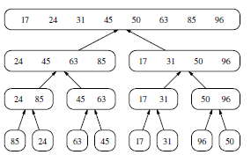
Merge Sorting

Slide 9
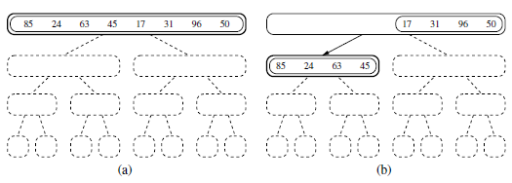
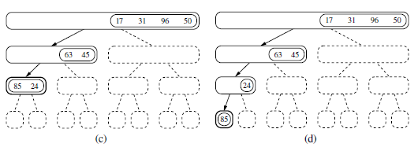

Slide 10
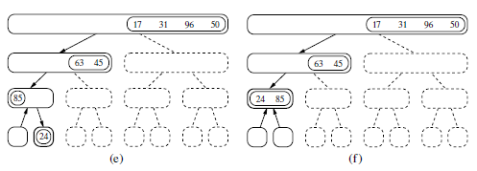
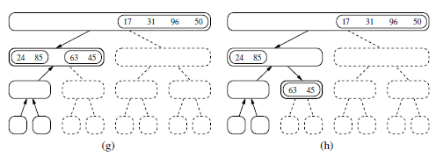

Slide 11
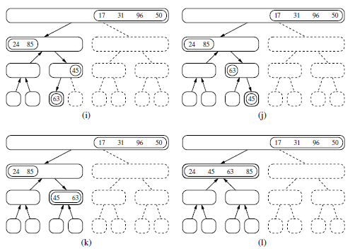

Slide 12
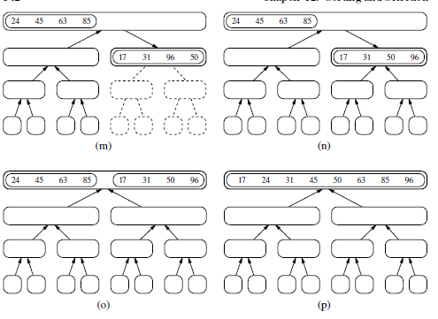

Slide 13
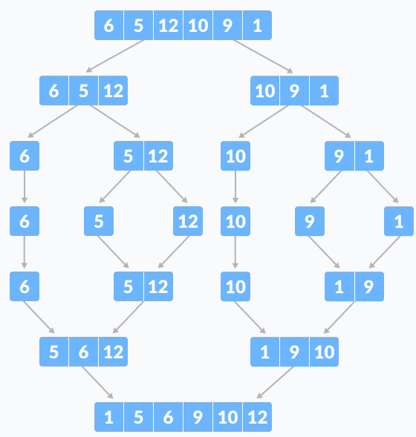

Slide 14
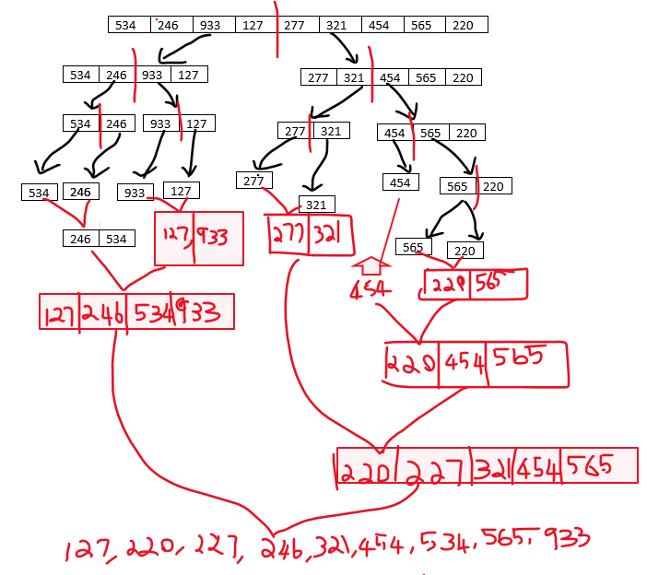

Slide 15
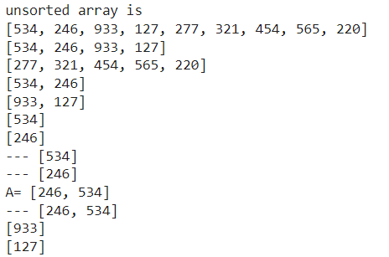
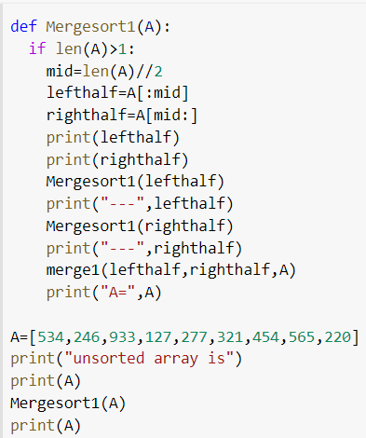
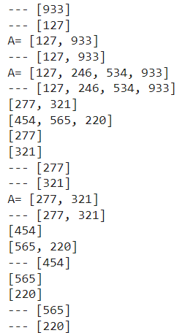
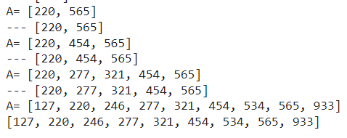

Slide 16
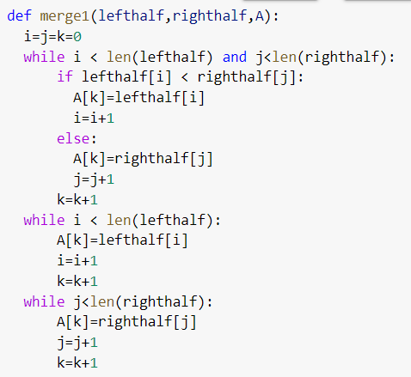

Slide 17
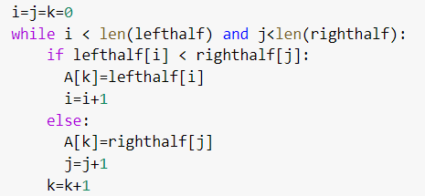
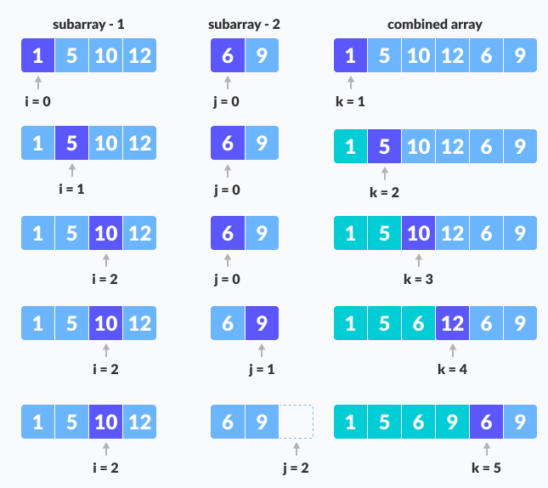

Slide 18
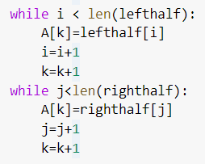
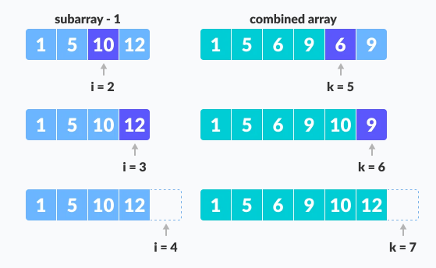
When we run out of elements in either lefthalf or righthalf, pick up the remaining elements and put in A[p..r]

Slide 19
Merge Sort Complexity
Time complexity
Best | O(n * log n)
worst | O(n * log n)
Average | O(n * log n)
Space complexity = O(n)

Slide 20
example 2: consider an array of 10 elements as:
a[1:10]=(310, 285, 179, 652, 351, 423, 861, 254, 450, 520)
algorithm MergeSort begins by splitting a[] into two subarrays each of size 5 as
a[1:5] and a[6:10]. =[310,285,179,652,351] & [ 423, 861, 254, 450, 520]
a[1:5] splits into a[1:3] and a[4:5] = [ 310,285,179] & [ 652,351 ]
a[1:3] is again splitted into a[1:2] and a[3:3] = [310,285] & [179]
a[1:2] is further divided into a[1:1] and a[2:2] = [310] & [285]

Slide 21
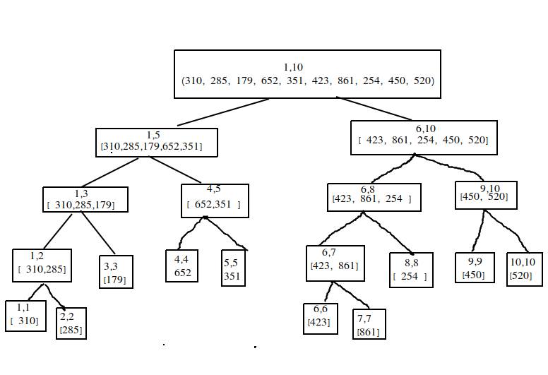
a[1:10]=(310, 285, 179, 652, 351, 423, 861, 254, 450, 520)
Tree of calls by Mergesort algorithm

Slide 22
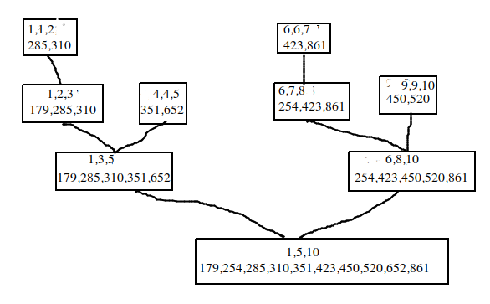
Tree calls of Merge algorithm

Slide 23
Merge sort Complexity
Complexity | Best case | Average Case | Worst Case
Time Complexity | O(n log n) | O(n log n) | O(n log n)
Space Complexity |  |  | O(n)
Time Complexity:
The list of size N is divided into a max of log N parts, and the merging of all sublists into a single list takes O(N) time, the worst case run time of this algorithm is O(NLogN)

Slide 24
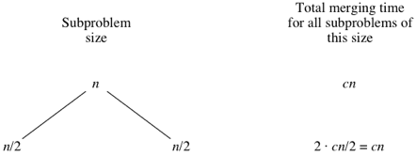
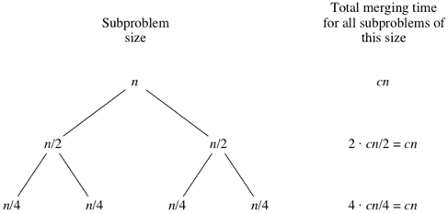
Complexity
The divide step takes constant time, regardless of the subarray size. After all, the divide step just computes the midpoint mid of the indices low and high. Recall that in big-Θ notation, we indicate constant time by Θ(1).
The conquer step, where we recursively sort two subarrays of approximately n/2 elements each, takes some amount of time, but we'll account for that time when we consider the subproblems.
The combine step merges a total of n elements, taking Θ(n) time.
let's consider that the divide and combine steps together take cn time for some constant c.

Slide 25
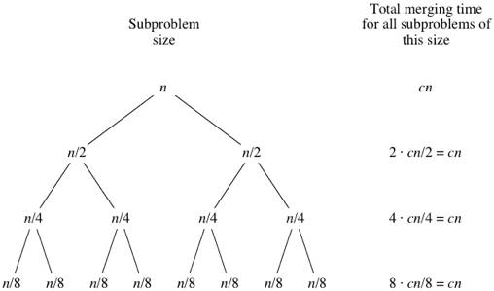
What do you think would happen for the subproblems of size n/8? There will be eight of them, and the merging time for each will be cn/8, for a total merging time of 8⋅cn/8=cn:
As the subproblems get smaller, the number of subproblems doubles at each "level" of the recursion, but the merging time halves. The doubling and halving cancel each other out, and so the total merging time is cn at each level of recursion. Eventually, we get down to subproblems of size 1: the base case.

Slide 26
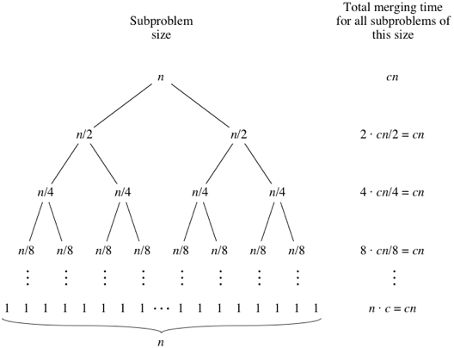
Time complexity = cn(log₂n+1).
When we use big-Θ notation to describe this running time, we can discard the low-order term (+1) and the constant coefficient (c), giving us a running time of Θ(nlog₂n).

Slide 27
Quick Sort Algorithm
Quick sort is an example for divide-and-conquer algorithmic technique. It is also called partition exchange sort.
Divide : The array A[low.. high] is partitioned into two non-empty sub arrays A[low..q] and A[q+1 .. high], such that each element of A[loww .. high] is less than or equal to each element of A[q+1 .. high].
The index q is computed as part of this partitioning procedure.
Conquer : The two sub arrays A[low..q] and A[q+1 .. high] are sorted by recursive calls to Quick sort.

Slide 28
Quick Sort Algorithm
Algorithm
The recursive algorithm consists of four steps:
l) If there are one or no elements in the array to be sorted, return.
2) Pick an element in the array to serve as the "pivot" point. (Usually the left-most element in the array is used.)
3) Split the array into two parts - one with elements larger than the pivot and the other with elements smaller than the pivot.
4) Recursively repeat the algorithm for both halves of the original array.

Slide 29
Quick Sort Algorithm
step 1: Select the Pivot element : in this case we select rightmost element of the array as the pivot element
step 2 :Rearrange the Array: elements of the array are rearranged so that elements that are smaller than the pivot are put on the left and the elements greater than the pivot are put on the right.

Slide 30
steps of rearranging the array is given:
A pointer is fixed at the pivot element. the pivot element is compared with the elements beginning from the first index
if the element is greater than the pivot element, a second pointer is set for that element.

Slide 31
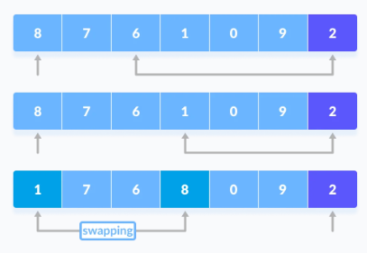
steps of rearranging the array is given:
3. Now, pivot is compared with other elements. If an element smaller than the pivot element is reached, the smaller element is swapped with the greater element found earlier.

Slide 32
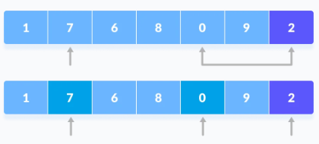
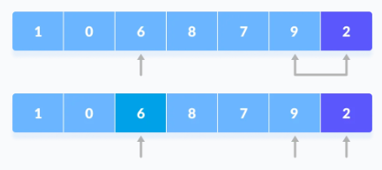
steps of rearranging the array is given:
4. Again, the process is repeated to set the next greater element as the second pointer. And, swap it with another smaller element.
5. The process goes on until the second last element is reached.
.

Slide 33
steps of rearranging the array is given:
6. Finally, the pivot element is swapped with the second pointer.
.

Slide 34
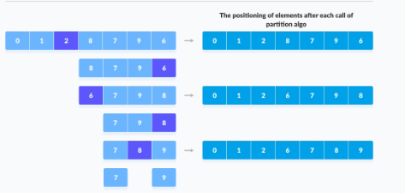
steps of rearranging the array is given:
step 3 : Divide subarrays.
Pivot elements are again chosen for the left and right sub-parts separately. And step 2 is repeated
.

Slide 35
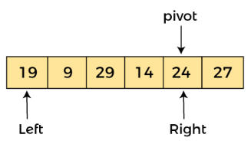
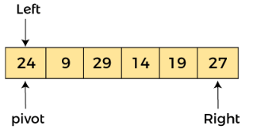
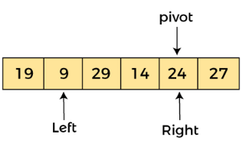
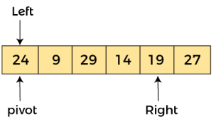
Example :
.

Slide 36
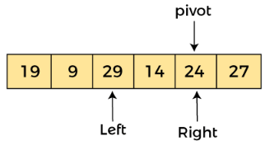
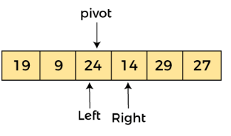
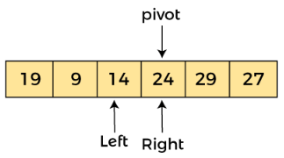
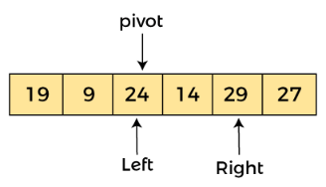
Example :
.

Slide 37
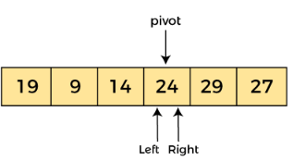
Example :
.

Slide 38
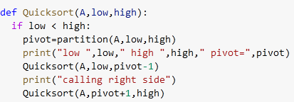
Quick sort algorithm

Slide 39
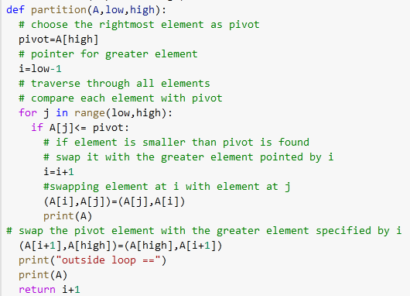
Quick sort algorithm

Slide 40
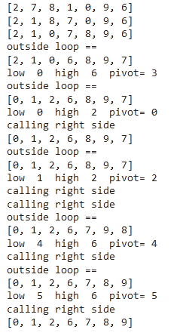
Quick sort algorithm

Slide 41
Quick Sort Complexity
Time complexity
Best [big omega] | O(n * log n) | It occurs when the pivot element is always the middle element or near to the middle element.
worst [ big O] | O(n²) | occurs when the pivot element picked is either the greatest of the smallest element. This condition leads to the case in which the pivot element lies in an extreme end of the sorted array. One sub-array is always empty and another sub-array contains n - 1 elements. Thus, quicksort is called only on this sub-array. However, the quicksort algorithm has better performance for scattered pivots.
Average | O(n * log n) | It occurs when the above conditions do not occur.
Space complexity = O(log n)

Slide 42
Analysis of quick sort
The pivot chosen by the partition function is always either the smallest or the largest element in the n-element subarray. Then one of the partitions will contain no elements and the other partition will contain n−1 elements—all but the pivot. So the recursive calls will be on subarrays of sizes 0 and n−1. As in merge sort, the time for a given recursive call on an n-element subarray is Θ(n). In merge sort, that was the time for merging, but in quicksort it's the time for partitioning.

Slide 43
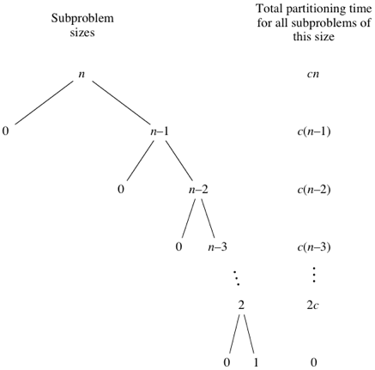
worst case running time of quick sort
n big-Θ notation, quicksort's worst-case running time is Θ(n²)

Slide 44
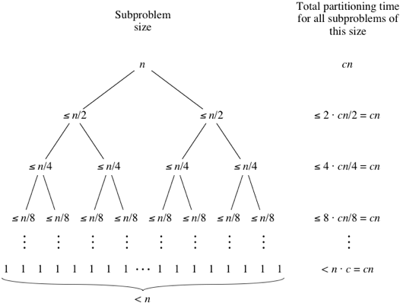
Best case running time of quick sort
Quicksort's best case occurs when the partitions are as evenly balanced as possible:
their sizes either are equal or are within 1 of each other.
The former case occurs if the subarray has an odd number of elements and the pivot is right in the middle after partitioning, and each partition has (n−1)/2 elements. The latter case occurs if the subarray has an even number n of elements and one partition has n/2 elements with the other having n/2−1. In either of these cases, each partition has at most n/2 elements.
n big-Θ notation, quicksort's worst-case running time is Θ(nlog_{2​}n)

Slide 45
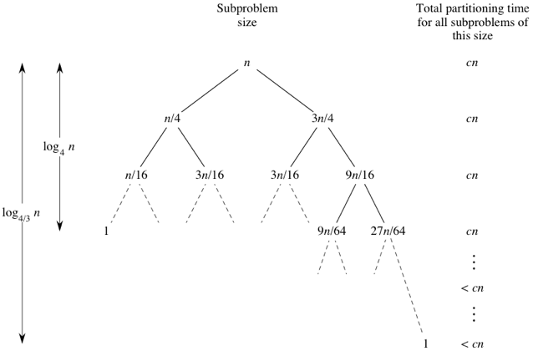
Average case running time of quick sort
First, let's imagine that we don't always get evenly balanced partitions, but that we always get at worst a 3-to-1 split. That is, imagine that each time we partition, one side gets 3n/4 elements and the other side gets n/4.
n big-Θ notation, quicksort's worst-case running time is Θ(nlog_{2​}n)

Slide 46
Selection Sort
Selection sort is a sorting algorithm that selects the smallest element from an unsorted list in each iteration and places that element at the beginning of the unsorted list.
This sorting algorithm is an in-place comparison-based algorithm in which the list is divided into two parts, the sorted part at the left end and the unsorted part at the right end. Initially, the sorted part is empty and the unsorted part is the entire list.
consider the following example:
the array is scanned for smallest element, and it is swapped with the first position as follows: in this 10 is found to be smallest, so it is swapped with the first element,
the array is scanned for next smallest element, in this 14 is found to be next smallest, so it is swapped with the second element, and so on

Slide 47
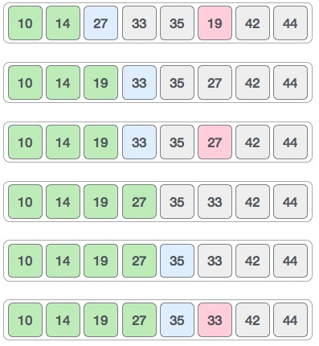
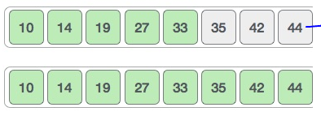
Selection Sort
The array is scanned for next smallest element, in this 19 is found to be smallest, so it is swapped with the third element, and so on

Slide 48
Selection Sort
Algorithm
Step 1 − Set MIN to location 0
Step 2 − Search the minimum element in the list
Step 3 − Swap with value at location MIN
Step 4 − Increment MIN to point to next element
Step 5 − Repeat until list is sorted

Slide 49
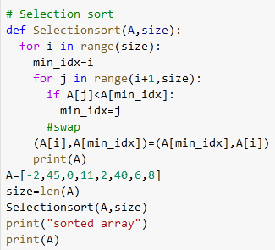
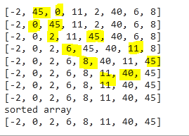
Selection sort algorithm

Slide 50
example for selection sort
310 | 285 | 179 | 652 | 351 | 423 | 861 | 254 | 450 | 520
set the first element as minimum
310 | 285 | 179 | 652 | 351 | 423 | 861 | 254 | 450 | 520
2. Compare minimum with the second element. If the second element is smaller than minimum, assign second element as minimum.
Compare minimum with the third element. Again, if the third element is smaller, then assign minimum to the third element otherwise do nothing. The process goes on until the last element.
310 | 285 | 179 | 652 | 351 | 423 | 861 | 254 | 450 | 520
minimum=310 , since second element 285 is lesser it becomes minimum now

Slide 51
310 | 285 | 179 | 652 | 351 | 423 | 861 | 254 | 450 | 520
Now since 179 is smaller than 285 , it becomes minimum now
310 | 285 | 179 | 652 | 351 | 423 | 861 | 254 | 450 | 520
652 is greater, so 179 remains minimum and so on
310 | 285 | 179 | 652 | 351 | 423 | 861 | 254 | 450 | 520
310 | 285 | 179 | 652 | 351 | 423 | 861 | 254 | 450 | 520

Slide 52
310 | 285 | 179 | 652 | 351 | 423 | 861 | 254 | 450 | 520
310 | 285 | 179 | 652 | 351 | 423 | 861 | 254 | 450 | 520
310 | 285 | 179 | 652 | 351 | 423 | 861 | 254 | 450 | 520
310 | 285 | 179 | 652 | 351 | 423 | 861 | 254 | 450 | 520
179 | 285 | 310 | 652 | 351 | 423 | 861 | 254 | 450 | 520
Till the minimum=175 only. Now it is swapped with first element as

Slide 53
179 | 285 | 310 | 652 | 351 | 423 | 861 | 254 | 450 | 520
in this second element 285 is taken as minimum and it is compared with other values in the next positions and if anything lesser than that value is found it is assigned as minimum and that value is swapped with second element.
MINIMUM= 285
minimum=254
179 | 285 | 310 | 652 | 351 | 423 | 861 | 254 | 450 | 520
179 | 285 | 310 | 652 | 351 | 423 | 861 | 254 | 450 | 520
179 | 285 | 310 | 652 | 351 | 423 | 861 | 254 | 450 | 520
179 | 285 | 310 | 652 | 351 | 423 | 861 | 254 | 450 | 520
179 | 285 | 310 | 652 | 351 | 423 | 861 | 254 | 450 | 520
179 | 285 | 310 | 652 | 351 | 423 | 861 | 254 | 450 | 520

Slide 54
179 | 285 | 310 | 652 | 351 | 423 | 861 | 254 | 450 | 520
179 | 254 | 310 | 652 | 351 | 423 | 861 | 285 | 450 | 520
179 | 254 | 310 | 652 | 351 | 423 | 861 | 285 | 450 | 520
179 | 254 | 310 | 652 | 351 | 423 | 861 | 285 | 450 | 520
179 | 254 | 310 | 652 | 351 | 423 | 861 | 285 | 450 | 520
179 | 254 | 285 | 652 | 351 | 423 | 861 | 310 | 450 | 520
179 | 254 | 310 | 652 | 351 | 423 | 861 | 285 | 450 | 520
Now minimum=285
now all the values are exhausted, and it is found that in this iteration minimum is 285. Now it is swapped with third element as:
179 | 254 | 310 | 652 | 351 | 423 | 861 | 285 | 450 | 520
179 | 254 | 310 | 652 | 351 | 423 | 861 | 285 | 450 | 520

Slide 55
179 | 254 | 285 | 652 | 351 | 423 | 861 | 310 | 450 | 520
179 | 254 | 285 | 310 | 351 | 423 | 450 | 520 | 652 | 861
179 | 254 | 285 | 652 | 351 | 423 | 861 | 310 | 450 | 520
179 | 254 | 285 | 652 | 351 | 423 | 861 | 310 | 450 | 520
179 | 254 | 285 | 652 | 351 | 423 | 861 | 310 | 450 | 520
179 | 254 | 285 | 652 | 351 | 423 | 861 | 310 | 450 | 520
Now minimum=310
now all the values are exhausted, and it is found that in this iteration minimum is 310. Now it is swapped with fourth element as:
179 | 254 | 285 | 652 | 351 | 423 | 861 | 310 | 450 | 520
179 | 254 | 285 | 310 | 351 | 423 | 861 | 652 | 450 | 520

Slide 56
Selection Sort complexity
Time Complexity
Best | O(n²)
Worst | O(n²)
Average | O(n²)
Space Complexity | O(1)
Cycle | Number of Comparison
1st | (n-1)
2nd | (n-2)
3rd | (n-3)
... | ...
last | 1

Slide 57
Selection Sort complexity
Number of comparisons: (n - 1) + (n - 2) + (n - 3) + ..... + 1 = n(n - 1) / 2 nearly equals to n².
Complexity = O(n²)
Also, we can analyze the complexity by simply observing the number of loops. There are 2 loops so the complexity is n*n = n².
Time Complexities:
Worst Case Complexity: O(n²) If we want to sort in ascending order and the array is in descending order then, the worst case occurs.
Best Case Complexity: O(n²) It occurs when the array is already sorted
Average Case Complexity: O(n²) It occurs when the elements of the array are in jumbled order (neither ascending nor descending).

Slide 58
https://www.enjoyalgorithms.com/blog/find-the-minimum-and-maximum-value-in-an-array

