Slide 1
Hash Tables

Slide 2
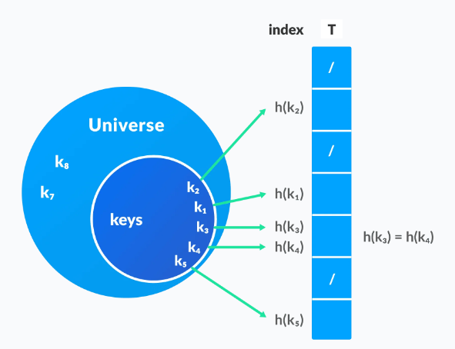
The Hash table data structure stores elements in key-value pairs where
Key- unique integer that is used for indexing the values
Value - data that are associated with keys.
Hashing function
in a hash table, a new index is processed using the keys. and , the element corresponding to that key is stored in the index. this process is called hashing

Slide 3
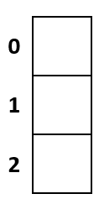
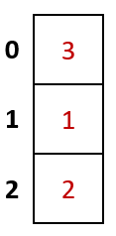
Example
The following is an example of a simple hash function
h(k) = k1 % m
Let’s assume that we have a list with a fixed size of 3 and the following values
[1,2,3]
h(1)= 1%3 = 1
h(2)=2%3 = 2
h(3)=3 % 3 =0

Slide 4
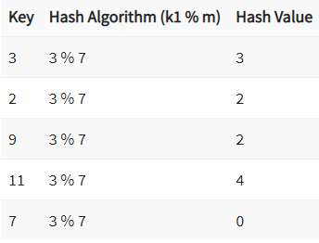
Suppose we have the following list of values
[3,2,9,11,7] Let’s assume that the size of the hash table is 7, and we will use the formula (k1 % m) where m is the size of the hash table.The following table shows the hash values that will be generated
The values 2 and 9 have the same hash value and we cannot store more than one value at each position. This problem is called collision and can be solved by chaining or probing

Slide 5
Chaining
Benefits of chained lists
The following are the benefits of chained lists:
Chained lists have better performance when inserting data because the order of insert is O(1).
It is not necessary to resize a hash table that uses a chained list.
It can easily accommodate a large number of values as long as free space is available.

Slide 6
Hash Collision
When the hash function generates the same index for multiple keys, there will be a conflict (what value to be stored in that index). This is called a hash collision.
We can resolve the hash collision using one of the following techniques.
Collision resolution by chaining
Open Addressing: Linear/Quadratic Probing and Double Hashing

Slide 7
Collision resolution by chaining
In chaining, if a hash function produces the same index for multiple elements, these elements are stored in the same index by using a doubly-linked list.
If j is the slot for multiple elements, it contains a pointer to the head of the list of elements. If no element is present, j contains NIL.

Slide 8
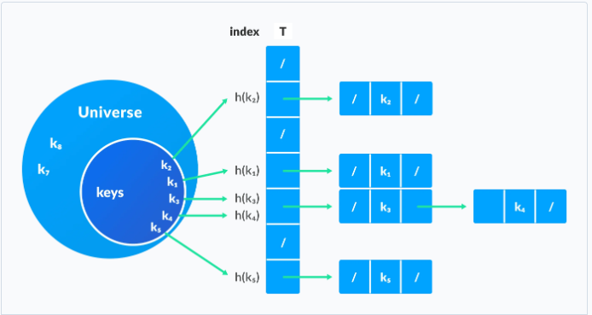
Collision resolution by chaining

Slide 9
Probing
The other technique that is used to resolve collision is probing. When using the probing method, if a collision occurs, we can simply move on and find an empty slot to store our value.
Methods of Probing:

Slide 10
Open Addressing
Unlike chaining, open addressing doesn't store multiple elements into the same slot. Here, each slot is either filled with a single key or left NIL.
Different techniques used in open addressing are:
i. Linear Probing
In linear probing, collision is resolved by checking the next slot.
rehash(key)=(n+1)%tablesize
h(k, i) = (h′(k) + i) mod m where
i = {0, 1, ….}
h'(k) is a new hash function
If a collision occurs at h(k, 0), then h(k, 1) is checked. In this way, the value of i is incremented linearly.
The problem with linear probing is that a cluster of adjacent slots is filled. When inserting a new element, the entire cluster must be traversed. This adds to the time required to perform operations on the hash table.

Slide 11
Quadratic Probing
It works similar to linear probing but the spacing between the slots is increased (greater than one) by using the following relation.
h(k, i) = (h′(k) + c1i + c2i2) mod m
where,
c1 and c2 are positive auxiliary constants,
i = {0, 1, ….}
rehash(key)= (n+k²)%tablesize (locations are checked with i+1²+i+2²+i+3²…

Slide 12
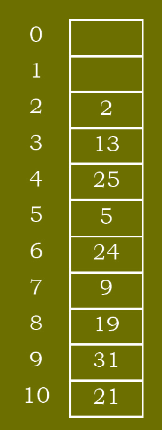
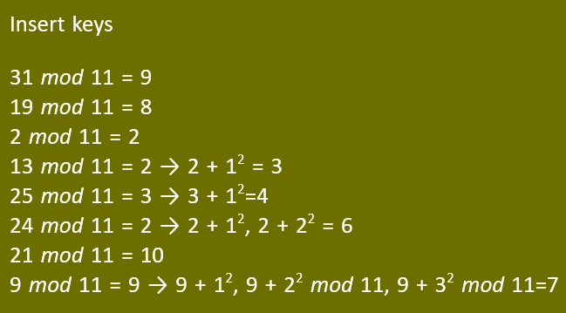
Quadratic Probing
Example : Let us assume that the table size is 11 (0 .. 10)
Hash function : h(key)= key mod 11

Slide 13
Double hashing
If a collision occurs after applying a hash function h(k), then another hash function is calculated for finding the next slot.
h(k, i) = (h1(k) + ih2(k)) mod m

Slide 14
0
1 | 79
2
3
4 | 69
5
7 | 98
8 | 72
9
10
11
12
insert the keys 79, 69, 98, 72, 14,50.
the size of table is = 13
Hash function is h₁(k)=k mod 13, and second hash function is h₂(k)=1+(k mod 11)
h₁(79)= 79 % 13 = 1
h₁(69) = 69 % 13 =4
h₁(98) = 98 % 13 = 7
h₁(72) = 72 % 13 = 7 [ now collision occurs, this to be solved using double hashing]
h_{new} = [h₁(72) + i* h₂(72) ] %13
= [ 7 + 1*(1+(72 % 11)) ] % 13
=[ 7 + 1*(1+6 )] % 13
= [7 + 7] % 13 = 14 % 13 = 1
Rehash again
h_{new} = [h₁(72) + i* h₂(72) ] %13
= [ 7 + 2*(1+(72 % 11)) ] % 13
=[ 7 + 2*(1+6 )] % 13
= [7 + 14] % 13 = 21 % 13 = 8

Slide 15
0
1 | 79
2
3
4 | 69
5 | 14
7 | 98
8 | 72
9
10
11 | 50
12
insert the keys 79, 69, 98, 72, 14,50.
the size of table is = 13
Hash function is h₁(k)=k mod 13, and second hash function is h₂(k)=1+(k mod 11)
h₁(14)= 14 % 13 = 1 [ now collision occurs, this to be solved using double hashing]
h_{new} = [h₁(14) + i* h₂(14) ] %13
= [ 1 + 1*(1+(14 % 11)) ] % 13
=[ 1 + 1*(1+3 )] % 13
= [1 + 4] % 13 = 5 % 13 = 5
h₁(50)= 50 % 13 = 11

Slide 16
complexity analysis of double hashing
Time complexity of Double Hashing
Each lookup in the hash-set costs O(1) constant time
In the worst case we might not find such a compliment and iterate through the entire array, this would cost us O(n) linear time.
Rest operations like subtraction are mere constant-time operations
hence total time complexity = O(n) time
Space Complexity of Double Hashing:
We need to maintain an extra hash-set of size upto n elements which costs us extra O(n) space.
Hence total space complexity = O(n) time.

Slide 17
Good Hash functions
A good hash function may not prevent the collisions completely however it can reduce the number of collisions.
Here, we will look into different methods to find a good hash function
Division Method
Multiplication Method
Universal Hashing

Slide 18
Division Method
If k is a key and m is the size of the hash table, the hash function h() is calculated as:
h(k) = k mod m
For example, If the size of a hash table is 10 and k = 112 then h(k) = 112 mod 10 = 2. The value of m must not be the powers of 2. This is because the powers of 2 in binary format are 10, 100, 1000, …. When we find k mod m, we will always get the lower order p-bits.

Slide 19
Multiplication Method
h(k) = ⌊m(kA mod 1)⌋
where,
kA mod 1 gives the fractional part kA,
⌊ ⌋ gives the floor value
A is any constant. The value of A lies between 0 and 1. But, an optimal choice will be ≈ (√5-1)/2 suggested by Knuth.

Slide 20
Hash table operations
Insertion – this Operation is used to add an element to the hash table
Searching – this Operation is used to search for elements in the hash table using the key
Deleting – this Operation is used to delete elements from the hash table

Slide 23
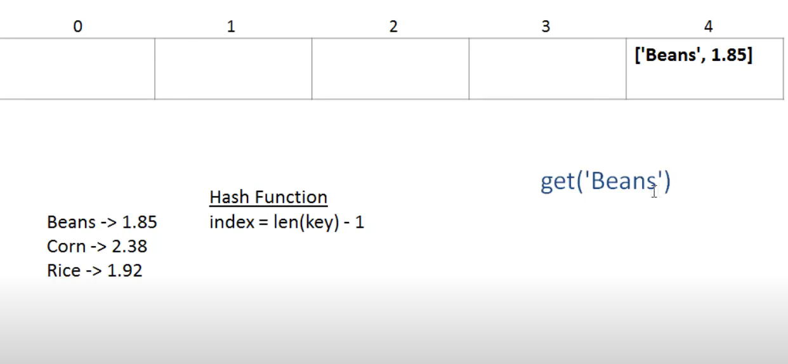

Slide 24
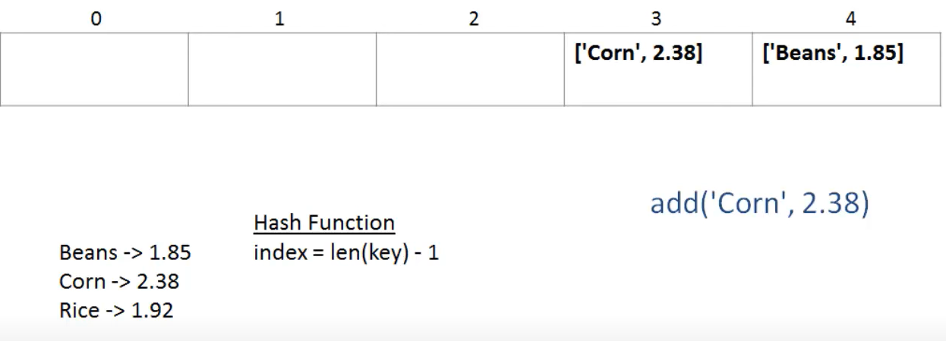

Slide 25
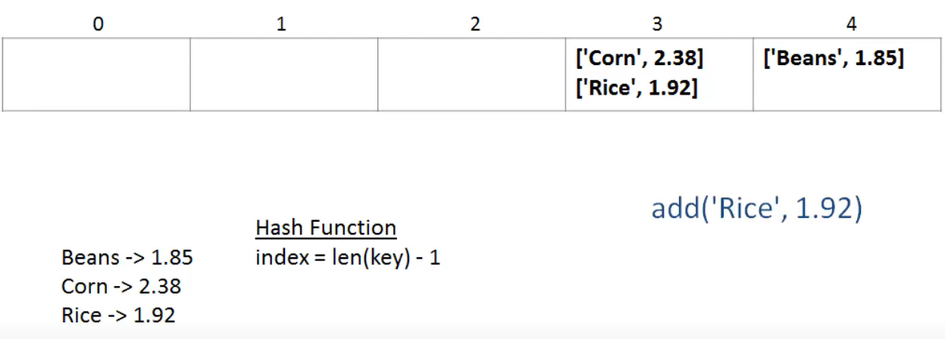

Slide 26
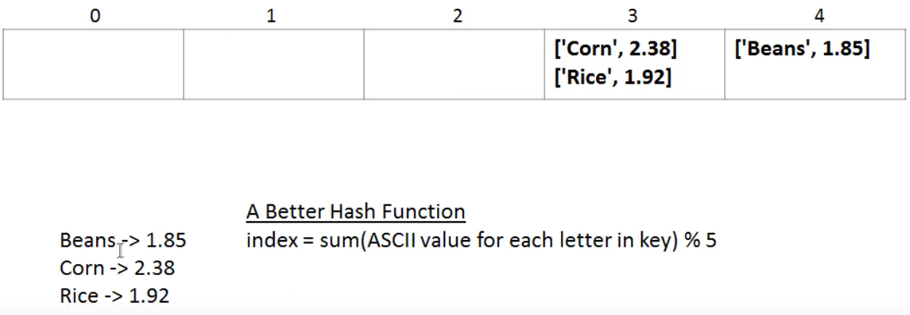
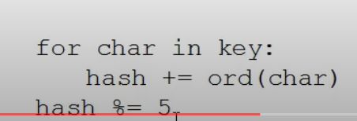

Slide 27
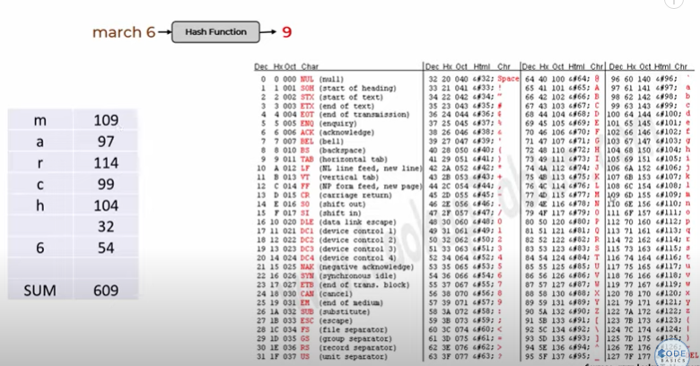

Slide 28
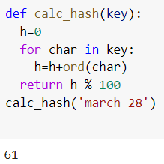

Slide 29
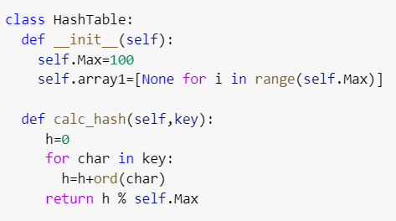
Hash function calculation

Slide 30
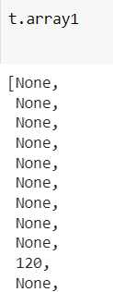
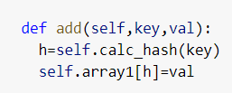
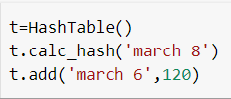
Add values in HashTable

Slide 31
Get the values from HashTable

Slide 32
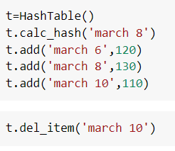
Delete an item from HashTable

Slide 33
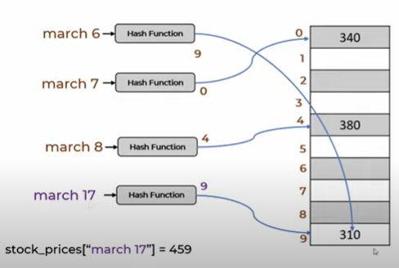
Collisions handling

Slide 34
Collisions handling

Slide 35
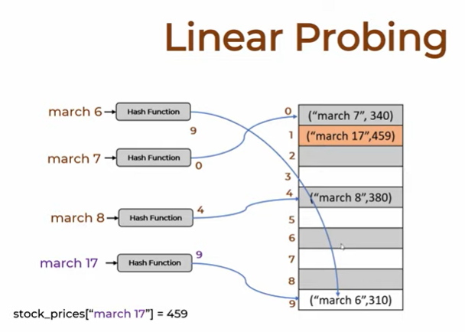
Collisions handling

Slide 36
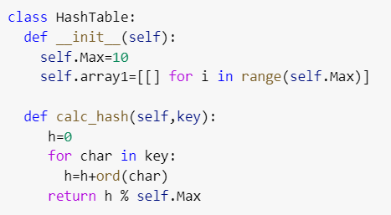
collision handling - chaining

Slide 37
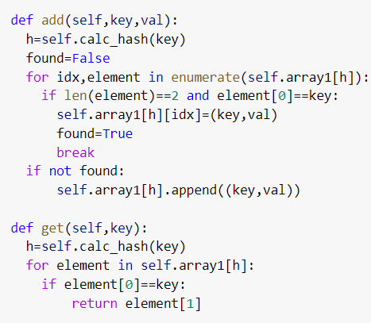
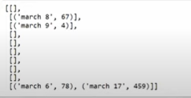
collision handling - chaining

Slide 38
collision handling - chaining

Slide 39
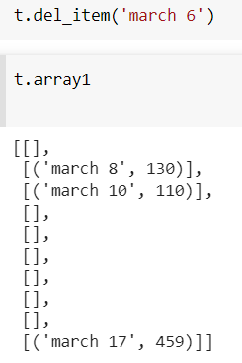
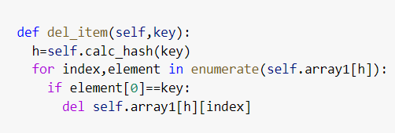
Deletion - collision handling

Slide 40
Applications of Hash Table
Hash tables are implemented where
constant time lookup and insertion is required
cryptographic applications
indexing data is required
https://github.com/codebasics/data-structures-algorithms-python/blob/master/data_structures/4_HashTable_2_Collisions/4_hash_table_exercise.md

Slide 41
Hash tables
https://www.programiz.com/dsa/hash-table
https://realpython.com/python-hash-table/
https://www.guru99.com/hash-table-data-structure.html
https://www.youtube.com/watch?v=9HFbhPscPU0
https://github.com/joeyajames/Python
https://www.youtube.com/watch?v=ea8BRGxGmlA

