Slide 1
Array creation

Slide 2
Array Structure
A one-dimensional array, is composed of multiple sequential elements stored in contiguous bytes of memory and allows for random access to the individual elements.
The entire contents of an array are identified by a single name.
Individual elements within the array can be accessed directly by specifying an integer subscript or index value, which indicates an offset from the start of the array. e.g

Slide 3
Low level arrays Vs Referential arrays
Python has 2 types of arrays
Low level arrays - data will be stored as bytes in regular memory blocks
referential arrays - concept of pointers are used
Low level arrays:
python internally represents each character as 2 bytes i.e 16 bits. consider word “Sample”
word “S” , has 2 indexes (2146 & 2147). this means one character is represented in 2 bytes. Total of 6 characters are stored as 12 bytes.

Slide 4
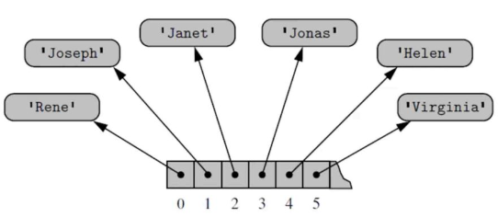
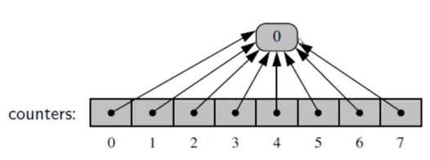
Low level arrays Vs Referential arrays
suppose we need to store 1000 employees with their employee IDs. The method of low level arrays become inefficient.
in this case we go for referential arrays as follows:
here each index is pointed to a specific object.
Python is intelligent enough to point duplicates to same index as follows:
When an array of size 8 and all the values are zeros , Python will reference it as above to save huge memory.

Slide 5
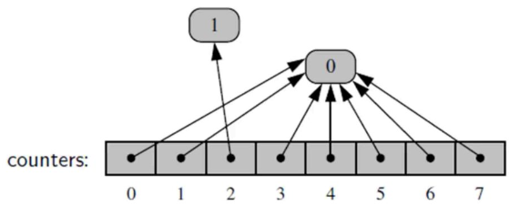
Low level arrays Vs Referential arrays
but what happened if any one portion of array is updated? Python manages this by creating A new referential object for the updated value only.

Slide 6
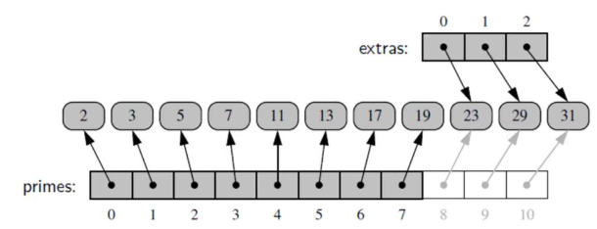
Low level arrays Vs Referential arrays
but what happened if array is extended? Python assigns a new index list when a list is extended. i.e it would have a primary link to new index slab and secondary link to existing index slab as shown above. This helps immensely when performing update or alter operations to happen efficiently. This process continues as and when an array is extended.

Slide 7
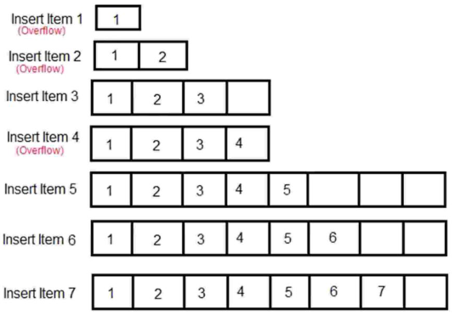
Dynamic arrays
we store huge amount of data using arrays and python has to consistently extend its memory allocation accordingly.Once a list or tuple memory overflows , the interpreter creates a new list or tuple of double size and copies everything to the newly created fresh array. The older array is discarded.

Slide 8
Array ADT
Array(size) : creates a one-dimensional array consisting of size elements with each element initially set to None. size must be greater than zero
length() : returns the length or number of elements in the array
getitem ( index ): Returns the value stored in the array at element position index. The index argument must be within the valid range. Accessed using the subscript operator.
setitem ( index, value ): Modies the contents of the array element at position index to contain value. The index must be within the valid range. Accessed using the subscript operator.
clearing( value ): Clears the array by setting every element to value.
iterator (): Creates and returns an iterator that can be used to traverse the elements of the array.

Slide 9
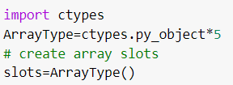
Creating a Hardware Array
the above statements creates an array named slots that contains five elements.
for the slots array, the legal range is [0..4]
a reference outside this like slots[6] will generate an error

Slide 10
Initialize the array & assign values to it
without initialization, if we try to access array, and exception will be raised. so our next step is to initialize array as follows:
data can be assigned to individual elements of array as follows: and the array looks like:

Slide 11
ADT for the dynamic array implementation
Python implements array from ctypes library. so the first step is to import it
import ctypes
then we create a class calle myArray() in which the following functions are defined
__init__ - a constructor
__len__ - function operator to return length of array
__getitem__ - returns array at a particular position
append(value) - add the value at end of array
_resize : inorder to add, it calls make_array() function to increase the size of array
make_array - actually code for increasing the size of array is given

Slide 12
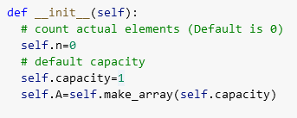
dynamic array implementation
constructor
lenth of array

Slide 13
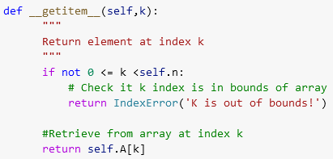
dynamic array implementation
get the item present in a particular index
When the subscript notation is used in a program, y = x[i], Python will call
the getitem method, passing the value of i to the index parameter.
in the above function, we pass index whose value we want to see.
inside the function, a check is done for out of index, and if it is then error message is given. else the value in the respective index is returned.

Slide 14
dynamic array implementation
add the item to the end of array
in the above function, we pass value to be added to our array.
it checks whether the array has reached its capacity, if so it calls resize function which doubles the size of the array, to make room for adding more elements
once the capacity of array is increased, the new value is added.

Slide 15
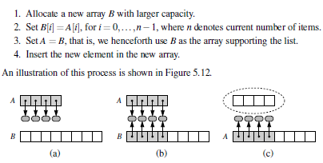
dynamic array implementation
The key is to provide means to grow the array A that stores the elements of a list. Of course, we cannot actually grow that array, as its capacity is fixed. If an element is appended to a list at a time when the underlying array is full, we perform the following steps:

Slide 16
dynamic array implementation
resize the capacity of array
in the above function, we pass original capacity of array and which in turn call another function called make_array() which physically increase space in memory for the array.

Slide 17
dynamic array implementation
increase the capacity of array

Slide 18
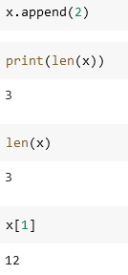
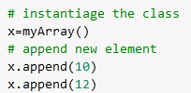
dynamic array implementation
execution of the array

Slide 19
map implementation
http://shirleyisnotageek.blogspot.com/2015/05/map-adt-using-python.html
https://medium.com/@bsurajbh/implementing-arrays-with-python-7586206f0b13
https://www.herevego.com/data-structures-1/
https://www.youtube.com/watch?v=VGehgCGrfds
https://www.herevego.com/hashing-python/

