Slide 1
Circular Linked List

Slide 2
Circular Linked List
A circular linked list is a type of linked list where first and last nodes are connected to each other to form a circle.
circularly singly linked list

Slide 3
Circular Linked List ADT
Function name | What it does
int isFull(); | Check whether dll is full or not.
int isEmpty(); | Check whether dll is empty or not
void insertbegin( qdata); | Insert a node at the begining
void insertend(qdata); | Insert a node at the end
void insertmiddle( qdata); | Insert a node in the middle , wherever needed
void deletionbegin( deldata); | delete the first node
void deletionend( deldata); | delete the last node
void deletionmiddle( deldata); | delete a node in the middle , wherever needed
int search( qdata); | Search for the given node
void traverse(); | Print forwardly the dll
int updatalist(olddata, newdata); | Update the particular node with the new data
void destroylist(); | Destroy the whole list

Slide 4
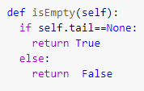
circular Linked List
create a class to store the information for a linked list is where the list starts (the head of the list). next, create another class to represent each node of the linked list

Slide 5
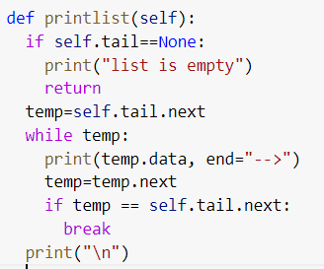
Traversing the list
Start with the head and access each node until you reach null. Do not change the head reference

Slide 6
Insertion in a circular Linked list
Insertion in a linked list can be done in three ways:
1) insertion at the beginning
2) insertion at the middle
3) insertion at the end

Slide 7
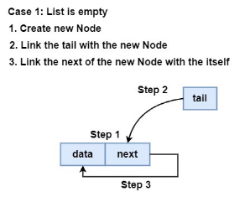
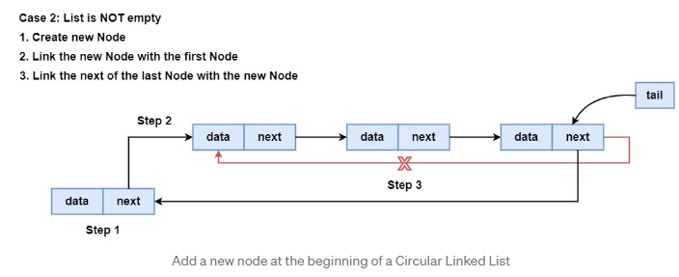
Insert at the beginning of Linked List

Slide 8
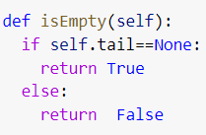
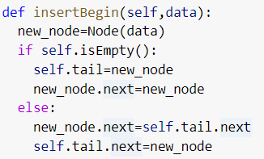
Insert at the beginning of Linked List

Slide 9
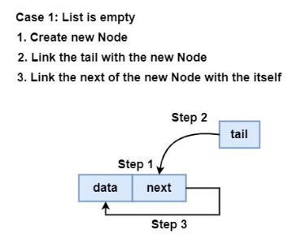
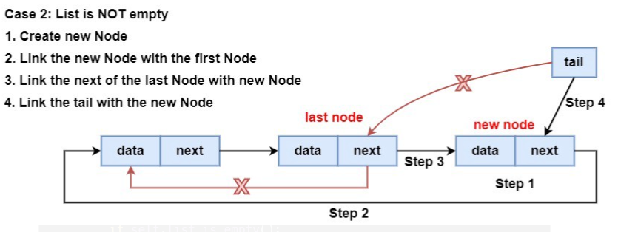
Insertion at the last of circular Linked List

Slide 10
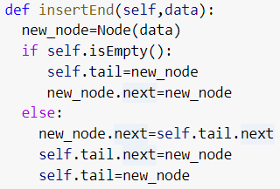
Insertion at the last of circular Linked List

Slide 11
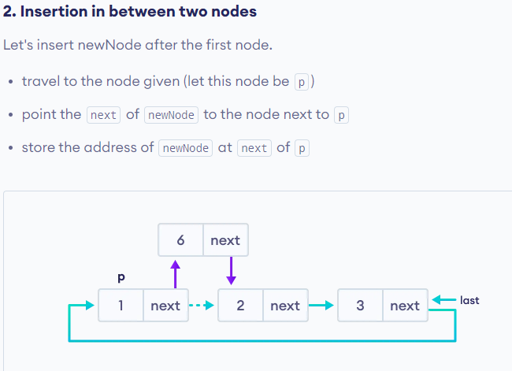
Insertion in the middle of circular Linkedlist

Slide 12
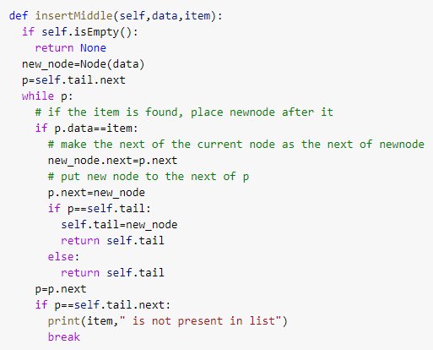
Insertion in the middle of circular Linkedlist

Slide 13
Deletion of a node in Circular Linked list
A node can be deleted from the list from three different places namely:
1) deleting the first node from the list
2) deleting the last node from the list
3) deleting an intermediate node from the list.

Slide 14
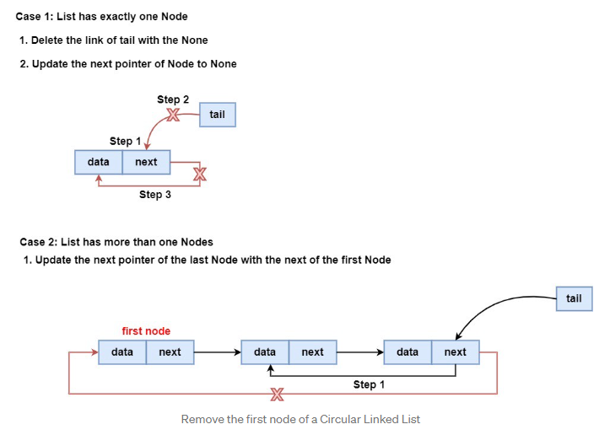
Deletion of a first node in Linked List

Slide 15
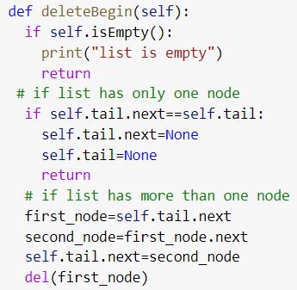
Deletion of a first node in Linked List

Slide 16
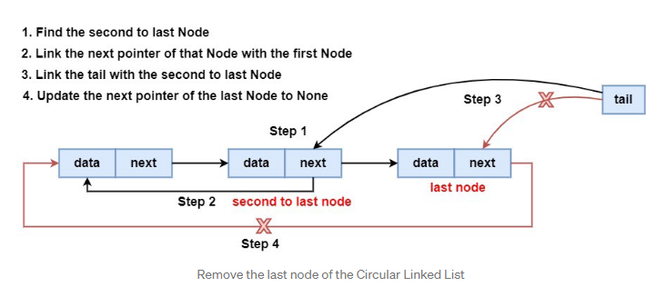
Deletion of a last node in Linked List

Slide 17
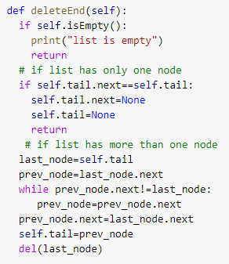
Deletion of a last node in Linked List

Slide 18
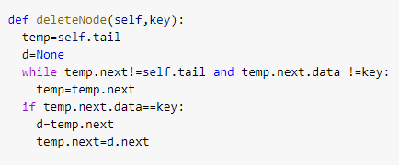
DeletDeletion of an in beween node in Linked List
ion of an intermediate node in Linked List

Slide 19
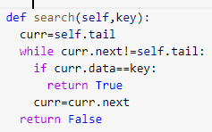
Searching for a value in linked list

Slide 20
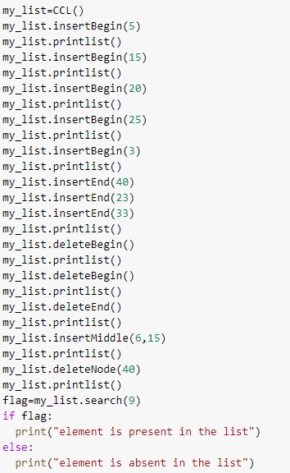
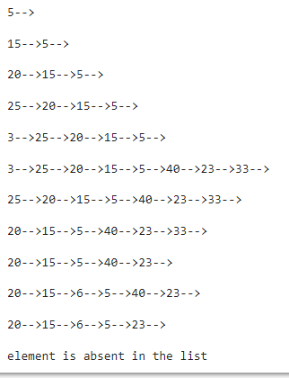

Slide 21
https://pythonwife.com/circular-singly-linked-list-in-python/
https://chercher.tech/python-data-structures/circular-singly-linked-list-python-ds

