Slide 1
QUEUE

Slide 2
What is a Queue?
A Queue allows all data operations at both the end.
a QUEUE can be implemented with
Array
Structure
Pointer
Linked List

Slide 3
Features of QUEUE
Queue is an ordered list of similar data type
Queue is a FIFO (First In First Out) structure – element inserted first will be removed first
ENQUEUE() function is used to insert new elements into the Queue
DEQUEUE() function is used to remove an element from the Queue.
Insertion is done from one end called the REAR ( or tail)
Removal is done from the other end called as FRONT (or head).
Queue is said to be in Overflow state when it is completely full and is said to be in Underflow state if it is completely empty.
peek() − get the front data element of the Queue, without removing it.
isFull() − check if Queue is full.
isEmpty() − check if Queue is empty.

Slide 4
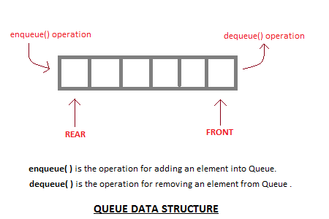
Applications of Queue
Queue, as the name suggests is used whenever we need to manage any group of objects in an order in which the first one coming in, also gets out first while the others wait for their turn, like in the following scenarios:
Serving requests on a single shared resource, like a printer, CPU task scheduling etc.
In real life scenario, Call Center phone systems uses Queues to hold people calling them in an order, until a service representative is free.
Handling of interrupts in real-time systems. The interrupts are handled in the same order as they arrive i.e First come first served.

Slide 5
Queue ADT
Queue operations may involve initializing or defining the queue, utilizing it, and then completely erasing it from the memory. Here we shall try to understand the basic operations associated with queues −
enqueue() − add (store) an item to the queue.
dequeue() − remove (access) an item from the queue.
Few more functions are required to make the above-mentioned queue operation efficient. These are −
peek() − Gets the element at the front of the queue without removing it.
isfull() − Checks if the queue is full.
isempty() − Checks if the queue is empty.
In queue, we always dequeue (or access) data, pointed by front pointer and while enqueing (or storing) data in the queue we take help of rear pointer.

Slide 6
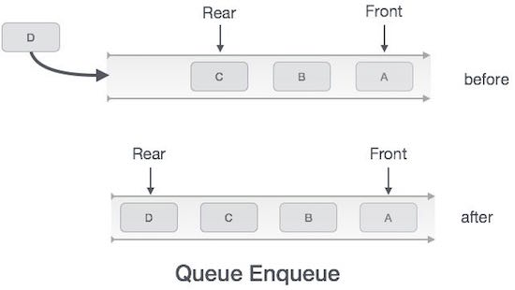
Enqueue Operation
Queues maintain two data pointers, front and rear. Therefore, its operations are comparatively difficult to implement than that of stacks.
The following steps should be taken to enqueue (insert) data into a queue −
Step 1 − Check if the queue is full.
Step 2 − If the queue is full, produce overflow error and exit.
Step 3 − If the queue is not full, increment rear pointer to point the next empty space.
Step 4 − Add data element to the queue location, where the rear is pointing.
Step 5 − return success.
front=0
rear=2

Slide 7
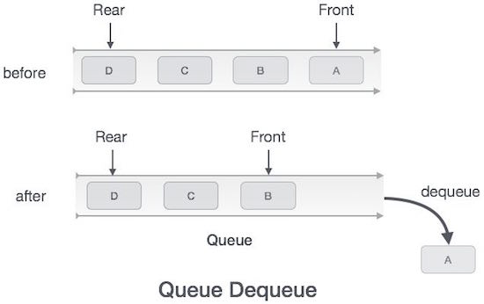
Dequeue Operation
Accessing data from the queue is a process of two tasks − access the data where front is pointing and remove the data after access. The following steps are taken to perform dequeue operation −
Step 1 − Check if the queue is empty.
Step 2 − If the queue is empty, produce underflow error and exit.
Step 3 − If the queue is not empty, access the data where front is pointing.
Step 4 − Increment front pointer to point to the next available data element.
Step 5 − Return success.

Slide 8
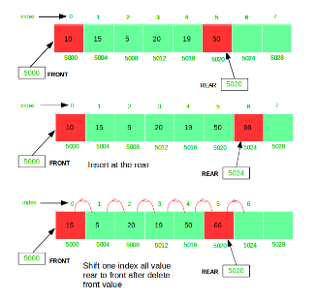
enQueue(), deQueue() operation

Slide 9
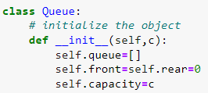
Structure of Queue

Slide 10
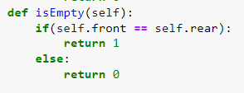
isFull(), isEmpty() operation

Slide 11
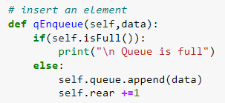
enqueue()

Slide 12
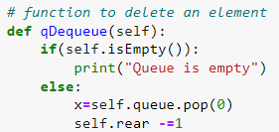
dequeue()

Slide 13
peek queue

Slide 14
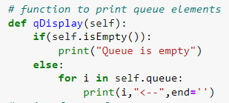
print queue

Slide 15
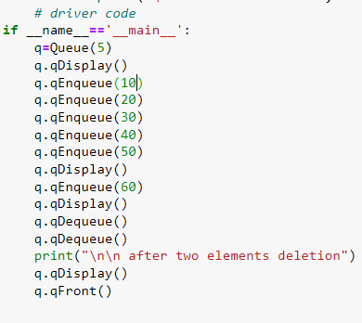
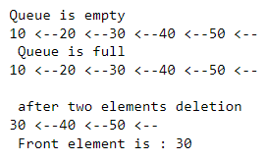
Time complexity of Enqueue = O(1)
Time complexity of dqueue = O(n)

