Slide 1
STACK

Slide 2
What is a Stack?
A stack allows all data operations at one end only.
At any given time, we can only access the top element of a stack
a stack can be implemented with
Array
Structure
Pointer
Linked List

Slide 3
Features of Stack
Stack is an ordered list of similar data type
stack is a LIFO (Last In First Out) structure or we can say FILO(First in Last Out).
PUSH() function is used to insert new elements into the stack
POP() function is used to remove an element from the stack. Both insertion and removal are allowed at only one end of element from the stack.
Both insertion and removal are allowed at only one end of Stack called Top.
Stack is said to be in Overflow state when it is completely full and is said to be in Underflow state if it is completely empty.
peek() − get the top data element of the stack, without removing it.
isFull() − check if stack is full.
isEmpty() − check if stack is empty.

Slide 4
Stack ADT
A Stack contains elements of same type arranged in sequential order. All operations takes place at a single end that is top of the stack and following operations can be performed:
push() – Insert an element at one end of the stack called top.
pop() – Remove and return the element at the top of the stack, if it is not empty.
peek() – Return the element at the top of the stack without removing it, if the stack is not empty.
size() – Return the number of elements in the stack.
isEmpty() – Return true if the stack is empty, otherwise return false.
isFull() – Return true if the stack is full, otherwise return false.

Slide 5
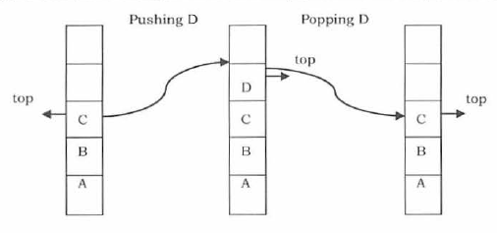
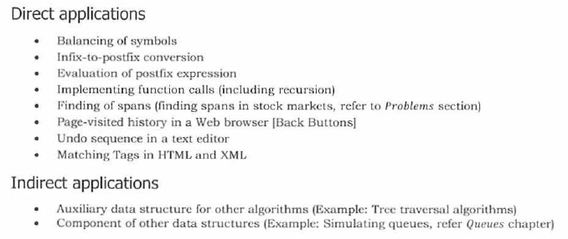
Stack

Slide 6
Stack implementation
A Stack can be implemented in the following ways:
simple array based implementation
dynamic array based implementation
Linked list implementation
stack using arrays:

Slide 7
stack structure

Slide 8
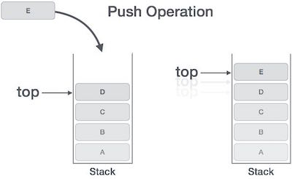
Push Operation
Algorithm for push
The process of putting a new data element onto stack is known as a Push Operation. Push operation involves a series of steps −
Step 1 − Checks if the stack is full.
Step 2 − If the stack is full, produces an error and exit.
Step 3 − If the stack is not full, increments top to point next empty space. top++;
Step 4 − Adds data element to the stack location, where top is pointing arr[top]=sdata;
Step 5 − Returns success.

Slide 9
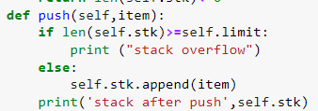
PUSH() Operation

Slide 10
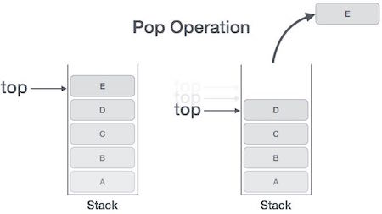
POP operation
Algorithm for Pop
Step 1 − Checks if the stack is empty.
Step 2 − If the stack is empty, produces an error and exit.
Step 3 − If the stack is not empty, accesses the data element at which top is pointing.
deldata=arr[top];
Step 4 − Decreases the value of top by 1. top--;
Step 5 − Returns success.

Slide 11
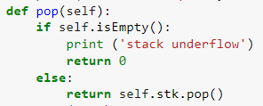
POP()

Slide 12
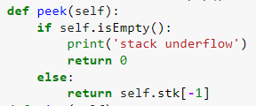
PEEK()
Return the element at the top of the stack without removing it, if the stack is not empty.

Slide 13
empty stack
The steps to be followed are:
Check whether the ‘top’ pointer is equal to -1
If the condition is true, it means, that the stack is empty. Otherwise , the stack is not empty.

Slide 14
size of the stack
The steps to be followed are:
return the count of elements in the stack
size of stack

Slide 15
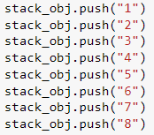
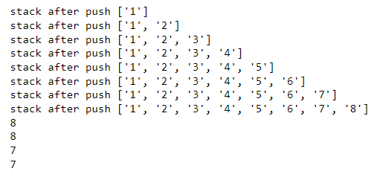
declaring object and Printing stack elements
creating an instance of the object
printing and popping the values from stack
Pushing data into stack

