Slide 1
Data structures and Algorithm using C++

Slide 2
A data structure is a way of organizing, storing and retrieving data and perform operations on these data in an efficient way.
Each data structue has its way of application.
For example one-dimensional array, can be used to store homogenous type of data.
Specialized data structuers can used to solve complex search algorithms.
Definition

Slide 3
Data types
PRIMITIVE DATA TYPES
COMPOSITE DATA TYPES
ABSTRACT DATA TYPES

Slide 4
Data types
Variables
there are two Data types
System defined data types (primitive data types)
user-defined data types

Slide 5
PRIMITIVE Data types
integers
These are Basic Data Type that directly operate upon Machine Instructions.
floating point
boolean
character
constants
Strings
pointers

Slide 6
COMPOSITE Data types
Lists
These are derived from Primary Data Type.
Using the composite data types, multiple pieces of related data can be refered as single datum.
array
stack
queues
Linked List
trees
Graphs

Slide 7
Data Structures
Data structure is a particular way of storing and organizin data in a computer so that it can be used efficiently. generally we store data in data structures like arrays, lists, files, stacks , queues, trees etc
depending on the organization of the data, data structure can be classified as:
Linear data structures: elements are accessed in a sequential order eg lists, stacks, queues
Non-Linear data structures : elements of this data are stored and accessed in a non-linear order. they are stored as the arrival of data order eg trees and graphs.

Slide 8
Abstract data type
An abstract data type is defined in term of its data items and its related operations rather than by its implementation.In this only what operations are to be done is mentioned not how.
The implementation is left to the developer. As it gives an implementation-independent view only , it is called ‘abstract’.
An ADT can be considered as a black box, where users can only see the syntax and semantics of its operations. The representation of the data structure is hidden.
It does not specify how data will be organized in memory and what algorithms will be used for implementing the operations.
The process of providing only the essentials and hiding the details is known as abstraction.

Slide 9
Basic ADT operations
1) constructor/Destructor :- creates / deletes a new instance (object) of an ADT.
2) Transformer :- changes the state of one or more of the data values of an instance.
3) Observer:- allows us to observe the state of one or more of the data values of an instance without changing them.
4) Iterator:- allows us to process all the components in a data structure sequentially.

Slide 10
Example ADT
stack
queue
linked list

Slide 11
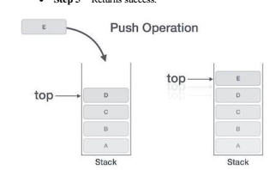
Stack ADT operations
Last In First Out (LIFO) method is adopted in stack
A Stack contains elements of same type arranged in sequential order.
All operations takes place at a single end that is top of the stack and following operations can be performed:
push() – Insert an element at one end of the stack called top.
pop() – Remove and return the element at the top of the stack, if it is not empty.
peek() – Return the element at the top of the stack without removing it, if the stack is not empty.
size() – Return the number of elements in the stack.
isEmpty() – Return true if the stack is empty, otherwise return false.
isFull() – Return true if the stack is full, otherwise return false.

Slide 12
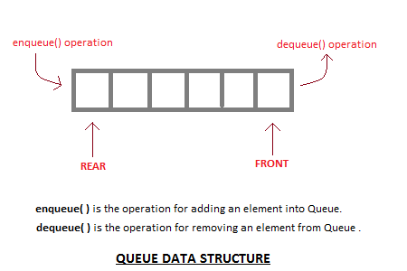
Queue ADT operations
First In First Out (FIFO) method is adopted in Queue
A Queue contains elements of same type arranged in sequential order. Operations takes place at both ends, insertion is done at end and deletion is done at front. Following operations can be performed:
enqueue() – Insert an element at the end of the queue.
dequeue() – Remove and return the first element of queue, if the queue is not empty.
peek() – Return the element of the queue without removing it, if the queue is not empty.
size() – Return the number of elements in the queue.
isEmpty() – Return true if the queue is empty, otherwise return false.
isFull() – Return true if the queue is full, otherwise return false.

Slide 13
Linked List ADT operations
get() – Return an element from the list at any given position.
insert() – Insert an element at any position of the list.
remove() – Remove the first occurrence of any element from a non-empty list.
removeAt() – Remove the element at a specified location from a non-empty list.
replace() – Replace an element at any position by another element.
Size() – Return the number of elements in the list.
isEmpty() – Return true if the list is empty, otherwise return false.
isFull() – Return true if the list is full, otherwise return false.

Slide 14
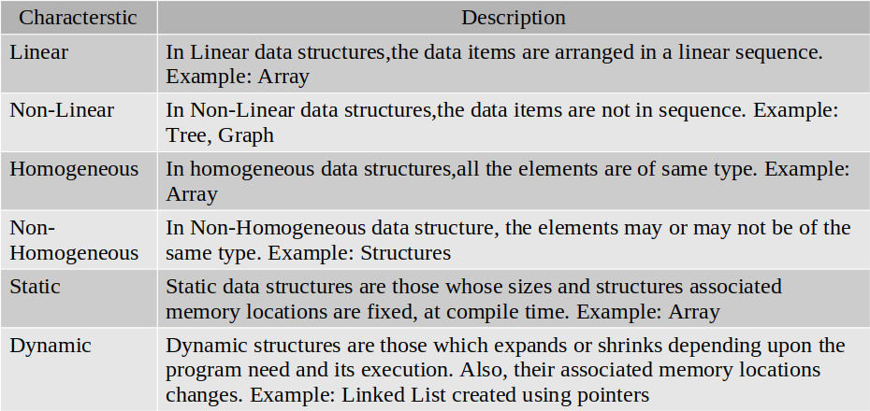
Data structures based on Characteristic

Slide 15
Thank you

