Slide 1
Python Functions
Scope of variables

Slide 2
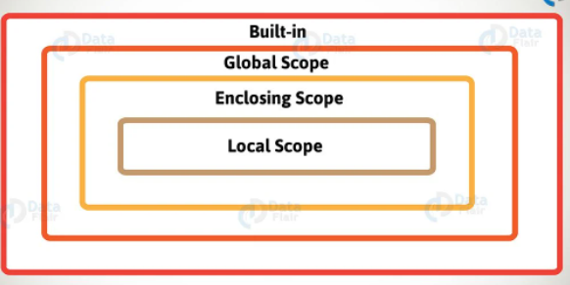
Scope of variables - types

Slide 3
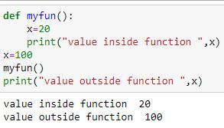
scope of variables - local variable
Scope of a variable: local variable
Is the portion of a program where the variable is recognized. Parameters and variables defined inside a function are not visible from outside the function. This is called local scope.
Lifetime of a variable :- is the period throughout which the variable exists in the memory. The lifetime of variables inside a function is as long as the function executes.
They are destroyed once we return from the function.
The value x=100 is defined outside function.
Then inside the myfun() function x is defined as x=20
When the function is called the value defined
Inside with the value=20
Again when the variable x is printed outside the
Value defined outside is only printed.
This shows the variable x inside function is considered local

Slide 4
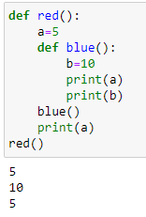
scope of variables - enclosing scope in python
Scope of a variable: in this code, b has local scope within function blue(), and ‘a’ has non-local scope in ‘blue()’

Slide 5
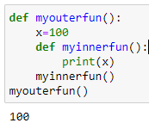
scope of variables - function within function
Scope of a variable: a local variable of a function can be accessed from function defined within (inner function)

Slide 6
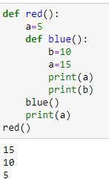
Scope of variables - nonlocal scope
Like the ‘global’ keyword, if a change to be made to a nonlocal variable, then it must use the keyword nonlocal
with out nonlocal keyword - The value of a outside function ‘blue’ does not change in this example

Slide 7
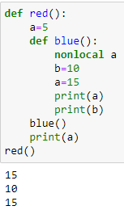
Scope of variables - nonlocal scope
Like the ‘global’ keyword, if a change to be made to a nonlocal variable, then it must use the keyword nonlocal
with nonlocal keyword - The value of ‘a’ outside function ‘blue’ change in this example

Slide 8
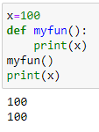
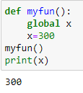
Scope of variables - Global variables
Scope of a variable:
Global variable
Variables outside of the function are visible from inside. They have global scope. They can be read inside the function but cannot change them. In order to modify the value of variables outside the function, they must be declared as global variables using the keyword. “global”

Slide 9
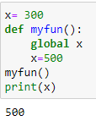
scope of variables - Global variables
Scope of a variable: Global variable
To change the value of a global variable inside a function, refer to the variable by using the “global” keyword

Slide 10
scope of variables - Built-in scope
This is the widest scope that exists. All the reserved keywords fall under this scope. We can call the keywords anywhere within our program without having to define them before use.
Example print(), global, del, split, import etc, while, for

Slide 11
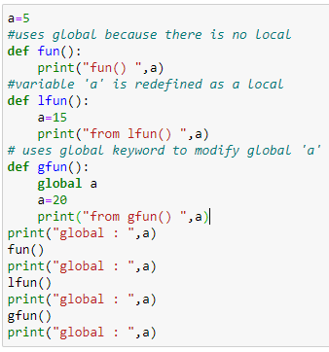
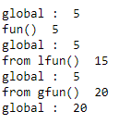
scope of variables - All

Slide 12
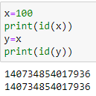
Python pass by reference
Pass by reference
When we pass something by reference any change we make to the variable inside the function then those changes are reflected to the outside value as well.
Python interpreter assigns a unique identifier to each object created say, int,list, tuple etc
Python build-in id() function returns this id which is roughly the memory address where it is stored. This shows that, actual and formal parameters have same id

Slide 13
Python pass by reference
Pass by reference : Thus in python a function is always called by passing a variable by reference. That is if a function modifies data received from the calling environment, the modification should reflect in the original data. But this is not always true.

Slide 14
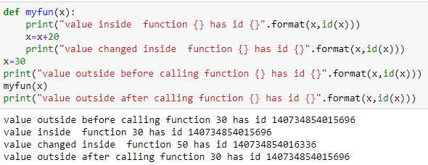
Python pass by reference
Pass by reference : any modification of immutable object such as int, string, float, tuple inside function will create a different object and does not affect original value . In the below example ‘x’ is assigned 30 is printed outside and passed as argument. As long as its value not modified, it has the same reference. But when it is modified another object is created with different reference.. Thus in the main program when after function call it is printed we can see the original reference is not changed.

Slide 15
Python pass by reference
Pass by reference : any modification of mutable object such list is passed to function will create the same object and any modification affect original value .

Slide 16
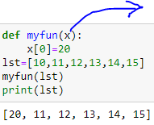
Python pass by reference
Pass by reference : any modification of mutable object such list is passed to function will create the same object and any modification affect original value .

Slide 17
https://data-flair.training/blogs/python-variable-scope/
https://techvidvan.com/tutorials/python-variable-scope/
https://www.geeksforgeeks.org/python-scope-of-variables/

