Slide 1
Python Dictionary

Slide 2
Python Dictionary
A python dictionary is used to store the data in a key-value pair format.
It is mutable
Key- must be a single element and must be unique
Value - can be any python data type like string, list, integer etc
Dictionary can be created by using multiple key-value pairs enclosed with the curly brackets {} and each key is separated from its value by the colon(:)
The syntax is :
d={ <key> : <value>, <key> : <value>, <key> : <value>, …}
Example
my_dict= { 1: ‘apple’, 2: ‘ball’}

Slide 3
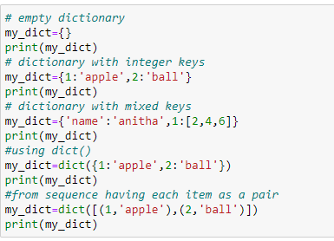
Python Dictionary

Slide 4
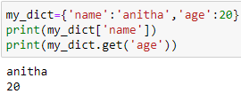
Python Dictionary
Accessing elements from dictionary

Slide 5
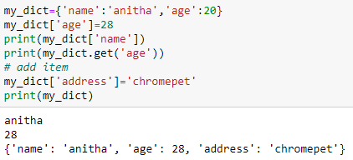
Python Dictionary
modifying elements in dictionary and adding elements in dictionary

Slide 6
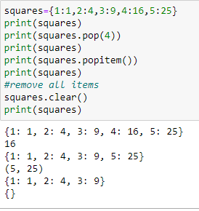
Python Dictionary
removing elements from dictionary
pop() = remove a particular item
clear() = remove all items
Del = remove individual items

Slide 7
Python Dictionary
items() - method will return each item in a dictionary, as tuples in a list
Adding a new item or changing existing values will keep dictionary update.

Slide 8
Python Dictionary
Accessing elements through loops
To check if key exists:

Slide 9
Python Dictionary
Change values of a specific item
Update dictionary - can be done using update() method

Slide 10
Python Dictionary
New item can be added with update() method as follows:
Remove an item using- pop() method
popitem() - removes the last item in the dictionary

Slide 11
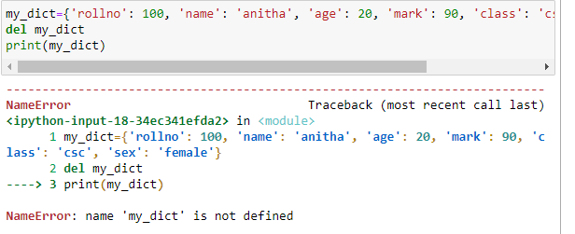
Python Dictionary
Del - used to remove an item specified
Del - used to remove all the items in the dictionary

Slide 12
Python Dictionary
clear() - empties dictionary

Slide 13
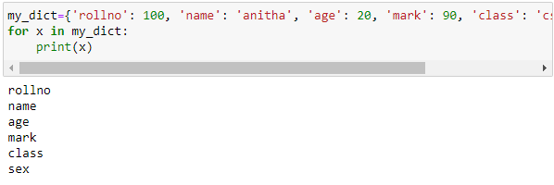
Python Dictionary
Loop through dictionary
Print all key names in the dictionary, one by one:
Print all values names

Slide 14
Python Dictionary
Loop through dictionary
values() - Print all values in the dictionary, one by one:
keys() -Print all keys in the dictionary, one by one:

Slide 15
Python Dictionary
Loop through dictionary
items() - print key and values

Slide 16
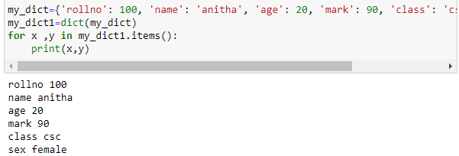
Python Dictionary
copy() - copy a dictionary

Slide 17
Python Dictionary
nested dictionary - method1
nested dictionary - method2

Slide 18
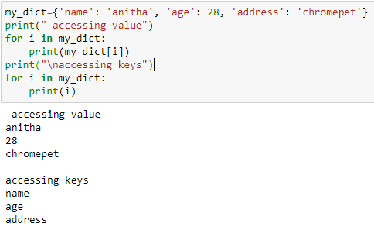
Python Dictionary
Accessing elements through loops

Slide 19
Python Dictionary
Accessing keys and value separately
keys() - this will return a list of all the keys in given dictionary
values() - will return list of all the values in given dictionary

Slide 20
Python Dictionary comprehension
Filter can be used with if statement as follows

Slide 21
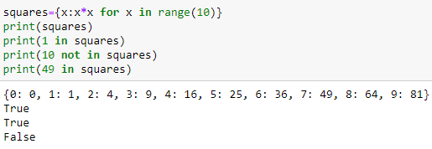
Python Dictionary comprehension
Membership test
‘in’ and ‘not in’ are used to check whether a particular key is present in dictionary or not

Slide 22
Python Dictionary functions
all() return value
true : if all elements in an iterable are true
False : if any element in an iterable is false

