Slide 1
Python control statements

Slide 2
Python Indentation
Indentation refers to the spaces at the beginning of a code line.
Where in other programming languages the indentation in code is for readability only, the indentation in Python is very important.
Python uses indentation to indicate a block of code.
if 5 > 2:
print("Five is greater than two!")
Python will give you an error if you skip the indentation:
if 5 > 2:
print("Five is greater than two!")
File "demo_indentation_test.py", line 2
print("Five is greater than two!")
^
IndentationError: expected an indented block

Slide 3
Python Indentation
You have to use the same number of spaces in the same block of code, otherwise Python will give you an error:
if 5 > 2:
print("Five is greater than two!")
print("Five is greater than two!")
File "demo_indentation2_error.py", line 3
print("Five is greater than two!")
^
IndentationError: unexpected indent

Slide 4
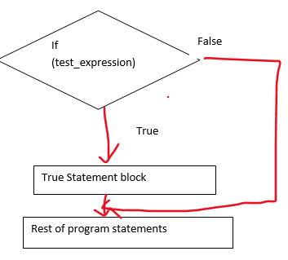
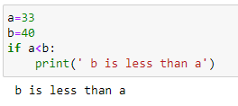
Python if statement
UNIT 1 | Lesson 1
If..else statement is used for taking decision in conditions
Syntax: if test_expression:
True statements block
Rest of program statements

Slide 5
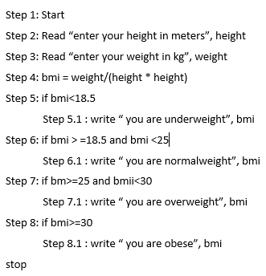
Python if statement
UNIT 1 | Lesson 1
Write a program to evaluate body mass index of a person to determine his weight status
BMI= wt / (ht * ht) where wt- in Kg
and ht - in meters
value | category
<18.5 | underweight
>=18.5 and <25 | Normal weight
>=25 and <30 | overweight
>=30 | obese

Slide 6
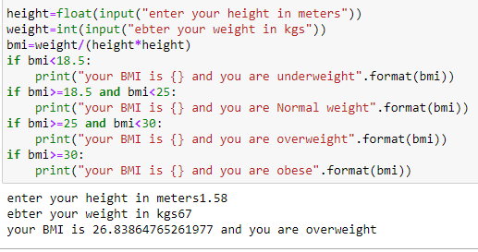
Python if statement
UNIT 1 | Lesson 1
Write a program to evaluate body mass index of a person to determine his weight status

Slide 7
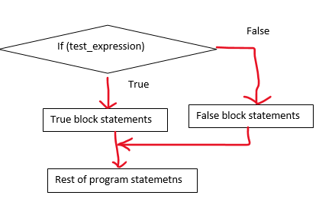
Python if- else statement
UNIT 1 | Lesson 1
If..else statement is used to make two-way decision. If the test expression is true then a set of statements will be executed and if false another set of statements can be executed
Syntax: if test_expression:
True statements block
else:
Rest of program statements

Slide 8
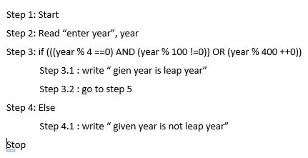
Program to compute whether a given year is a leap year or not
If (year% 4 ==0 and year % 100 !=0) or year % 400==0

Slide 9
Program to compute whether a given year is a leap year or not
If (year% 4 ==0 and year % 100 !=0) or year % 400==0

Slide 10
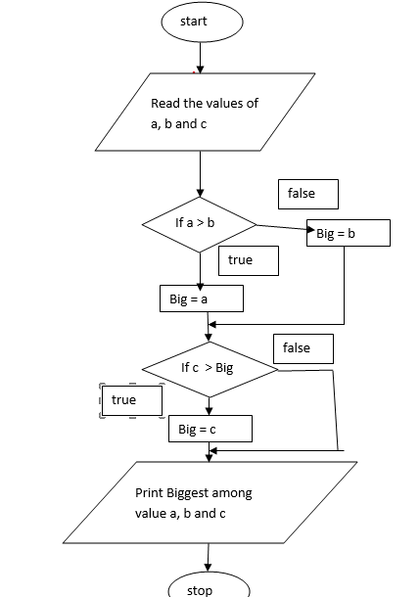

Slide 11
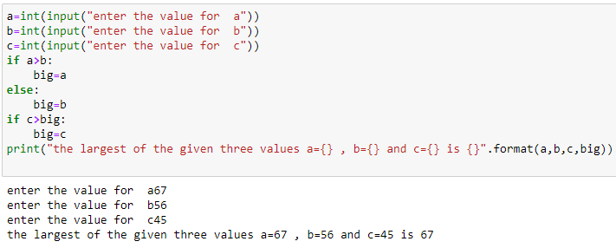
Largest among three integers

Slide 12
Python if- elif-else statement
UNIT 1 | Lesson 1
Multiple selection based on condition
Syntax: if test_expression:
If block statements
elif test_expression:
elif block statements
elif test_expression:
elif block statements
else:
else block statements
Rest of program statements

Slide 13
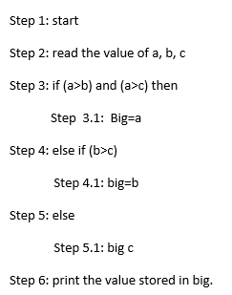
Python if- elif-else statement
Find the biggest among three numbers

Slide 14
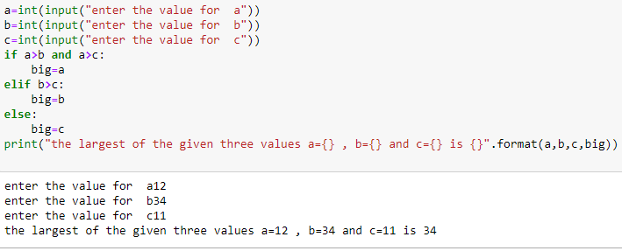
Python if- elif-else statement
UNIT 1 | Lesson 1
Find the biggest among three numbers

Slide 15
If..elif..else example
Find the average of 5 marks and calculate Percentage range and class accordingly
Percentage range | class
<35 | failure
>=35 and <50 | passed
>=50 and <60 | Second class
>=60 and <70 | First class
>=70 | First class with distinction

Slide 16
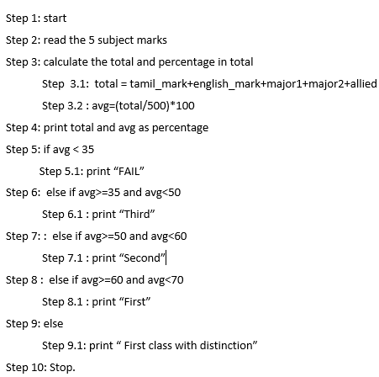

Slide 17
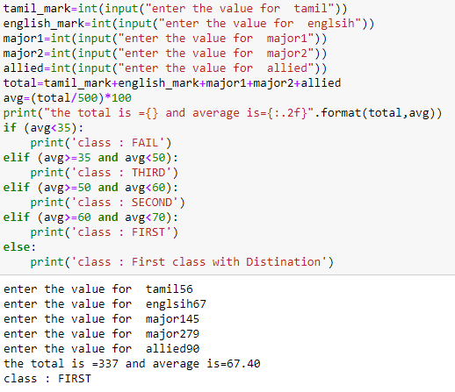

Slide 18
Repetition statements
To execute a set of statements repeatedly based on some conditions ;
Two loops:
While loop
For loop

Slide 19
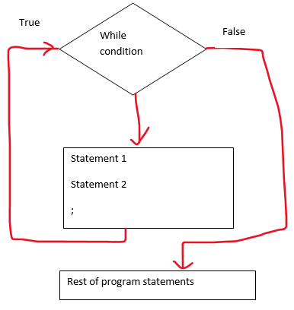
While loop
While condition:
statement1
Statement2
;
statementN

Slide 20
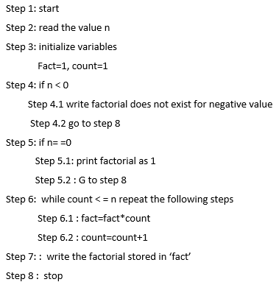
Program to compute the factorial for a given number

Slide 21
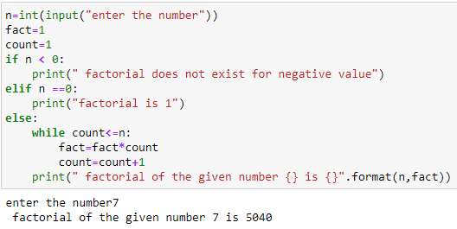
Program to compute the factorial for a given number

Slide 22
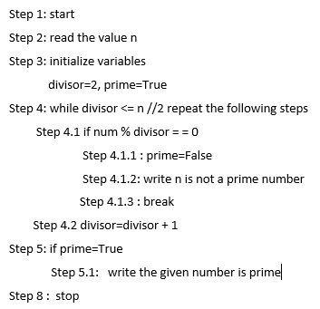
Program to check whether the given number is prime or not

Slide 23
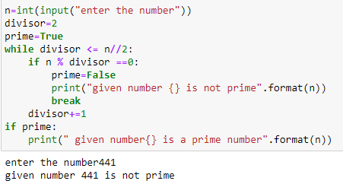
Program to check whether the given number is prime or not

Slide 24
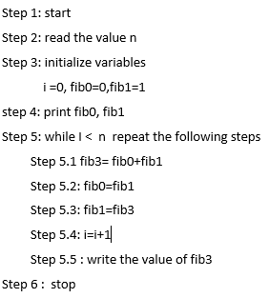
Program to calculate fibonacci number

Slide 25
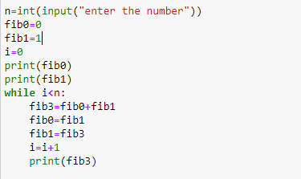
Program to calculate fibonacci number

Slide 26
For .. loop
For value in sequence:
Statement 1
Statement 2
;
Statement N
Rest of the program statements
The for loop is an iterative loop like while loop. Using this one can iterate lists, tuple, dictionary, strings, arrays etc
The range function is used along with for loop for condition based looping
Syntax : range(start, stop, [step])
range(stop) - produces loops to iterate from 0 to stop-1
range(start, stop) - produces numbers from start to stop-1
range(start, stop, step) - produces numbers from start to stop-1 and increments by step.

Slide 27
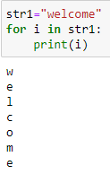
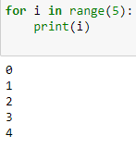
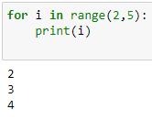
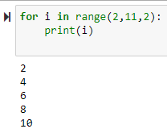
For loop

Slide 28
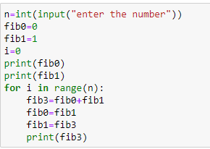
Fibonacci series using for loop

Slide 29
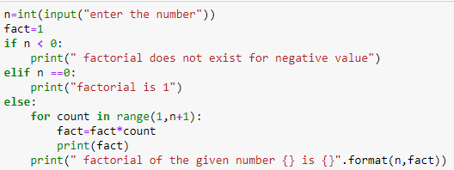
Factorial of the given number - for loop

Slide 30
Break and continue statement
Break and continue give additional controls for a loop
Break - using this the control can come out of the immediate loop.(terminate loop) once break it can not go inside the loop
Continue - when this is used inside a loop the current iteration is skipped and next iteration will be done. I.e suppose the loop has to execute from 1 to 10 and the loop variable is count, if we want to skip a particular count say 5, it can be done by checking inside loop as if count==5 then continue. In this case count=5 will be skipped and count=6 will be carried over

Slide 31
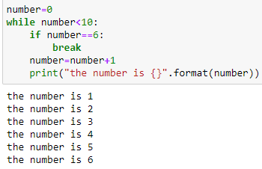
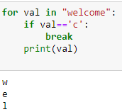
Break statement in while and for loop

Slide 32
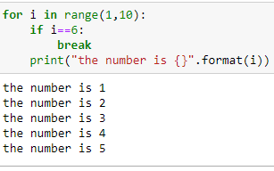
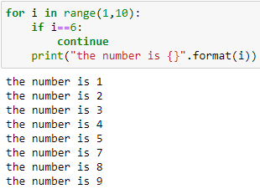
Break and continue in for loop

Slide 33
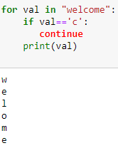
Continue statement

Slide 35
Pass statement
for loops cannot be empty, but if you for some reason have a for loop with no content, put in the pass statement to avoid getting an error.
for x in [0, 1, 2]:
pass

Slide 36
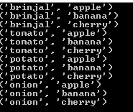
Loop within loop
For i in range(start, end):
Statements in first for loop
For j in range(start,end):
Statements in second for loop

Slide 37
Features of Python
UNIT 1 | Lesson 1
Can be integrated with C , C++, java
Can be integrated with COM and CORBA components
Quick development of Application

