Slide 1
Python - Zip() function

Slide 2
zip() -method
zip() - method takes iterable or containers and returns a single iterator object, having mapped values from all the containers.
It is used to map the similar index of multiple containers so that they can be used just using a single entity.
Syntax
zip(*iterators)
Parameters : python iterables or containers (list, string etc)
Return value : returns a single iterator object , having mapped values from all the containers

Slide 3
Combine two list

Slide 4
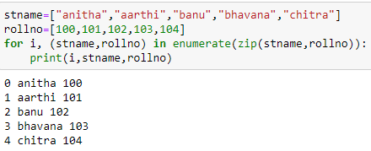
Python zip enumerate

Slide 5
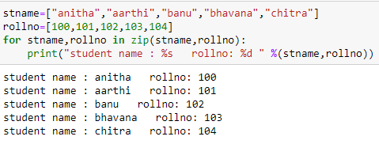

Slide 6
Combining two list with and without zip

Slide 7
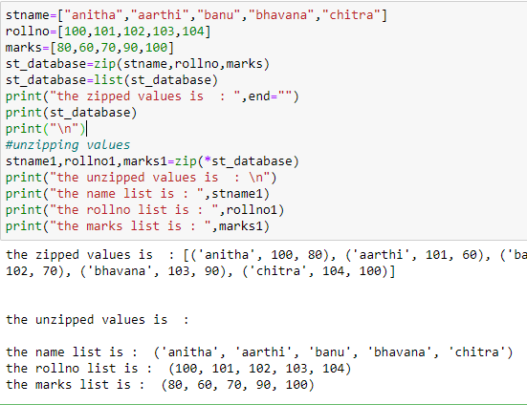
Unzip the values
Unzipping means converting the zipped values back to the individual self as they were. This is done with the help of “*” operator.

