Slide 1
Python - Ternary operator

Slide 2
Use of if else as ternary operator
[on_true value1] if condition else (on_false value_2]
When the condition evaluates to True, then the result of this one-liner if..else expression will be value_1. Whereas, if the condition evaluates to False, then the result of this one-liner expression will be value_2

Slide 3
Use of if else as ternary operator
To use with tuple
(if_test_false,if_test_true)[test]
Use with Dictionary

Slide 4
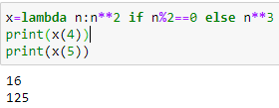
Use of if else as ternary operator with lambda

Slide 5
Use of if.elif in ternary operator

Slide 6
https://www.freecodecamp.org/news/lambda-function-in-python-example-syntax/
https://www.geeksforgeeks.org/python-lambda-anonymous-functions-filter-map-reduce/
https://thispointer.com/python-how-to-use-if-else-elif-in-lambda-functions/

