Slide 1
Python - Packages

Slide 2
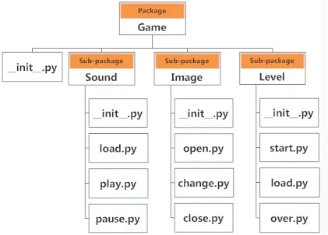
Packages - python
We organize our files in different folders and subfolders based on some criteria, so that they can be managed easily and efficiently.
For example, we keep all our games in a Games folder and we can even subcategorize according to the genre of the game or something like this.
The same analogy is followed by the Python package.
A package is folder that contains various modules as files.
If we want to import start module we can do like this
import Game.Level.start

Slide 3
Steps to create Packages
Create a folder where we put modules and a file called __init__.py
Steps
Create a folder named mypackage.
Inside this folder create an empty Python file __init__.py
Then create two modules mod1.py and mod2.py in this folder
Consider mod1.py has :
Consider mod2.py has

Slide 4
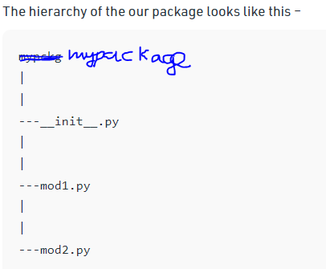
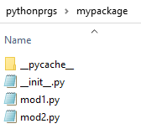
The directory looks like this

Slide 5
Understanding __init__.py
__init__.py helps the Python interpreter to recognize the folder as package. It also specifies the resources to be imported from the modules. If this file is empty means that all the functions of the modules will be imported. We can also specify the functions from each module to be made available.
For example
from .mod1 import welcome
from .mod2 import displayline

Slide 6
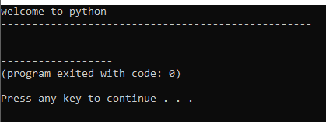
Import modules from a package
We can import these modules using the from .. import statement and the dot(.) operator as
Syntax
Import package_name.module_name
Example : create another file named pack2.py outside the folder mypackage as follows output

Slide 7
Import specific function from the module
Suppose our module mod1.py is as follows:
We can import specific function from module as
output

Slide 8
Namespaces and Scope in Python

Slide 9
https://python-course.eu/python-tutorial/packages.php
https://www.programiz.com/python-programming/package
https://www.geeksforgeeks.org/python-packages/

