Slide 1
Python - Method overriding

Slide 2
Method overriding
Method overriding is a concept of object oriented programming that allows us to change the implementation of a function in the child class that is defined in the parent class. It is the ability of a child class to change the implementation of any method which is already provided by one of its parent class(ancestors).
Following conditions must be met for overriding a function:
Method overriding cannot be done within a class. We need a child class from a parent class. Inheritance should be there. Function overriding cannot be done within a class. We need to derive a child class from a parent class.
The function that is redefined in the child class should have the same signature as in the parent class i.e. same number of parameters and the same name as in parent class
The child class method is called overriding method and the parent class method is called overridden method.

Slide 3
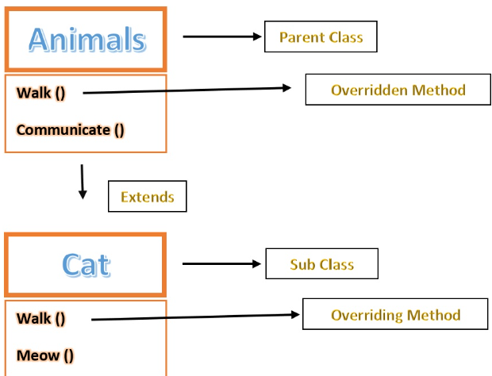
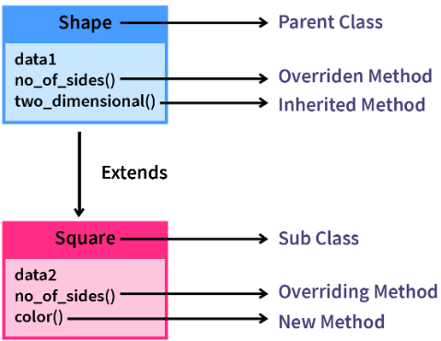
Method overriding

Slide 4
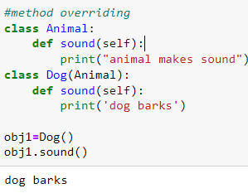
Method overriding
In the code Animal is the parent class. Dog (child class) is inheriting Animal class. Method sound() is in all the classes. In this when obj1.sound() is called it calls first method defined inside the class only (derived class)
It doesn’t call parent method. This is called method overriding.

Slide 5
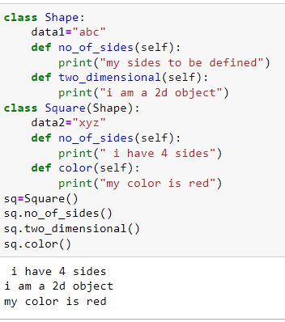
Method overriding
when we create an object of the Square class and call the method no_of_sides() we will see, it will override the already existing version of the parent class.
Order of searching the method
In this approach -> the method or attributes are first searched in the base class. If it is not present then the searching moves a level up -- to the immediate parent class. And if again no luck, then the searching continues following the same search approach.

Slide 6
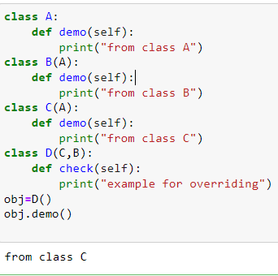
Order of method overriding
Class D->class C->class B->class A
Since, the class D will find the method demo() instantly in class C so will execute class C's method and will not search in other classes.

Slide 7
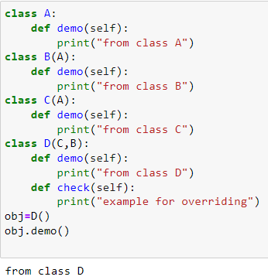
Order of method overriding - multiple inheritance
Suppose we have the method demo() in all the classes then it will be like this
Class D->class C->class B->class A
Since, the class D will find the method demo() instantly inside itself , it will execute class D's method and will not search in other classes.

Slide 8
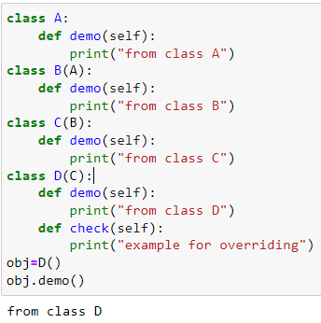
Order of method overriding - multilevel inheritance
When we override the methods or attributes of the Parent class or GrandParent class through the child class(class 3 here), then it is known as Overriding in Multi-level Inheritance. In this example above, if class D provides it's own implementation for class C and class B then it is Overriding in Multi-level Inheritance.
Class D->class C->class B->class A
Since, the class D will find the method demo() instantly inside itself , it will execute class D's method and will not search in other classes.

Slide 9
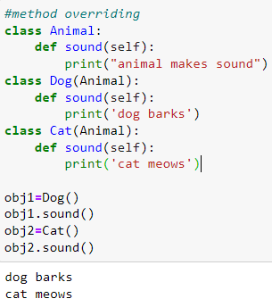
How to call base class overridden method from derived class?
Two ways to call base class overridden method:
Using class name
Using super()

Slide 10
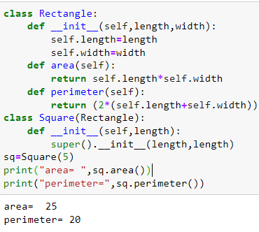
Using super()
The super() builtin allows us to access methods of the base class
super() in single inheritance

Slide 11
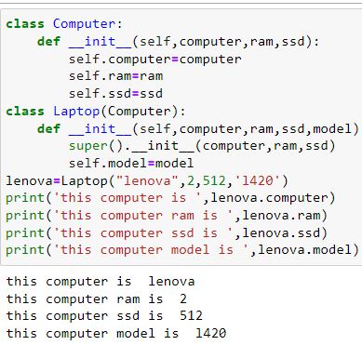
Use of super() for constructor overriding
In the given example three properties are defined inside the base class, and the derived class has four properties.

Slide 12
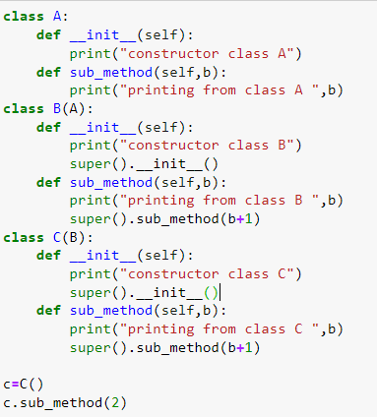
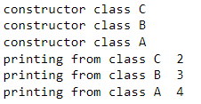
Use of super() in multilevel inheritance
The super() function will always refer to an immediate superclass.
The super() function can refer to the __init()__ function and call all other functions of a superclass.
output

Slide 13
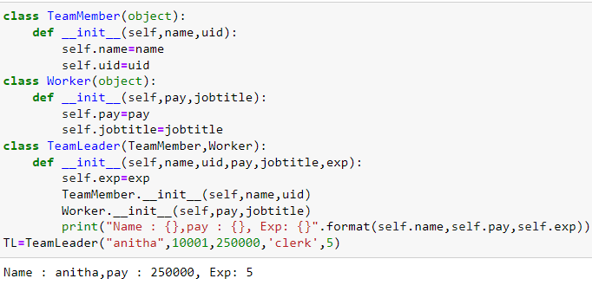
Use of classname for overriding in multiple inheritance
In this example, the TeamMember class has two properties: name and uid. Worker class has two properties: pay and jobtitle. Both of these classes are base classes.
Then we have defined a derived class called TeamLeader, which extends TeamMember and Worker.
That means we can access all the properties of Parent class in a child or derived class.
In the final line, we have created an object and passed the four properties in the constructor. And finally, we will get the output. Here we ca

