Slide 1
Python - Method overloading

Slide 2
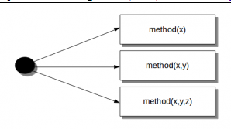
Method overloading
Overloading is the ability of a function or an operator to behave in different ways based on the parameters that are passed to the function, or the operands that the operator acts on.
Method with same name , but passed with different parameters is called method overloading. Methods in Python can be called with zero, one, or more parameters. This process of calling the same method in different ways is called method overloading.

Slide 3
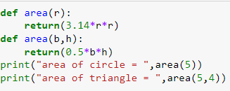
Python does not support method overloading. For example in the following program. In the below code, we have defined two area method, but we can only use the second area method, as python does not support method overloading. We may define many methods of the same name and different arguments, but we can only use the latest defined method. Calling the other method will produce an error. Like here calling will produce an error as the latest defined area method takes two arguments.

Slide 4
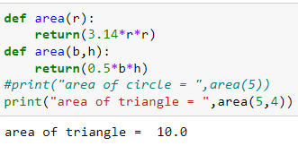
We can comment the first call then we get as

Slide 5
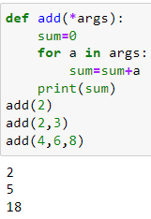
Method overloading

Slide 6
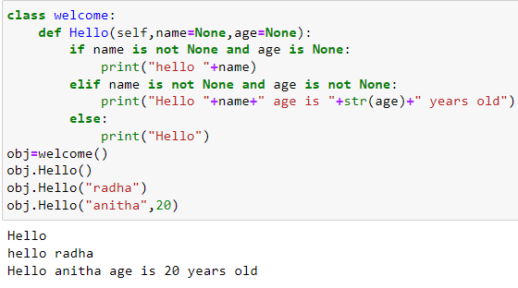
Method overloading
The method overloading can be achieved as follows: In the below example, we have created a method that can be called with fewer arguments than it is defined to allow. Also, it is not limited to two variables and your method can have more variables which are optional.

Slide 7
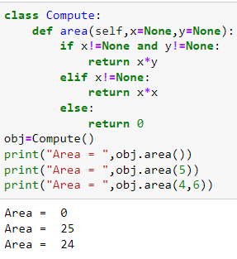
Method overloading

Slide 8
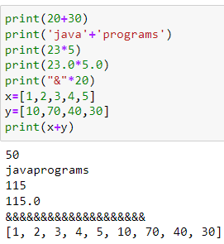
operator overloading
Operator Overloading means giving extended meaning beyond their predefined operational meaning.
For example operator + is used to add two integers as well as join two strings and merge two lists.
It is achievable because ‘+’ operator is overloaded by int class and str class.
the same built-in operator or function shows different behavior for objects of different classes, this is called Operator Overloading.
To perform operations on user defined objects
We can use magic function and do the operations

Slide 9
Binary Operator (magic functions
We can achieve operator overloading with python magic functions
Operator | Magic Method
+ | __add__(self, other)
– | __sub__(self, other)
* | __mul__(self, other)
/ | __truediv__(self, other)
// | __floordiv__(self, other)
% | __mod__(self, other)
** | __pow__(self, other)
Operator | Magic Method
>> | __rshift__(self, other)
<< | __lshift__(self, other)
& | __and__(self, other)
| | __or__(self, other)
^ | __xor__(self, other)

Slide 10
Comparison operator
unary operator
< __lt__(self, other)
> __gt__(self, other)
<= __le__(self, other)
>= __ge__(self, other)
== __eq__(self, other)
!= __ne__(self, other)
Operator | Magic Method
– | __neg__(self)
+ | __pos__(self)
~ | __invert__(self)

Slide 11
Assignment operator
-= __isub__(self, other) x=x-1 x -=1
+= __iadd__(self, other)
*= __imul__(self, other)
/= __idiv__(self, other)
//= __ifloordiv__(self, other)
%= __imod__(self, other)
**= __ipow__(self, other)
>>= __irshift__(self, other)
<<= __ilshift__(self, other)
&= __iand__(self, other)
|= __ior__(self, other)
^= __ixor__(self, other)

Slide 12
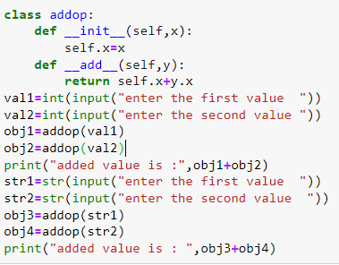
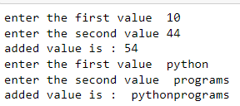
Operator overloading

Slide 13
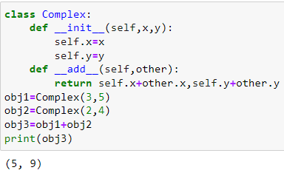
Operator overloading

Slide 14
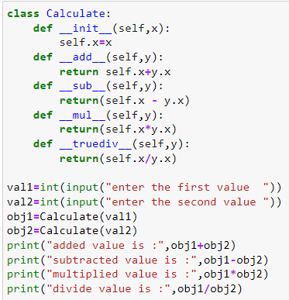
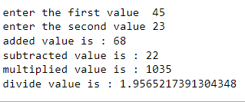
Binary Operator overloading

Slide 15
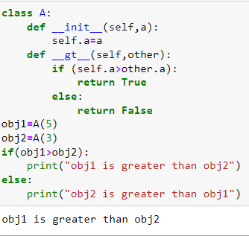
Comparison operator overloading

Slide 16
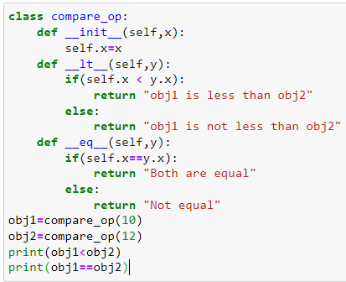
Overloading equality and less than operators

