Slide 1
Python - Containership / Composition

Slide 2
Composition / Containership in Python
Composition is an object oriented design concept that models a has a relationship. In composition, a class known as composite contains an object of another class known to as component. In other words, a composite class has a component of another class.
With composition, a class Composite has an instance of class Component and can leverage its implementation. The Component class can be reused in other classes completely unrelated to the Composite.
Containership should be used when the two classes have a ‘has a’ relationship. For example, a collegs has Professors, so , College class’s object can contain one or more Professor class’s objects.
For example the Employee class has an Address object. Address implements all the functionality to handle addresses, and it can be reused by other classes.
Other classes like Customer or Vendor can reuse Address without being related to Employee. They can leverage the same implementation ensuring that addresses are handled consistently across the application.

Slide 3
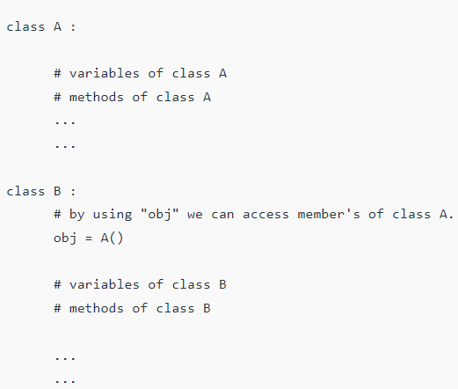
In composition one of the classes is composed of one or more instance of other classes. In other words one class is container and other class is content and if you delete the container object then all of its contents objects are also deleted.

Slide 4
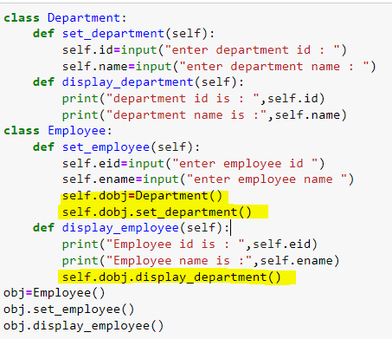
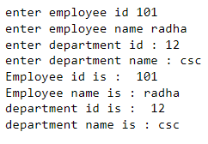

Slide 5
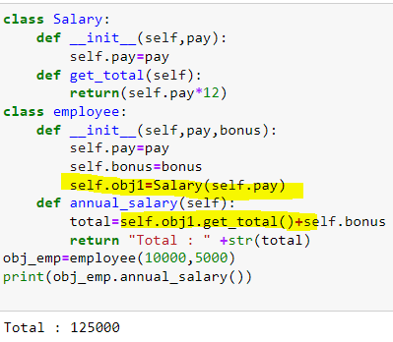

Slide 6
Inheritance vs Containership:
Inheritance | Containership
1. It enables a class to inherit data and functions from a base class | 1. It enables a class to contain objects of different classes as its data member.
2. The derived class may override the functionality of base class. | 2. The container class can't override the functionality of the contained class.
3. The derived class may add data or functions to the base class. | 3. The container class can't add anything to the contained class.
4. Inheritance represents a "is-a" relationship. | 4. Containership represents a "has-a" relationship.

