Slide 1
Python - classes & objects

Slide 2
What is object oriented programming?
OOP is about creating “objects”.
An object is a group of interrelated variables and functions. These variables are often referred as properties of the object.
The functions defined inside are referred as methods which are behavior of the objects.
For example:
A car can be an object. Its properties are - its color, its model, its price, its brand etc. its method which define its behavior are acceleration, slowing down, gear change etc.
A dog as an object. Its properties are its color, his breed, his name, his weight etc. its behavior functions are walking, barking, playing etc
Oops is famous as it helps to implement real-world entities.

Slide 3
Major concepts of OOPs
Class
Object
Method
Inheritance
Encapsulation
Polymorphism
Data Abstraction

Slide 4
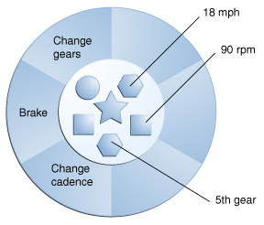
Objects
Software objects are conceptually similar to real-world objects. They consists of state (properties) and related behavior (methods that operate on properties)
For example, if the bicycle only has 6 gears, a method to change gears could reject any value that is less than 1 or greater than 6
This gives a control over the objects.

Slide 5
Objects
It gives the following benefits
Modularity : the source code for an object can be written and maintained independently of the source code for other objects. Once created, an object can be easily passed around inside the system.
Information-hiding : by interacting only with an object’s methods, the details of its internal implementation remain hidden from the outside world.
Code re-use: if an object already exists (perhaps written by another software developer), you can use that object in your program. This allows specialists to implement/test/debug complex, task-specific objects, which you can then trust to run in your own code.
Pluggability and debugging ease: If a particular object turns out to be problematic, you can simply remove it from your application and plug in a different object as its replacement. This is analogous to fixing mechanical problems in the real world. If a bolt breaks, you replace it, not the entire machine.

Slide 6
Classes - python
Class creates a user-defined data structure, which holds its own data members and member functions, which can be accessed and used by creating an instance of that class. A class is like a blueprint for an object.
Some points on Python class:
Classes are created by keyword class.
Attributes are the variables that belong to a class.
Attributes are always public and can be accessed using the dot (.) operator. Eg.: Myclass.Myattribute

Slide 7
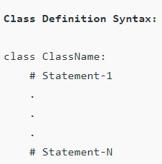
Classes - python
A Class is a collection of objects. It is a data structure defined by user.
Create a class as follows:
Create object

Slide 8
The self
Class methods must have an extra first parameter in the method definition. We do not give a value for this parameter when we call the method, python provides it.
If we have a method that takes no arguments, then we still have to have one argument.
This is similar to this pointer in C++

Slide 9
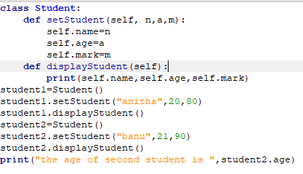
Object methods
The Student class contains two methods setStudent() and displayStudent()
An instance of object student1 which is of type Student1 class is created.
Then by using that and through setStudent() (object.method()) we pass arguments to the methods.
Then using displayStudent() we print the values stored in it.
We are able to access the variables inside the objects as if they are declared outside as in print statement.
It is because by default all variables are public in python.But this is not a good practice. So better we declare them as private. In python there is no explicit declaration as private. This can be done by declaring variables with two leading underscores as __names, __age etc

Slide 10
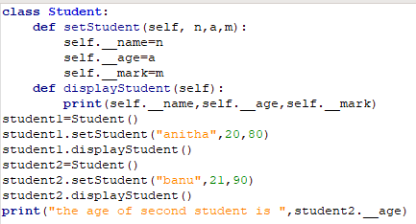
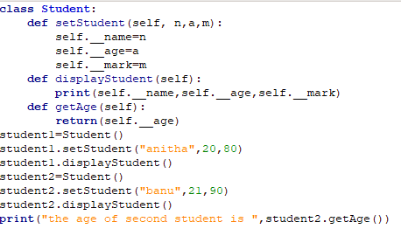
Object methods
In the above program we try to access the private variable student2.__age. So it posts the error.
If we have to display it can be done through methods defined inside class only.
Get through methods defined inside class

Slide 11
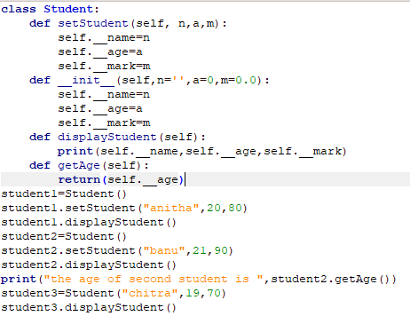
constructor methods
While creation of objects itself , if we want to initialize then we can go for constructors. In python you can declare construction using
def __init__() : When both setProperty() method and __init__() method are used, the init method must have some default values. This is because always when an instance of an object is created, this method will be called. After that only setProperty() method will be called.
Initialize the variables

Slide 12
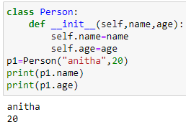
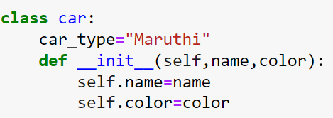
Classes - constructor in python
__init__() function : All classes have a function called __init__(), which is always executed when the class is being initiated. This is similar to constructor in C++ and Java
Use the __init__() function to assign values to object properties, or other operations that are necessary to do when the object is being created:The __init__() function is called automatically every time the class is being used to create a new object.

Slide 13
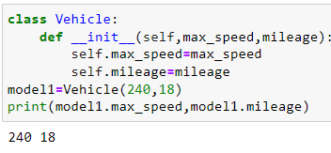
Write a Python program to create a Vehicle class with max_speed and mileage instance attributes.
We can create class without any variables and methods as:
class Vehicle:
pass

Slide 14
Print namespace of class

Slide 15
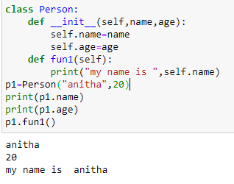
Object Methods
Objects can contain methods. When we define a class only the description or a blueprint of the object is created. There is no memory allocation unit we create its object. The object instance contains real data or information
The self parameter is a reference to the current instance of the class, and is used to access variables that belong to the class.

Slide 16
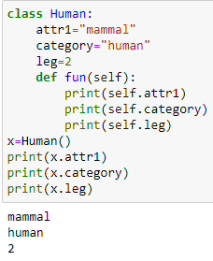
Object Methods
Objects can contain methods.
The self parameter is a reference to the current instance of the class, and is used to access variables that belong to the class.

Slide 17
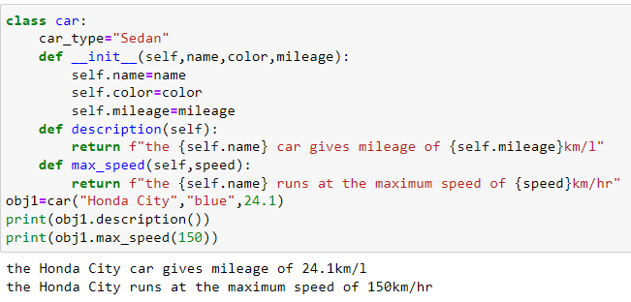
Object Methods
Objects can contain methods.
The self parameter is a reference to the current instance of the class, and is used to access variables that belong to the class.

Slide 18
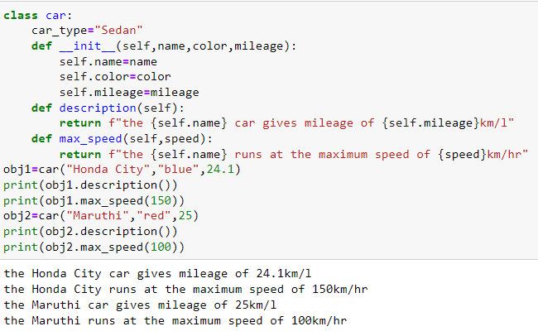
Object Methods - creating more objects
Creating more Objects of the same type.

Slide 19
Objects creation
While creating objects the following points must be noted:
Can create any number of objects of the class
If the method requires n parameters and if we do not pass the same number of arguments then an error will occur
Order of argument matters.
For example (2nd point)

Slide 20
Objects creation
3. Order of argument matters. For example (3nd point)

Slide 21
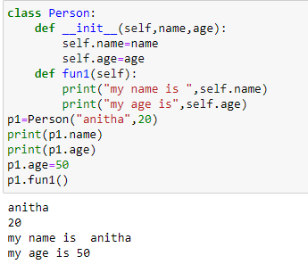
Modify object properties

Slide 22
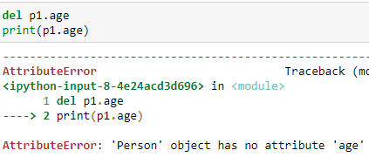
Delete object properties

Slide 23
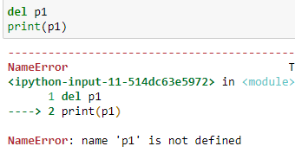
Delete object

Slide 24
Pass statement
class definitions cannot be empty, but if you for some reason have a class definition with no content, put in the pass statement to avoid getting an error.

Slide 25
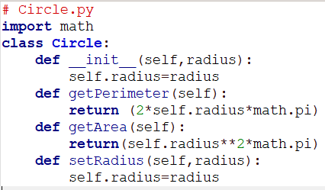
Class in modules
Output

Slide 26
Hiding data fields - Encapsulation
Making the data fields private protects data and makes the class easy to maintain.
Direct access of data fields is not a good practice because:
Data may be tampered with
The class becomes difficult to maintain and vulnerable to bugs.
To prevent direct modifications of data fields, don’t let the client directly access data fields. This is known as data hiding. This can be done by making the fields to be private.
In python, the private data fields are defined with two leading underscores.
Example : self.__radius=radius
It also can be done by defining private method named with two leading underscores.

Slide 27
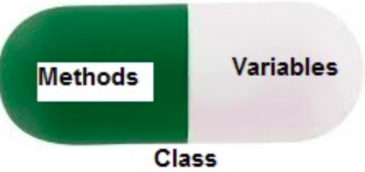
Encapsulation
Encapsulation is one of the fundamental concepts in object-oriented programming. It describes the idea of wrapping data and the methods that work on data within one unit.This puts restrictions on accessing variables and methods directly and can prevent the accidental modification of data.

Slide 28
Hiding data fields
Private data fields and methods can be accessed within a class, but they cannot be accessed outside the class.
To make a data field accessible for the client, provide a get method to return its value.
To enable a data field to be modified, provided a set method to set a new value.
Example:
def getPropertyName(self):
def isPropertyName(self):
def setPropertyName(self,propertyValue):

Slide 29
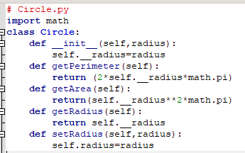
Use of private data

Slide 30
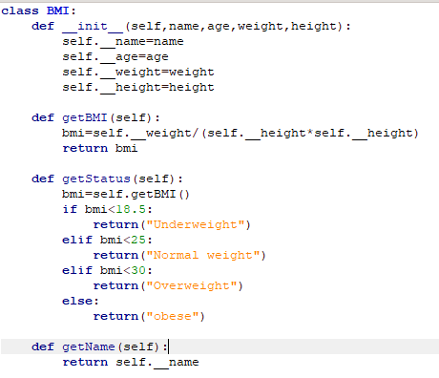
Use of private data

Slide 31
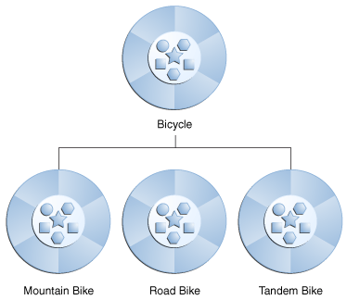
Inheritance

Slide 32
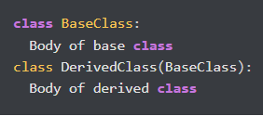
inheritance
The process of inheriting the properties of the parent class into a child class is called inheritance. The existing class is called a base class or parent class and the new class is called a subclass or child class or derived class.
The main purpose of inheritance is the reusability of code because we can use the existing class to create a new class instead of creating it from scratch.
The child class acquires all the data members, properties and functions from the parent class.
Syntax:

Slide 33
Type of inheritance
Single inheritance
Multiple inheritance
Multilevel inheritance
Hierarchical inheritance
Hybrid inheritance

Slide 34
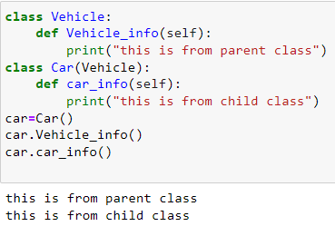
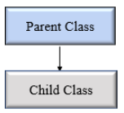
Single Inheritance

Slide 35
Single Inheritance
class Vehicle:
def __init__(self,name,max_speed,mileage):
self.name=name
self.max_speed=max_speed
self.mileage=mileage
class Bus(Vehicle):
pass
schoolbus=Bus("volvo",160,12)
print("vehicle name : ",schoolbus.name,"speed :",schoolbus.max_speed,"mileage : ",schoolbus.mileage)

Slide 36
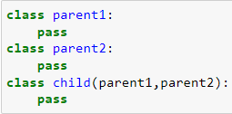
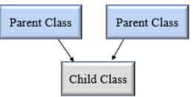
Multiple Inheritance
In multiple inheritance, one child class can inherit from multiple parent classes. So here is one child class and multiple parent classes

Slide 37
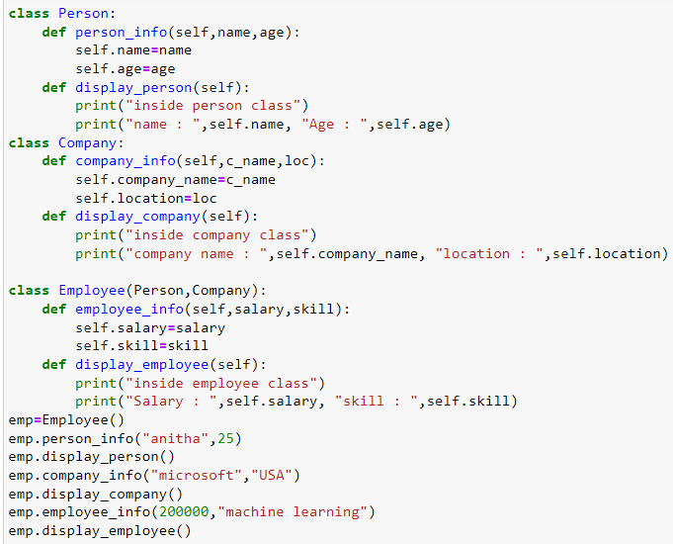
Multiple Inheritance

Slide 38
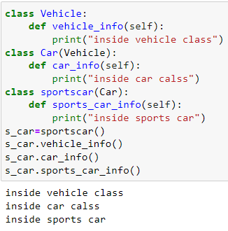
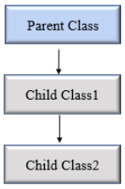
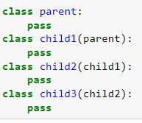
Multilevel inheritance
In multilevel inheritance, a class inherits from a child class or derived class. Suppose three classes A, B, C. A is the superclass, B is the child class of A, C is the child class of B. In other words, we can say a chain of classes is called multilevel inheritance.

Slide 39
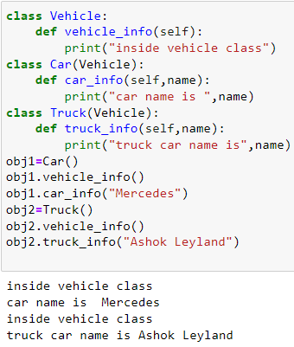
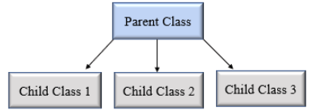
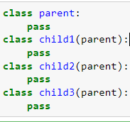
Hierarchical Inheritance
In Hierarchical inheritance, more than one child class is derived from a single parent class. In other words, we can say one parent class and multiple child classes.

Slide 40
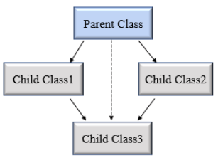
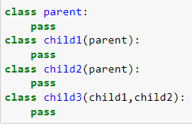
Hybrid Inheritance
When inheritance is consists of multiple types or a combination of different inheritance is called hybrid inheritance.

Slide 41
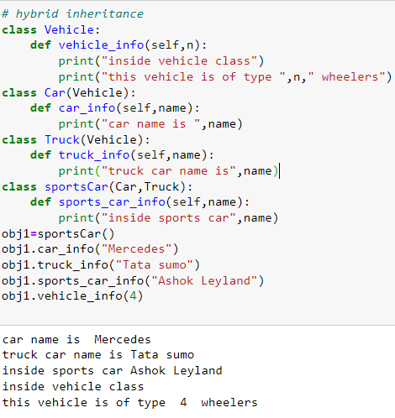
In this both hierarchical and multiple inheritance exists.

Slide 42
Python super() function
When a class inherits all properties and behavior from the parent class is called inheritance. In such a case, the inherited class is a subclass and the latter class is the parent class.
In child class, we can refer to parent class by using the super() function. The super function returns a temporary object of the parent class that allows us to call a parent class method inside a child class method.
Benefits of using the super() function.
We are not required to remember or specify the parent class name to access its methods.
We can use the super() function in both single and multiple inheritances.
The super() function support code reusability as there is no need to write the entire function

Slide 43
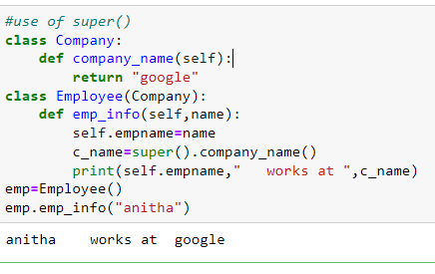
Python super() function

Slide 44
Python issubclass() function
Syntax
To verify whether a particular class is a subclass of another class issubclass() function is used. It returns a true or false value.
Where:
class: class to be checked
classinfo : a class, type or a tuple of classes or data types

Slide 45
Python issubclass() function

