Slide 1
Digital Logic- Introduction

Slide 2
History of Digital Computers
Digital is almost related with computer. Nowadays there is no field which doesn’t adopt computer technology for their operations.
From bank to the devices used in out home (mobile, washing machine, kitchen cookwares etc). it is endless.
The development of digital system can be discussed as:
Abacus
Napier’s device
Slide Rule
Pascal’s calculating Machine (PASCALINE)
LEIBNITZ’s improved Pascal Machine
Punched Card
Charles Babbage’s Engines
Hollerith’s Machine
Mark-1 Digital computer
First electronics computer (ATanasoff- Berry Computer)
ENIAC - Electronic Numerical Integrator and Calculator
EDVAC- Electronic Discrete Variable Automatic Computers
UNIVAC1- Universal Automatic Computer 1
Integrated chip technology
Microprocessor
SoC - System on Chip
Personal Computer

Slide 3
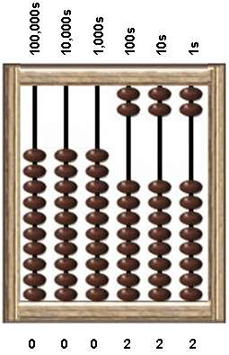
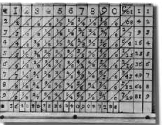
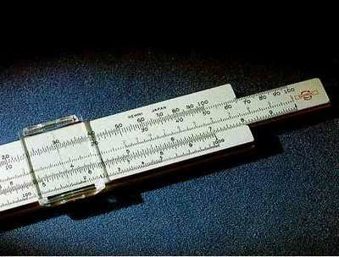
Abacus
Napier’s device
Slide rule
John Napier - a scottish Mathematician found it
products and quotients of large number could be obtained
invented in 17th century based on logarithms by John Napier

Slide 4
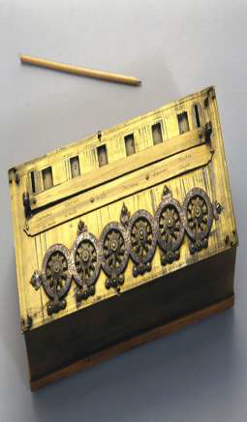
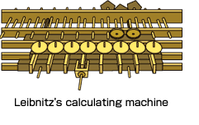
Pascal’s calculating machine
Leibnitz’s improved Pascal’s calculating machine
Pascal machine was improved in 1674 CE
can do multiplication, division and square root operation
Blaise Pascal - French Mathematician developed this device in 1642 CE
do only addition and subtraction

Slide 5
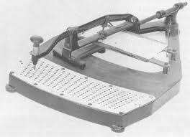
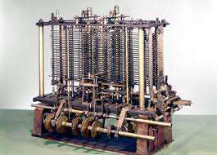
Punched Card
Charles Babbage (1792-1871) - Father of Computer
Charles Babbage (1792-1871) made a machine called Difference Engines
Later modified the device as Analytical Engine
Punched cards were first used around 1725
by Basile Bouchon and Jean-Baptiste Falcon
and greatly improved by Joseph Marie Jacquard in 1801.

Slide 16
Types of computers
Analog computers
Digital Computers

Slide 19
Analog and Digital Signals
There are two basic types of electrical signals, namely, analog and digital.
The analog signals are continuous in nature and digital signals are discrete in nature.
The electronic device that works with continuous signals is known as analog device and the electronic device that works with discrete signals is known as digital device.
Digital Signals- Computers are digital device which works with two levels of signals as High(1, on) and Low (0, off) . Computer is used to solve mainly numerical problems. Again it is not convenient to work with symbolic representation. For that purpose we move to numeric representation.

