Slide 1
Number System

Slide 2
There are two basic types of electrical signals, namely, analog and digital. The analog signals are continuous
in nature and digital signals are discrete in nature.
The electronic device that works with continuous signals is known as analog device and the electronic device
that works with discrete signals is known as digital device.
computers are digital device which works with two levels of signals as High(1, on) and Low (0, off)
Computer is used to solve mainly numerical problems. Again it is not convenient to work with symbolic
representation. For that purpose we move to numeric representation

Slide 3
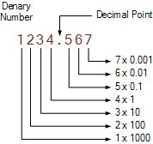
Number system
The technique to represent and work with numbers is called number system.
major number system are:
Decimal number system
binary number system
octal number system
hexadecimal number system
Decimal number system
Base 10 number system having digits from 0 to 9.
positional value system
Example
737 - 7 x 10² + 3 x 10¹ + 7 x 10⁰
8965 - 8 x 10³ + 9 x 10² + 6 x 10¹ + 5 x 10⁰
1000+200+30+4+0.5+0.06+0.007= 1234.567

Slide 4
Number system- positional value
The weightage of each position is given as
Decimal system with positioning Decimal - floating point
Binary system with positioning Binary - floating point
Octal system with positioning Octal - floating point
Hexadecimal system with positioning Hexadecimal - floating point
10⁵ | 10⁴ | 10³ | 10² | 10¹ | 10⁰
10⁻¹ | 10⁻² | 10⁻³ | 10⁻⁴ | 10⁻⁵
2⁵ | 2⁴ | 2⁵ | 2⁴ | 2³ | 2² | 2¹ | 2⁰
2⁻¹ | 2⁻² | 2⁻³ | 2⁻⁴ | 2⁻⁵
8⁵ | 8⁴ | 8⁵ | 8⁴ | 8³ | 8² | 8¹ | 8⁰
8⁻¹ | 8⁻² | 8⁻³ | 8⁻⁴ | 8⁻⁵
16⁵ | 16⁴ | 16⁵ | 16⁴ | 16³ | 16² | 16¹ | 16⁰
16⁻¹ | 16⁻² | 16⁻³ | 16⁻⁴ | 16⁻⁵

Slide 5
Decimal to Binary
Decimal
Octal
Binary
Hexadecimall
Decimal to Binary
divide by 2, keep track of the remainder
first remainder is bit 0 (LSB, least-significant bit)
second remainder is bit 1
etc

Slide 6
Decimal to Binary
decimal numbers can be converted to binary by repeated division of the number by 2
43₁₀= 101011₂
do the following conversion from decimal to binary
244₁₀
145₁₀
112₁₀

Slide 7
Decimal to Binary with fractions

Slide 8
Binary to Decimal
Decimal
Octal
Binary
Hexadecimal

Slide 9
Binary Number system
electrical signals are represented as high and low, on and off, 1 and 0
so representing as 0 and 1 (2 digits) is called binary system. each binary digit is also called as bit. this is also positional value system.
right most digit is called Least significant bit(LSB) and left most digit is called as most significant bit(MSB)
MSB LSB
Binary to decimal equivalent can be found like this
Multiply each bit by 2^{n}, where “n” is the weight of the bit
the weight is the position of the bit, starting from 0 on the right
Add the results
2⁵ | 2⁴ | 2³ | 2² | 2¹ | 2⁰
1 | 1 | 0 | 0 | 1 | 1

Slide 10
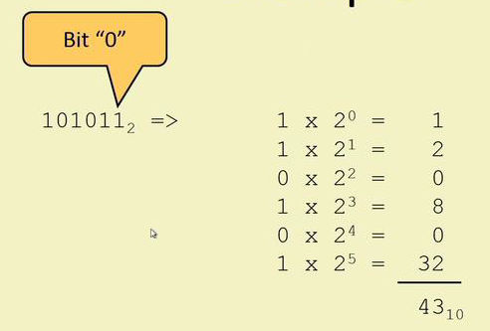
Binary to decimal conversion
electrical signals are represented as high and low, on and off, 1 and 0
so representing as 0 and 1 (2 digits) is called binary system. each binary digit is also called as bit. this is also positional value system.
right most digit is called Least significant bit(LSB) and left most digit is called as most significant bit(MSB)
MSB LSB
11010= 1 x 2⁴ + 1 x 2³ + 0 x 2² + 1 x 2¹ + 0 x 2⁰
= 16 + 8 + 0 + 2 + 0
= 26₁₀
do the following binary number to decimal
101010 2) 111010 3) 110001
2⁵ | 2⁴ | 2³ | 2² | 2¹ | 2⁰
1 | 1 | 0 | 0 | 1 | 1

Slide 11
Binary to decimal conversion
1010.011 = 1x2³+0x2²+1x2¹+0x2⁰+0x2⁻¹+1x2⁻²+1x2⁻³
= 8 + 0 + 2 + 0 + 0 + ¼ + ⅛
= 10.375 ¼= 0.25
⅛ =0.125
-------------
0.375
0.1 0 1 1
1x2⁻⁴ = 0.0625
1x2⁻³ = 0.125
0x2⁻² = 0
1x2⁻¹ = 0.5
------------
0.6875₁₀
1101.0111 = (1×2³) + (1×2²) + (0×2¹) + (1×2⁰) + (0×2⁻¹) + (1×2⁻²) + (1×2⁻³) + (1×2⁻⁴)
= 8 + 4 + 0 + 1 + 0 + 1/4 + 1/8 + 1/16
= 8 + 4 + 0 + 1 + 0 + 0.25 + 0.125 + 0.0625 = 13.437510
2⁰ | 1 | 1
2⁻¹ | 1/2 | 0.5
2⁻² | 1/4 | 0.25
2⁻³ | 1/8 | 0.125
2⁻⁴ | 1/16 | 0.0625
2⁻⁵ | 1/32 | 0.03125

Slide 12
Binary to decimal conversion
0.11 = (1x2⁻¹)+(1x2⁻²)=0.5+0.25=0.75₁₀
11.001=(1x2¹)+(1x2⁰)+(1x2⁻³)= 2+1+0.125 = 3.125₁₀
1011.111=(1x2³)+(1x2¹)+(1x2⁰)+(1x2⁻¹)+(1x2⁻²)+(1x2⁻³)
= 8 + 2 + 1+ 0.5 + 0.25 + 0.125 = 11.875₁₀

Slide 13
computer memory terms
1 byte = 8 bits
1 Kilobytes (KB) = 1024 bytes
1 Megabyte (MB) = 1024 KB
1 Gigabyte (GB) = 1024 MB
1 Terabyte (TB) = 1024 GB
1 Exabyte (EB) = 1024 TB
1 Zettabyte (ZB) = 1024 EB
1 Yottabyte (YB) = 1024 ZB

Slide 14
Decimal to Octal
Decimal
Octal
Binary
Hexadecimal

Slide 15
Decimal to Octal
decimal numbers can be converted to octal by repeated division of the number by 8
473₁₀= 731₈

Slide 16
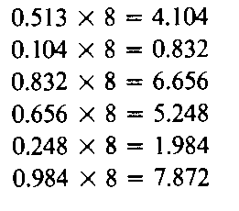
Decimal to Octal for fractional number
(0.513)₁₀= (0.406517)₈

Slide 17
Octal to Decimal
Decimal
Octal
Binary
Hexadecimal

Slide 18
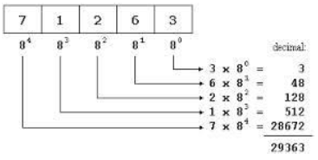
Octal Number System
Octal number system has ( 8 digits) - 0,1,2,3,4,5,6,7
it is also a positional value system.
Decimal equivalent of any octal number is sum of product of each digit with its positional value.
726₈ = 7 x 8² + 2 x 8¹ + 6 x 8⁰
= 448 + 16 + 6
= 470₁₀
8⁵ | 8⁴ | 8³ | 8² | 8¹ | 8⁰

Slide 19
Octal to Binary
Decimal
Octal
Binary
Hexadecimal

Slide 20
Octal to Binary
Convert each octal digit to a 3-bit equivalent binary representation
546₈
101 100 110
2723₈
010 111 010 011

Slide 21
Binary to Octal
Decimal
Octal
Binary
Hexadecimal

Slide 22
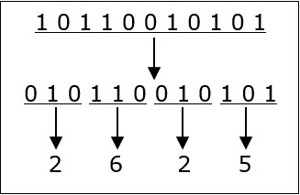
Binary to Octal and Vice Versa
To convert a binary number to octal number, these steps are followed:-
Starting from the least significant bit, make groups of three bits
if there are one or two bits less in making the groups, 0s can be added after the most significant bit
convert each group into its equivalent octal number
010 110 010 101₂= 2625₈
100110₂= 100 110 = 46₈
Octal to Binary
54673₈=101 100 110 111 011₂
to convert an octal number to binary, each octal digit is converted to its 3-bit binary equivalent
octal digit | 0 | 1 | 2 | 3 | 4 | 5 | 6 | 7
Binary Equivalent | 000 | 001 | 010 | 011 | 100 | 101 | 110 | 111

Slide 23
Decimal to Hexadecimal
Decimal
Octal
Binary
Hexadecimal

Slide 24
Number system relationship
Hexadecimal | Decimal | Octal | Binary
0 | 0 | 0 | 0000
1 | 1 | 1 | 0001
2 | 2 | 2 | 0010
3 | 3 | 3 | 0011
4 | 4 | 4 | 0100
5 | 5 | 5 | 0101
6 | 6 | 6 | 0110
7 | 7 | 7 | 0111
8 | 8 | 10 | 1000
Hexadecimal | Decimal | Octal | Binary
9 | 9 | 11 | 1001
A | 10 | 12 | 1010
B | 11 | 13 | 1011
C | 12 | 14 | 1100
D | 13 | 15 | 1101
E | 14 | 16 | 1110
F | 15 | 17 | 1111

Slide 25
Decimal to Hexadecimal Number System
Hexadecimal number system has ( 16 symbols) - 0 to 9 and A to F
it is also a positional value system.
Hexadecimal equivalent of any decimal number can be found by repeated division of the number by 16
16⁵ | 16⁴ | 16³ | 16² | 16¹ | 16⁰

Slide 26
Hexadecimal to Decimal
Decimal
Octal
Binary
Hexadecimal

Slide 27
Hexadecimal to Decimal Number System
Hexadecimal number system has ( 16 symbols) - 0 to 9 and A to F
it is also a positional value system.
Hexadecimal equivalent of any decimal number can be found by repeated division of the number by 16
1D9₁₆= 1x16² + 13x16¹ + 9x16⁰ ABC₁₆ = C x 16⁰ = 12 x 1 = 12
= 256 + 208 + 9 = B x 16¹ = 11 x 16 = 176
= 473₁₀ = A x 16⁰ = 10 x 256=2560
27BF₁₆= 2x16³ + 7x16² + 11x16¹ + 15x16⁰ -------
= 8192 + 1792 + 176 + 15 2748₁₀
= 10175₁₀
726₁₆ = 7x16² + 2x16¹ + 6x16⁰
= 1792 + 32 + 6
= 1830₁₀
16⁵ | 16⁴ | 16³ | 16² | 16¹ | 16⁰

Slide 28
Binary to Hexadecimal
Decimal
Octal
Binary
Hexadecimal

Slide 29
Binary to Hexadecimal
To convert a binary number to hexadecimal number, these steps are followed:-
Starting from the least significant bit, make groups of four bits
if there are one or two bits less in making the groups, 0s can be added after the most significant bit
convert each group into its equivalent hexadecimal number
101 1011 0101₂= 5B5₁₆
Octal to Binary
54673₈=101 100 110 111 011₂
to convert an hexadecimal number to binary, each hexadecimal digit is converted to its 4-bit binary equivalent
goto slide 8
78BA₁₆= 0111 1000 1011 1010₂

Slide 30
Hexadecimal to Binary
Decimal
Octal
Binary
Hexadecimal

Slide 31
Hexadecimal to Binary
10AF₁₆
0001 0000 1010 1111
1B0C₁₆
0001 1011 0000 1100
1 5 4 1 4
1B0C₁₆=15414₈

Slide 32
Exercise - Convert
Decimal | Binary | Octal | Hexa-Decimal
33
 | 1110101
 |  | 703
 |  |  | 1AF

Slide 33
Decimal Arithmetic
Decimal Addition
11
19.7
12.8
------
32.5
Decimal Subtraction
8 17
19.7
12.8
-------
6.9
Decimal multiplication
19.7 x 12.8
---------------
1576
394
197
---------------
25216 = 252.16
Decimal division
43 / 10 = 4.3
43/2 = 21.5

Slide 34
Arithmetic operations -Binary Addition
Rules-Binary Addition
0 + 0 = 0
0 + 1 = 1
1 + 0 = 1
1 + 1 = 0, and carry 1 to the next more significant bit
example:
00011010 + 00001100 =?
1 1
0 0 0 1 1 0 1 0 = 0x2⁷+0x2⁶+0x2⁵+1x2⁴+1x2³+0x2²+1x2¹+0x2⁰ =16+8+2= 26
0 0 0 0 1 1 0 0 = 0x2⁷+0x2⁶+0x2⁵+0x2⁴+1x2³+1x2²+0x2¹+0x2⁰ = 8+4 = 12
--------------------- -----
0 0 1 0 0 1 1 0 = 0x2⁷+0x2⁶+1x2⁵+0x2⁴+0x2³+1x2²+1x2¹+0x2⁰ = 32+4+2= 38

Slide 35
Binary Addition
11 1
1011.01
11.011
------------
1110.101
1111
10101
11011
------------
110000
1111
11001
111
------------
100000
11011 11
10101.101
1101.011
--------------
100011.000
1110 11
111.0111
10011.001
-----------------
11010.1001

Slide 36
1’s Complement and 2’s Complement
1’s complement of a binary number = change 1’s into 0 , and 0’s into 1 (inverse the number)
example : Find 1’s complement of (11010)₂
number = 11010
1’s complement =00101
2’s complement of a binary number = find 1’s complement and add 1 to the result. (used to represent negative numbers.
2’s complement = 1’s complement + 1
find 2’s complement of (11010)₂
number = 11010
1
1’s complement = 00101
add 1 = 1
-----------
00110

Slide 37
Arithmetic operations -Binary subtraction
Rules-Binary subtraction
0 - 0 = 0
0 - 1 = 1, and borrow 1 from the next more significant bit
1 - 0 = 1
1 - 1 = 0
example:
00011010 - 00001100 =?
Binary subtraction can be done in two ways.
by finding 1’s complement
by finding 2’s complement
Binary subtraction -Using 1’s complement - steps
find the 1’s complement of subtrahend
add this with minued
if the result of addition has a carry over , bring down the carry to the last bit add add it to the result
if there is no carry over, it means the result is negative. so find the 1’s complement of the result.

Slide 38
Binary Subtraction- 1’s complement
Ex : 110101 - 100101 Decimal equivalent
Minued = 00110101 =2⁵+2⁴+2²+2⁰ = 32+16+4+1 = 53
1’s complement of subtrahend = 11011010 =2⁵+2²+2⁰ = 32+4+1 = 37
-------------- ----
1 00001111 16
1
--------------
00010000
Ex : 101011 - 111001 111 Decimal equivalent
Minued = 00101011 =2⁵+2³+2¹+2⁰ = 32+8+2+1 = 43
1’s complement of subtrahend = 11000110 =2⁵+2⁴ +2³+2⁰ = 32+16+8+1 = 57
-------------- ----
11110001 -14
--------------
no carry, so negative number, 00001110 = 2³+2²+2¹ =8+4+2 = 14
so find the 1’s complement
of result

Slide 39
Binary Subtraction with fraction - 1’s complement
Ex : 1011.001 - 110.10 Decimal equivalent
Minued = 00001011.001 = 2³+2¹+2⁰+⅛ =11.125
1’s complement of subtrahend = 11111001.011 = 2²+2¹+½ = 6.5
------------------- --------
1 00000100.100 4.625
1
--------------------
00000100.101 =22+½+⅛
find
10110.01 - 11010.10
ans= -100.01

Slide 40
Binary Subtraction- 2’s complement
rules
2’s complement of the subtrahend is found
add it with minuend
if the final carry over of the sum is 1, it is dropped and the result is positive.
if there is no carry, the result is negative. so find the 2’s complement of the result again

Slide 41
Binary Subtraction- 2’s complement
Ex : 110101 - 100101 Decimal equivalent
Minued = 00110101 =2⁵+2⁴+2²+2⁰ = 32+16+4+1 = 53
1’s complement of subtrahend = 11011010 =2⁵+2²+2⁰ = 32+4+1 = 37
2’s complement + 1
11011011 16
1 00010000
Ex : 101011 - 111001 Decimal equivalent
Minued = 00101011 =2⁵+2³+2¹+2⁰ = 32+8+2+1 = 43
1’s complement of subtrahend = 11000110 =2⁵+2⁴ +2³+2⁰ = 32+16+8+1 = 57
+ 1
11000111
no carry, so negative number, 11110010 = 2³+2²+2¹ =8+4+2 = 14
so find the 2’s complement = 00001101
of result 1
= 00001110

Slide 42
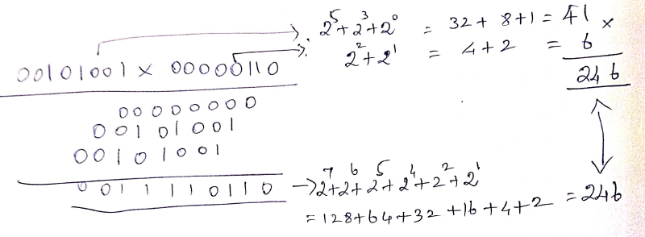
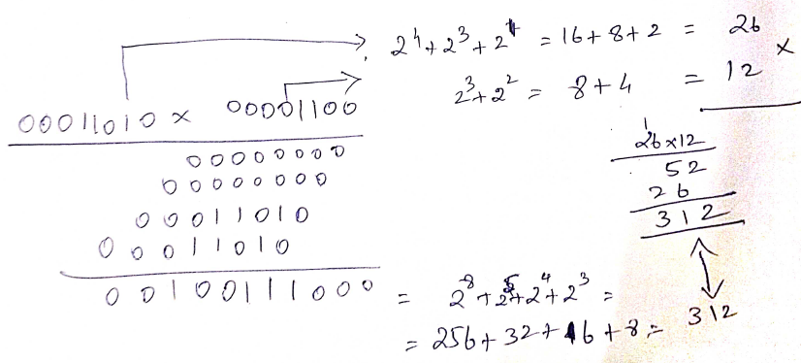
Arithmetic operations -Binary multiplication
Rules-Binary multiplication
0 x 0 = 0
0 x 1 = 0
1 x 0 = 0
1 x 1 = 1, and no carry or borrow bits
example:
00101001 x 00000110 = 11110110

Slide 43
Arithmetic operations -Binary multiplication
10111 x 1101
10111x1101
----------------
10111 1101
101110 1101
---------------
1110011 1101 first intermediate sum
10111
--------------
100101011 final sum
11011.101 x 101.111
11011.101 x 101111
------------------------------------
11011101 101111
11011101 101111
------------------------------
1010010111
11011101 101111
---------------------------------
11000001011
11011101 101111
----------------------------------
110011110011
0 101111
-------------------------------
110011110011
11011101 101111
--------------------------------
10100010010011
--------------------------------
result = 10100010.010011

Slide 44
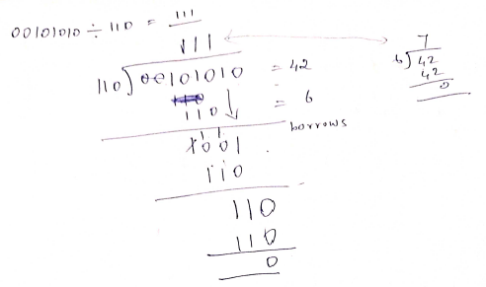
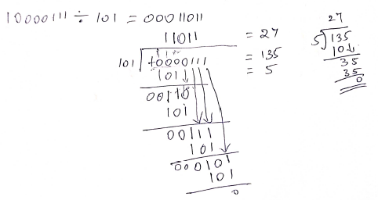
Arithmetic operations -Binary division
Binary division is the repeated process of subtraction

Slide 45
Arithmetic operations -Binary division
10110.1 / 1101
1101 ) 10110.1 (1.101
1101
--------------------------
10011
1101
-------------------------
011000
1101
----------------------
1011
-------------------
example 4: 101.11 / 111
111) 101.11 (0.
11 1
-----------------------
10 01
1 11
---------------------
10
11001 / 101
101 ) 11001 (101
101
-------------
101
101
--------------------
answer = 101
example 2
11101.01 / 1100
1100 ) 11101.01 (10.011
1100
----------------
10101
1100
---------------------------
10010
1100
--------------------------
01100
1100
-------------------------------

Slide 46
Gray code representation
Decimal Number | Binary Code | Gray code
0 | 0000 | 0000
1 | 0001 | 0001
2 | 0010 | 0011
3 | 0011 | 0010
4 | 0100 | 0110
5 | 0101 | 0111
6 | 0110 | 0101
7 | 0111 | 0100
8 | 1000 | 1100
9 | 1001 | 1101
Decimal Number | Binary Code | Gray code
10 | 1010 | 1111
11 | 1011 | 1110
12 | 1100 | 1010
13 | 1101 | 1011
14 | 1110 | 1001
15 | 1111 | 1000
convert (10110)₂ to its gray code
1 + 0 + 1 + 1 + 0
1 1 1 0 1
convert gray code 1000 to binary
1 0 0 0
1 1 1 1
the gray code belongs to a class of codes called minimum change codes, in which only one bit in the code changes when moving from one code to the next.

Slide 47
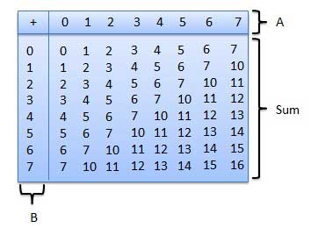
Octal Addition and subtraction
Addition : 456₈+123₈=601₈
11
456 = 302₁₀
123 = 83₁₀
------------------
601 = 385₁₀
Subtraction : 456₈-173₈=333₈
8
456 = 302₁₀
173 = 123₁₀
------------------
263 = 179₁₀

Slide 48
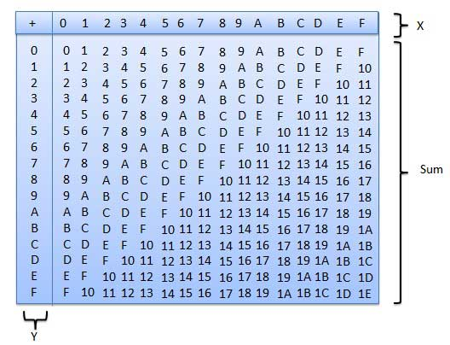
Hexadecimal Addition and subtraction
Addition : 4A6₁₆+1B3₁₆=659₁₆
11
4A6 = 1190₁₀
1B3 = 435₁₀
------------------
659 = 1625₁₀
Subtraction : 4A6₁₆-1B3₁₆=2F3₁₆
8
4A6 = 1190₁₀
1B3 = 435₁₀
------------------
2F3 = 755₁₀

