Slide 1
Binary Tree Traversal

Slide 2
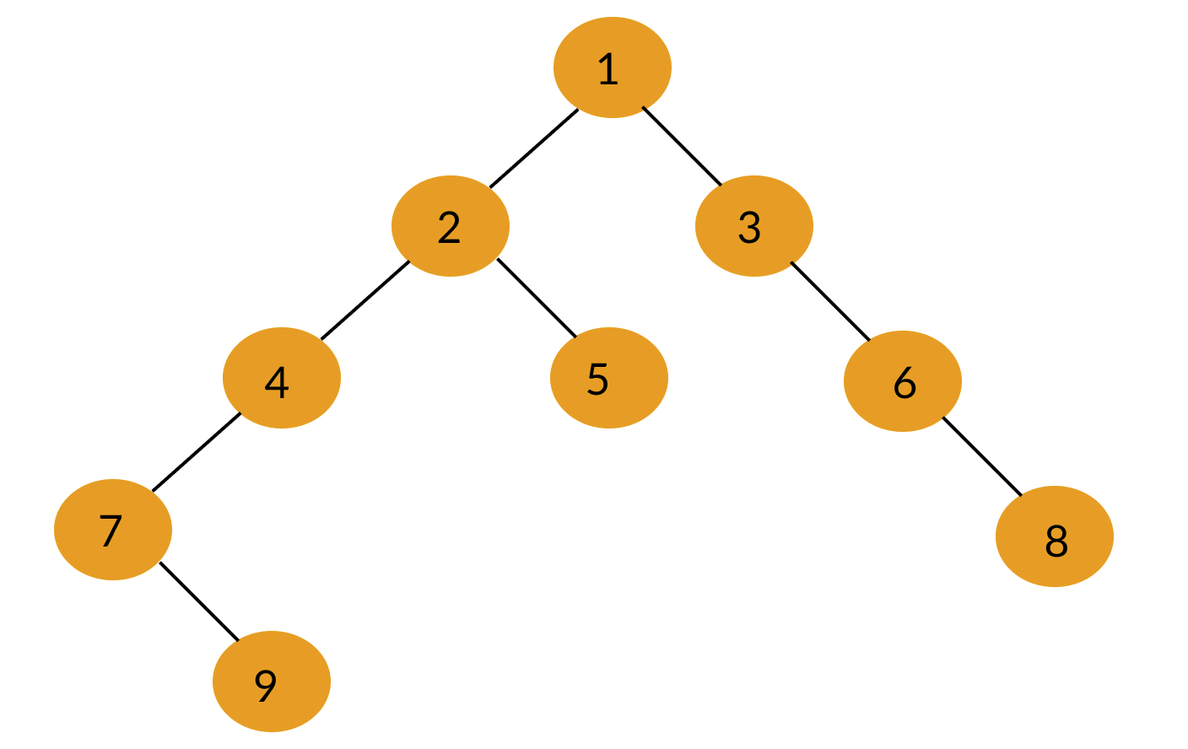
Binary tree
A binary tree has a special condition that each node can have a maximum of two children.

Slide 3
Tree Traversal
The most important operation in tree is visiting its node exactly one time. The task performed while traversing a binary tree are:
visiting a node (denoted by letter V)
Traversing the left subtree (denoted by letter L)
Traversing the right subtree (denoted by letter R)
A tree can be traversed in three ways
in-order traversal (L V R)
pre-order traversal (V L R)
post-order traversal (L R V)

Slide 4
Pre-Order Traversal (V L R)
The steps for traversing a binary tree for pre-order traversal are
process the root node
traverse the left subtree
traverse the right subtree
The value in each node while visiting in the above order is printed.
In the above example the pre-order traversal is : 1 2 4 7 9 5 3 6 8

Slide 5
Inorder traversal (L V R)
This is otherwise called as symmetric order traversal and its order of execution is
traverse the left subtree
process the root node
traverse the right subtree
In the above example the In-order traversal is : 7 9 4 2 5 1 3 6 8

Slide 6
Postorder traversal (L R V)
This is otherwise called as symmetric order traversal and its order of execution is
traverse the left subtree
traverse the right subtree
process the root node
In the above example the Post-order traversal is : 9 7 4 5 2 8 6 3 1

Slide 7
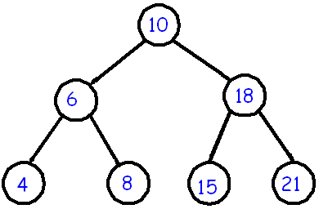
Binary Search Tree Basic Operations
A BST is a binary tree where nodes are ordered in the following way:
each node contains one key (also known as data)
the keys in the left subtree are less then the key in its parent node, in short L < P;
the keys in the right subtree are greater the key in its parent node, in short P < R;
duplicate keys are not allowed.
The basic operations that can be performed on a binary search tree data structure, are the following −
Insert − Inserts an element in a tree/create a tree.
Search − Searches an element in a tree.
Preorder Traversal − Traverses a tree in a pre-order manner.
Inorder Traversal − Traverses a tree in an in-order manner.
Postorder Traversal − Traverses a tree in a post-order manner.

Slide 8
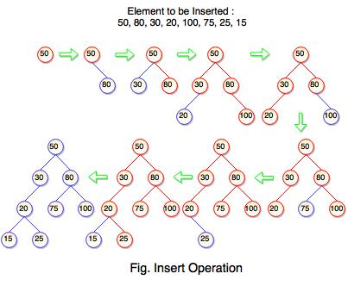
Binary Search Tree insert Operations

Slide 9
1. Insert Operation
Insert operation is performed with O(log n) time complexity in a binary search tree.
Insert operation starts from the root node. It is used whenever an element is to be inserted.
The following algorithm shows the insert operation in binary search tree:
Step 1: Create a new node with a value and set its left and right to NULL.
Step 2: Check whether the tree is empty or not.
Step 3: If the tree is empty, set the root to a new node.
Step 4: If the tree is not empty, check whether a value of new node is smaller or larger than the node (here it is a root node).
Step 5: If a new node is smaller than or equal to the node, move to its left child.
Step 6: If a new node is larger than the node, move to its right child.
Step 7: Repeat the process until we reach to a leaf node.

